Slide 1
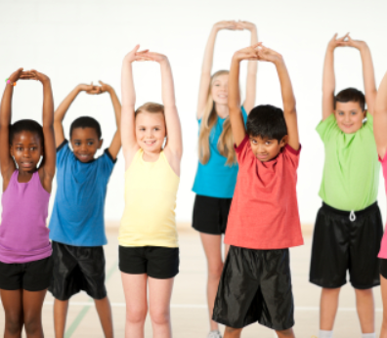

Exercise Time

Slide 2
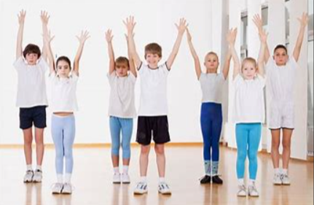
Arms stretches
First we are going to stretch both arms up high in the air and count out from1-10. Ready? Arms up 1 2 3 4 5 6 7 8 9 10.
Now bring your arms back down to your side and give them a wiggle.
Lets do this again ready? Arms up 1 2 3 4 5 6 7 8 9 10 . Bring your arms back down and give them another wiggle.
Well done.

Slide 3
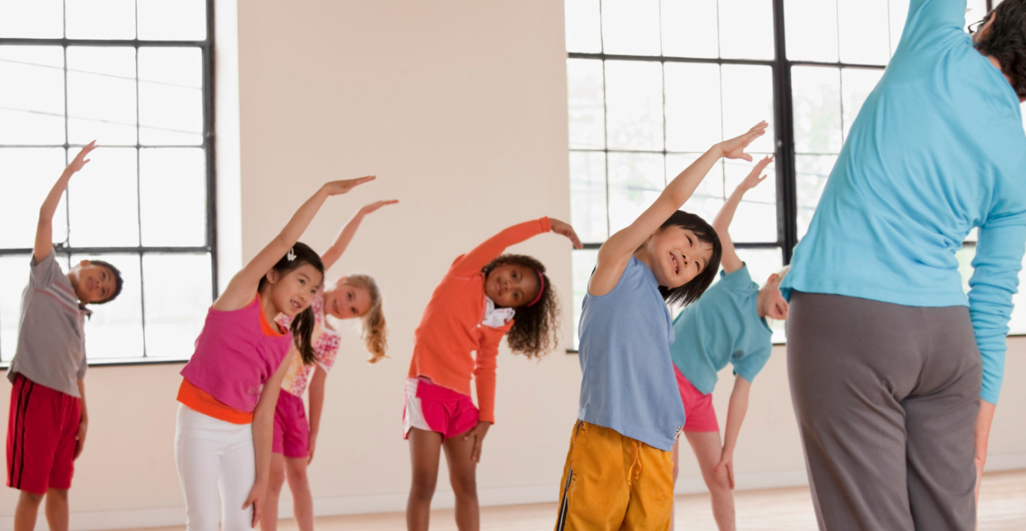
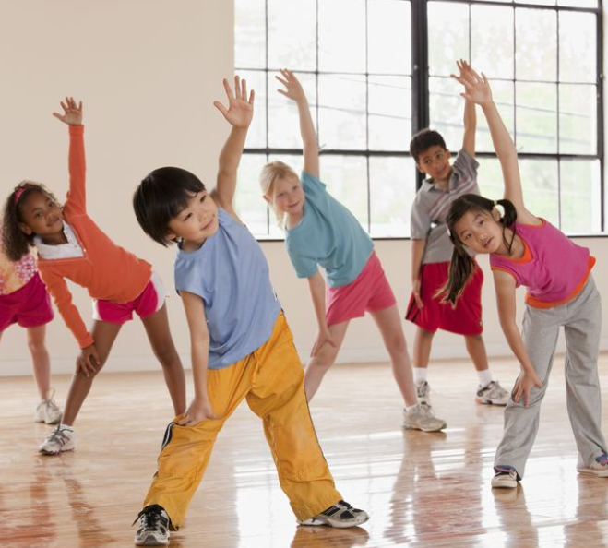
Waist stretches
Next raise your left arm up straight above your head, and then lean over to your right side just like the children in this photo. Stay still and count out 1 2 3. bring your arm back down to your side again.
Then do then same with your right arm stretch up and lean over to your left side and count 1 2 3…arm back down again.
Fantastic.

Slide 4
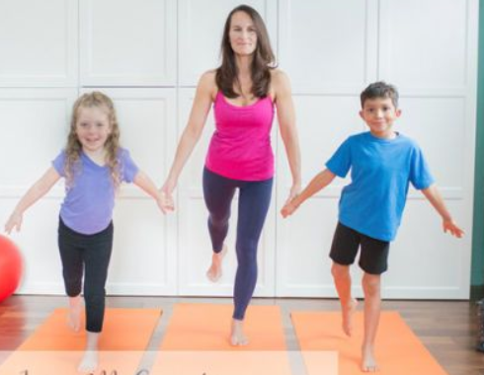
Leg swings
Now we are going to place our arms out to the side and slowly swing our right leg behind us and then bring it back to the front.
Lets do these leg swings together 5 times ready… 1 2 3 4 5 and put our foot back on the floor.
Good now do the same with the left leg swing it out and back ready… 1 2 3 4 5 and again put our foot back on the floor.
Excellent well done.

Slide 5
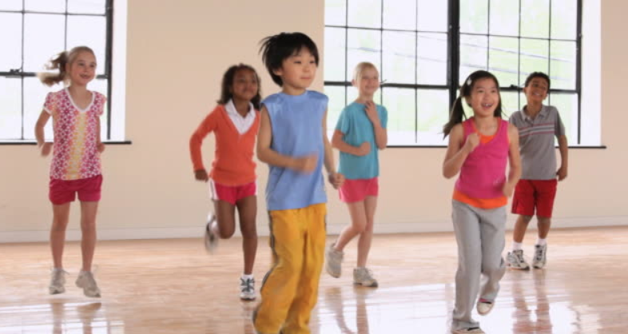
Running on the spot
Now we are going to run on the spot, remember to stay in your space!
As we run we are going to count to ten ready go…1 2 3 4 5 6 7 8 9 10…and stop! Well done.
Lets do that again ready go… 1 2 3 4 5 6 7 8 9 10 and stop!
Well done.

Slide 6
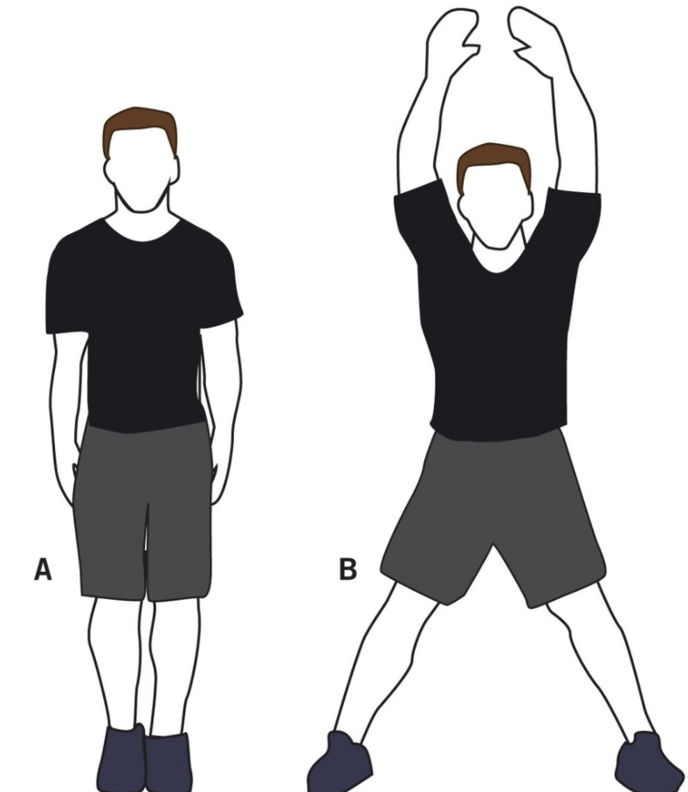
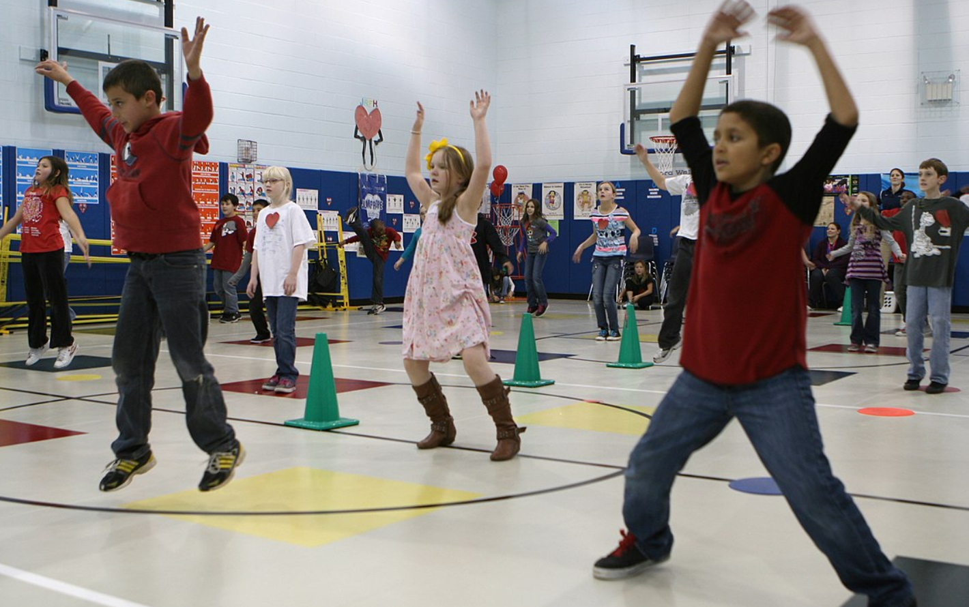
Star jumps
Next we are going to swing our arms above our head and spread our feet apart as we jump. This will look like a star as we move. We are going to do this 5 times, ready go… 1 2 3 4 5 and stop. Well done.

Slide 7
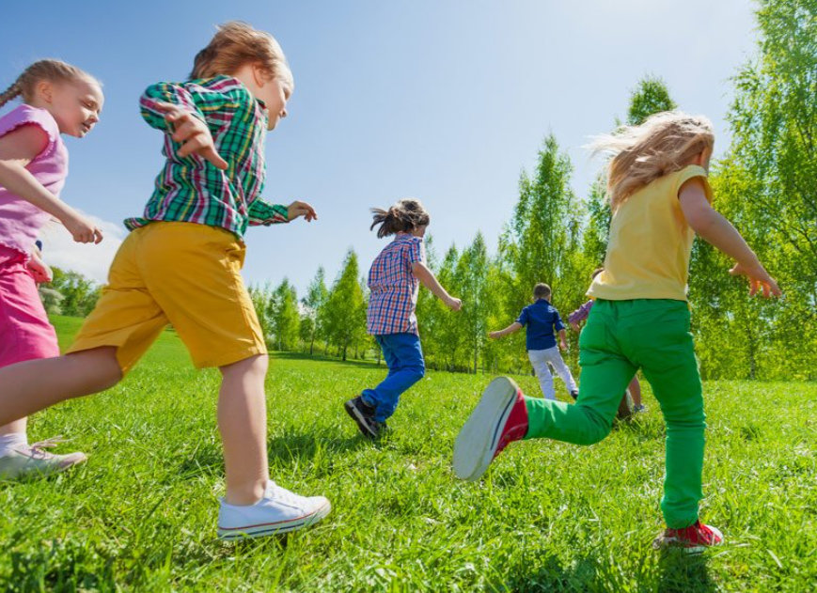
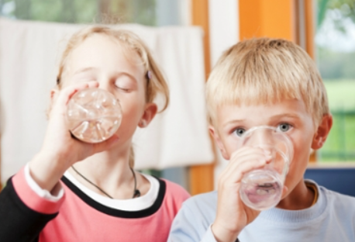
Over the weeks we can do more of these exercises, as the children learn how to do them and as we get fitter.
You can also play some music as you exercise once we have learnt the routine and we do not need to listen to the full instructions.
Remember it is very important to have a drink of water after exercising or doing any physical activity.

