Slide 1
RWI Pink: Light and Shadow

Slide 2
f ff | l ll le | m mm | n nn kn | r rr | s ss se | v ve | z zz s | sh | th | ng nk
b bb | c k ck | d dd | g gg | h | j | p pp | qu | t tt | w wh | x | y | ch tch
Speed Sounds

Slide 3
a at | e hen | i in | o on | u up | ay day | ee y see | igh high | ow blow
oo zoo | oo look | ar car | or for | air fair | ir whirl | ou shout | oy boy
Speed Sounds

Slide 4
see | stand | check | low | high | show | cast
screen | light
mid day
shad ow
pupp et
Story Green Words

Slide 5
send -> sends | ray -> rays | block -> blocked
Story Green Words

Slide 6
we | you | your | what
make | short | the | I’ve
some | her | go | call
no | me | want | all
Red words

Slide 7
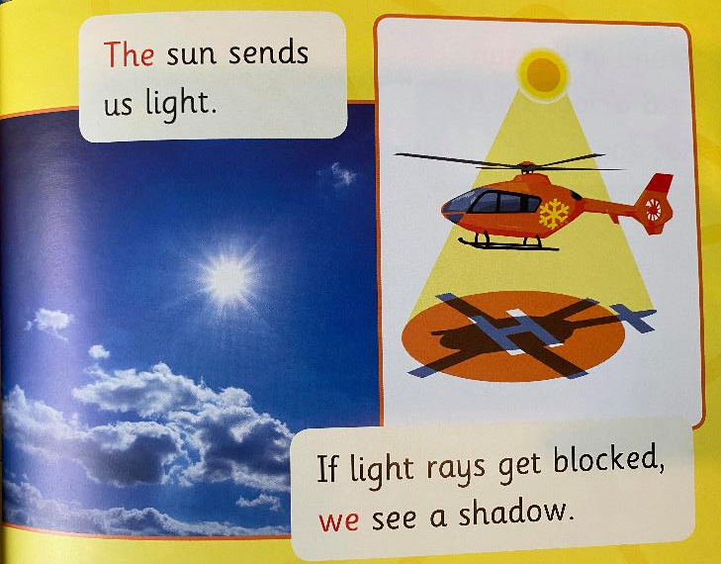
Light and Shadow

Slide 8
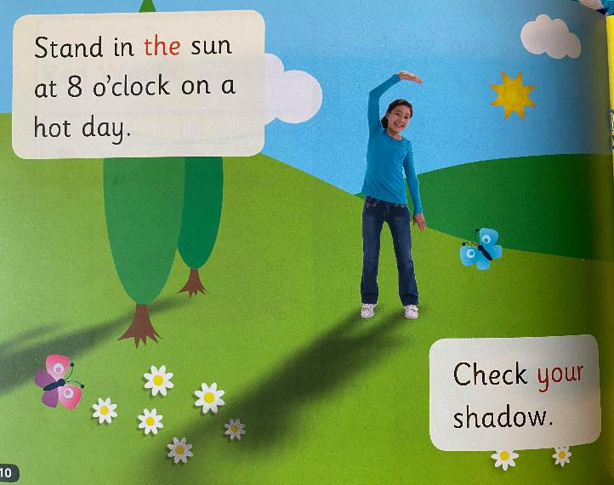
Light and Shadow

Slide 9
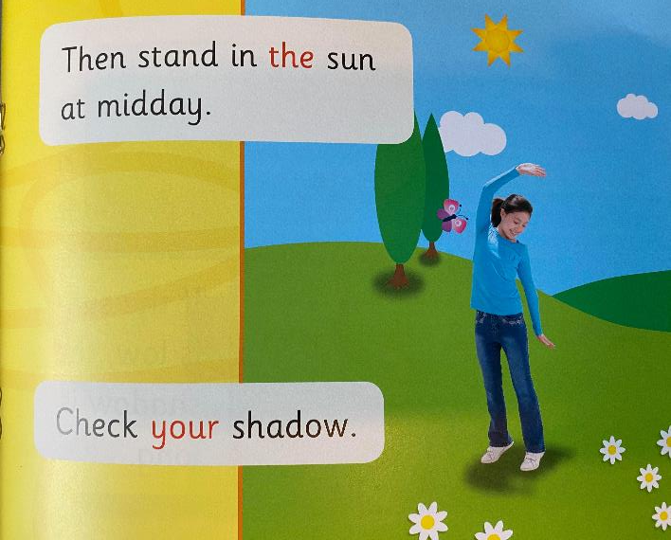
Light and Shadow

Slide 10
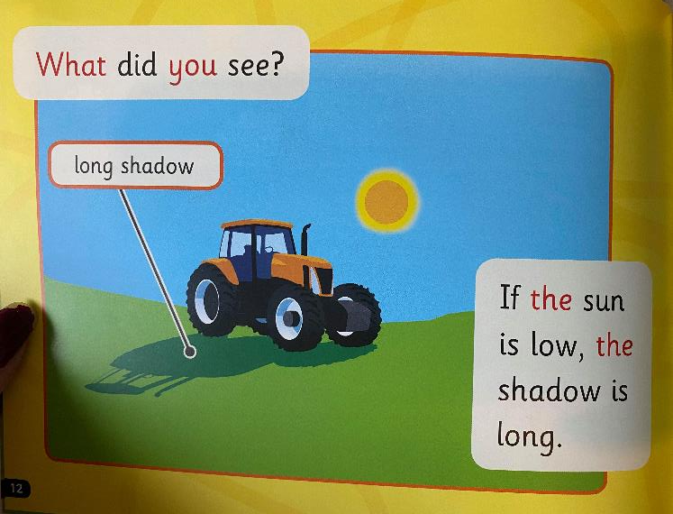
Light and Shadow

Slide 11
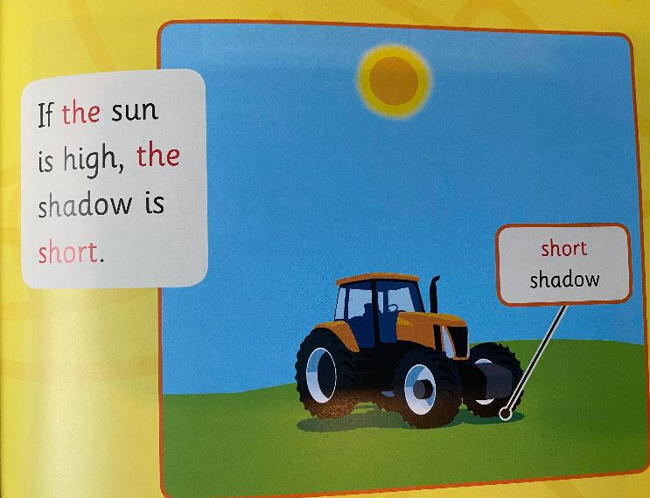
Light and Shadow

Slide 12
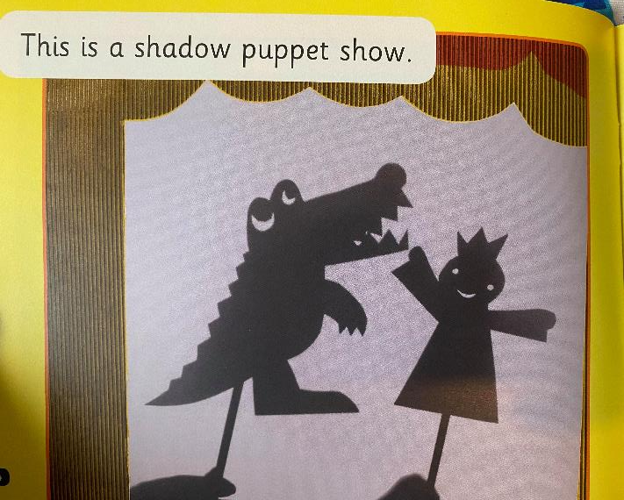
Light and Shadow

Slide 13
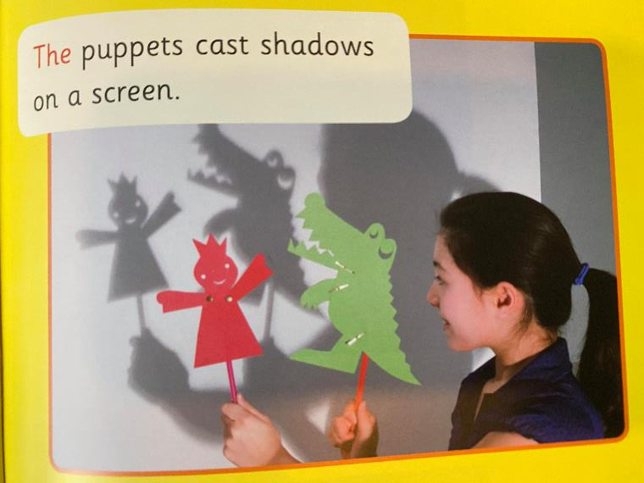
Light and Shadow

Slide 14
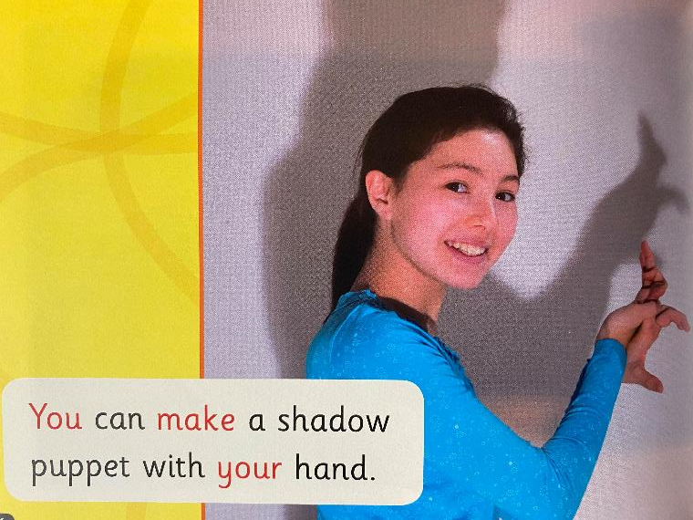
Light and Shadow

