Slide 1
Unit and non-unit fractions

Slide 2
What is a unit fraction?
We know that fractions are made up of 2 parts, numerators and denominators.
In a unit fraction, the numerator is always 1. For example ½ and ¼

Slide 3
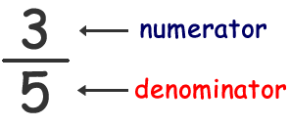
What is a non-unit fraction?
Unit fractions and non-unit fractions are both made up of 2 parts.
In a non- unit fraction, the numerator is always larger than 1.
For example 2/3 or 3/5

Slide 4
Identifying fractions from visual representations
To identify fractions, the numerator tells you how many ‘bits’ or equal groups we’re talking about. The denominator is how many ‘bits’ or equal groups there are altogether.
This shows 1/10 because 1 bit out of 10 are shaded.
This shows 7/10 because 7 bits out of 10 are shaded.

Slide 5
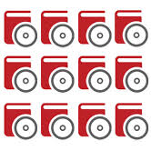
Equivalent fractions
This could be 2/6 or 1/3 because 1 out of 3 equal parts are shaded.
This could be 3/12 or ¼ because 1 out of 4 equal parts are circled.

