Slide 1
Learning intention - To understand and apply the active and passive voice.

Slide 2
Active and passive voice
Can anyone explain what the active and passive voice is using the two sentences below?
The worm crawled through the apple.
The apple was crawled through by the worm.

Slide 3
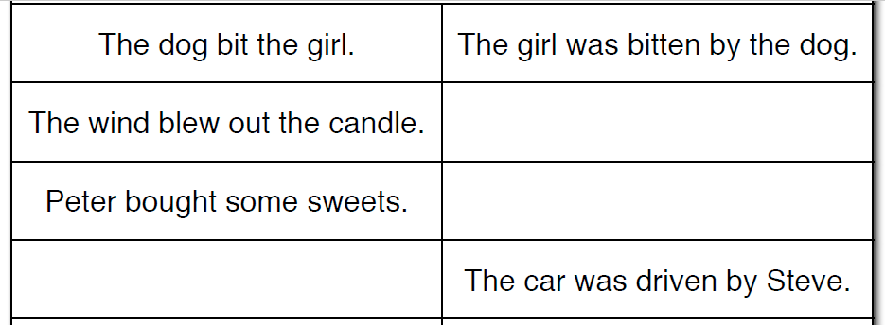
Complete the tables with the active and passive voice. Active voice Passive voice

Slide 4
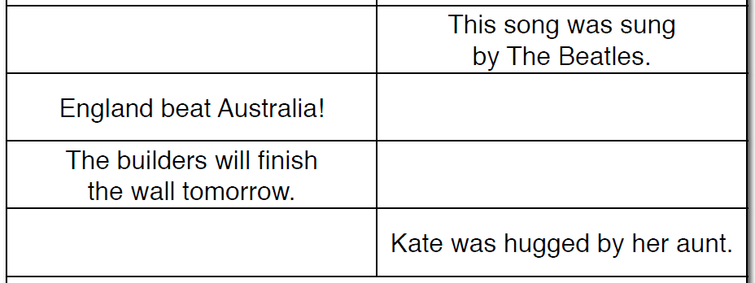
Active voice Passive voice

Slide 5
Task
Complete a very simple action (such as lifting up a pencil). Write down what you have done as an active sentence. Underneath, change the sentence to the passive voice. Do at least 5.
Mrs Lincoln – Johnson lifted up the pencil.
The pencil was lifted up by Mrs Lincoln - Johnson.

Slide 6
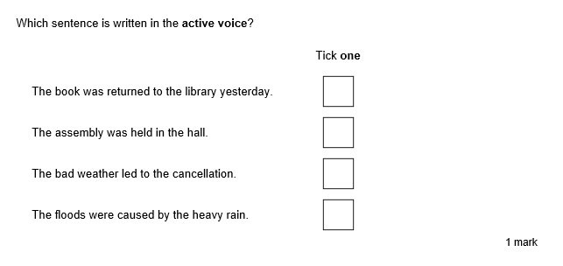
Test style question

Slide 7
Test style question

