Slide 1
Explore the meaning of Scientific Vocabulary

Slide 2
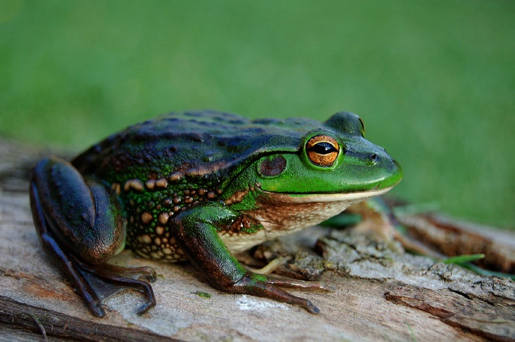
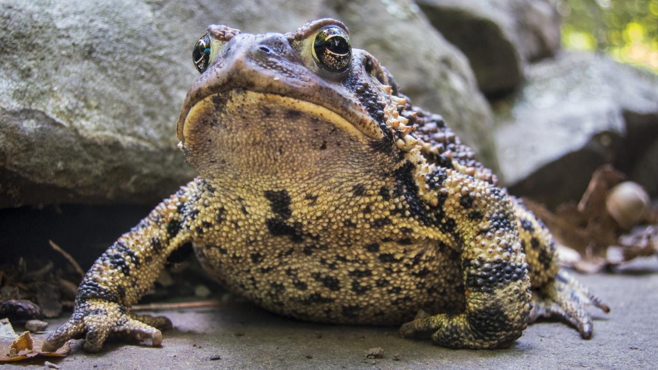
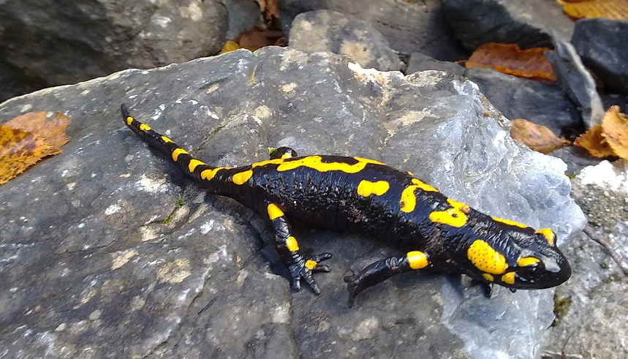
Amphibian
A cold blooded animal that can live on both land and water.
They are vertebrates.
They have moist, scale less skin.
Frogs, toads, and salamanders are all amphibians.

Slide 3
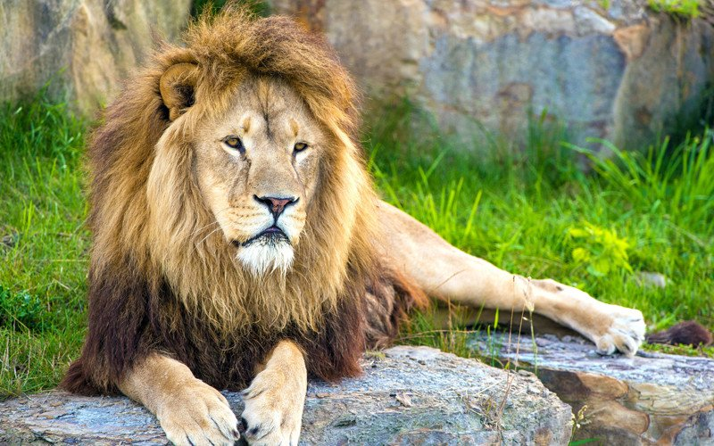
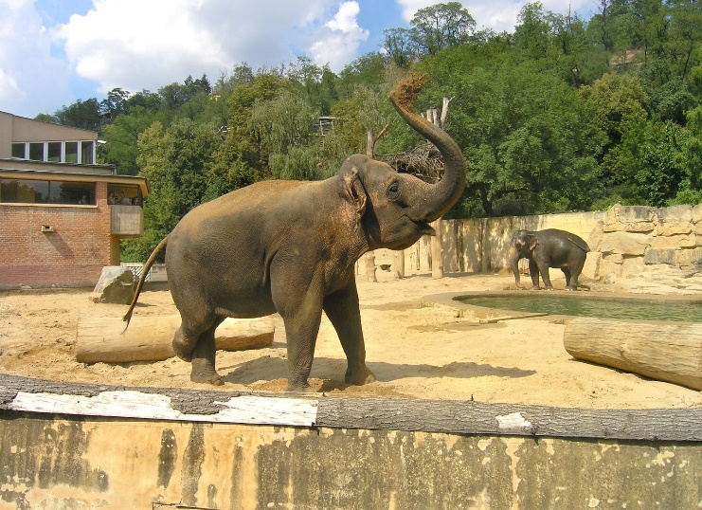
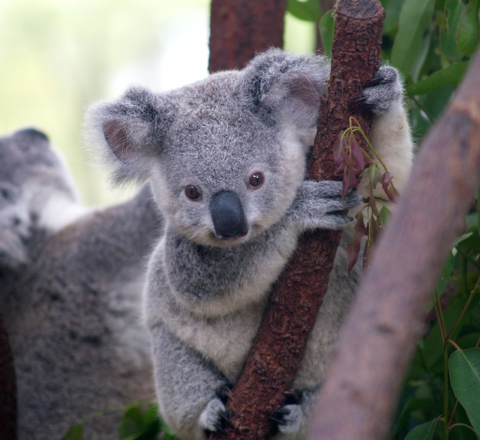
Mammal
A warm blooded animal, which feeds her young (babies) on milk from her own body.
Most mammals give birth to live young, not eggs.
Lions, elephants and koala bears are examples of mammals.

Slide 4
Invertebrates
Invertebrates are animals that do not have a backbone.
More than 90% of all living animal species are invertebrates.
Worms, jellyfish and starfish are invertebrates.

Slide 5
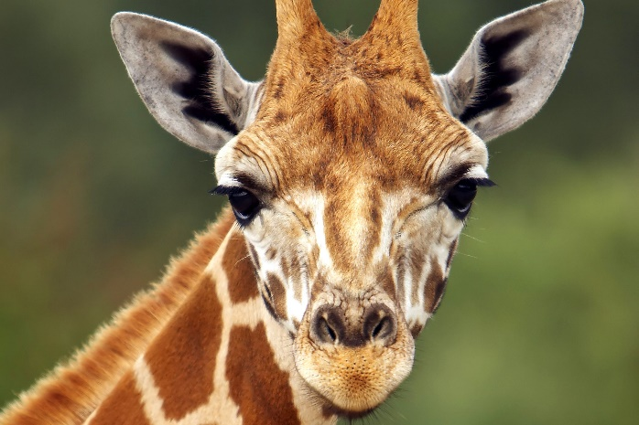
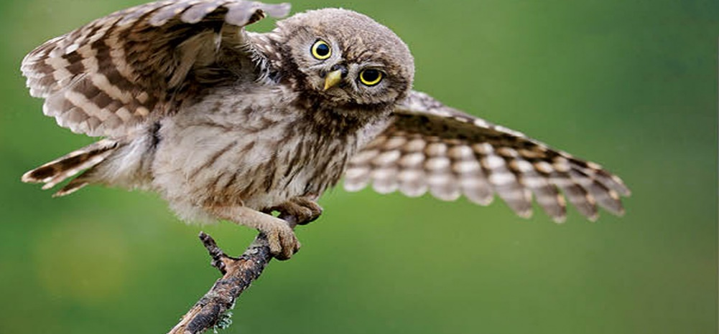
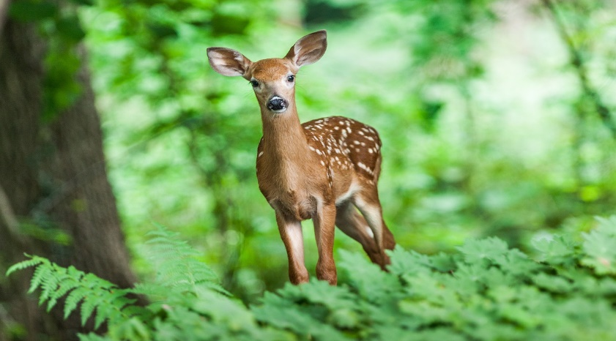
Vertebrates
Vertebrates are animals that have a back bone.
Giraffes, owls and deer are all examples of vertebrates.

