Slide 1

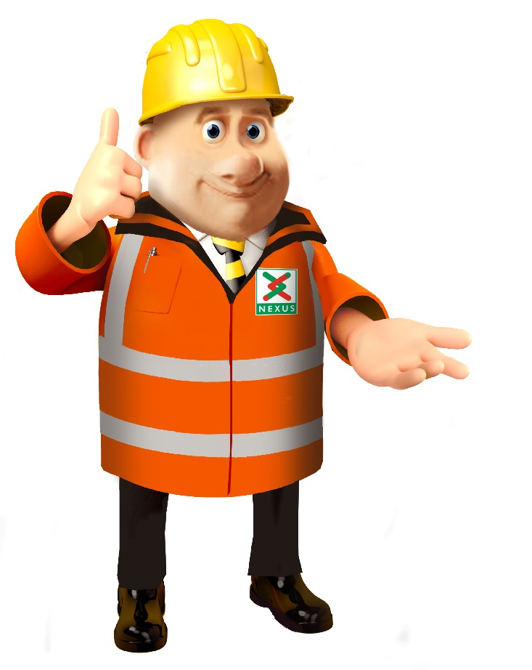

PSHE Alternative Learning intention: To know ways to keep safe near rail tracks.
Do you recognise this symbol?

Slide 2
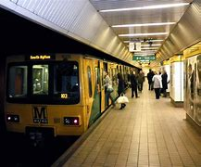
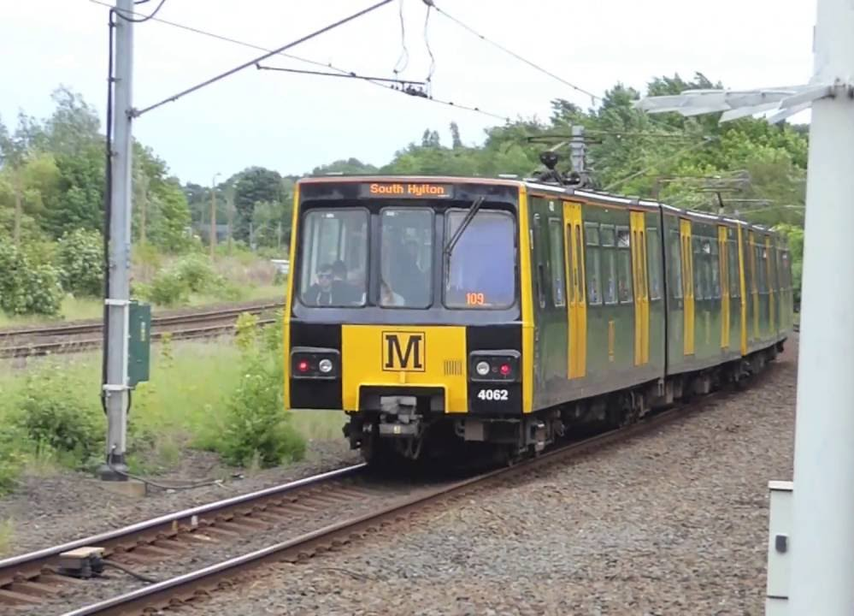


Nexus own and look after the Tyne and Wear Metro service.

Slide 3
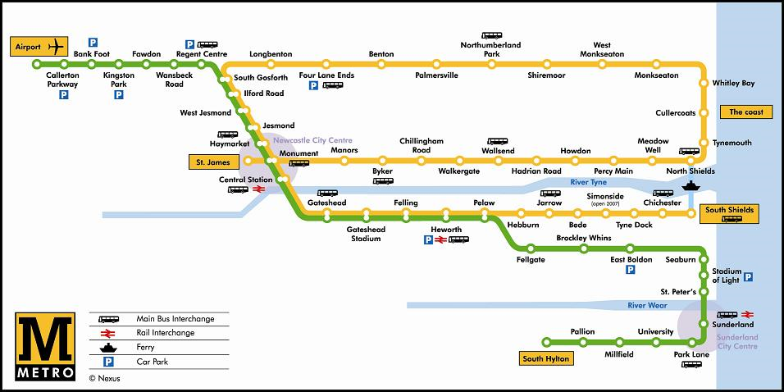

Slide 4
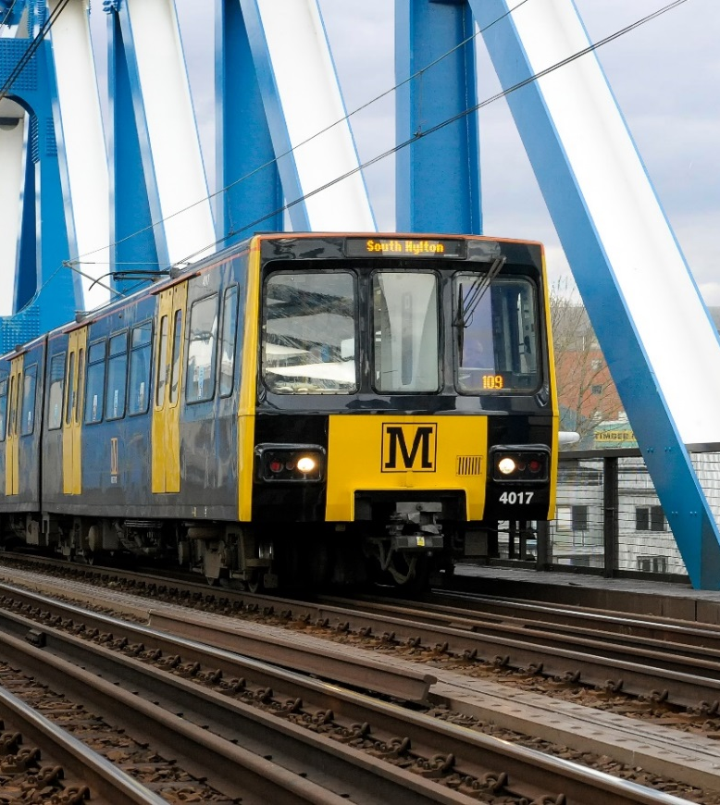
90 trains
40 tonnes each
50 mph
150 metres to stop in an emergency
That is as long as 1 ½ football pitches!
1500 volts of electricity
Jump 1 metre

Slide 5




28 Feb
15 Feb
For 2 weeks, the Newcastle Metro will be closed between Longbenton and Felling.
Notes:
Between the 15th February

Slide 6
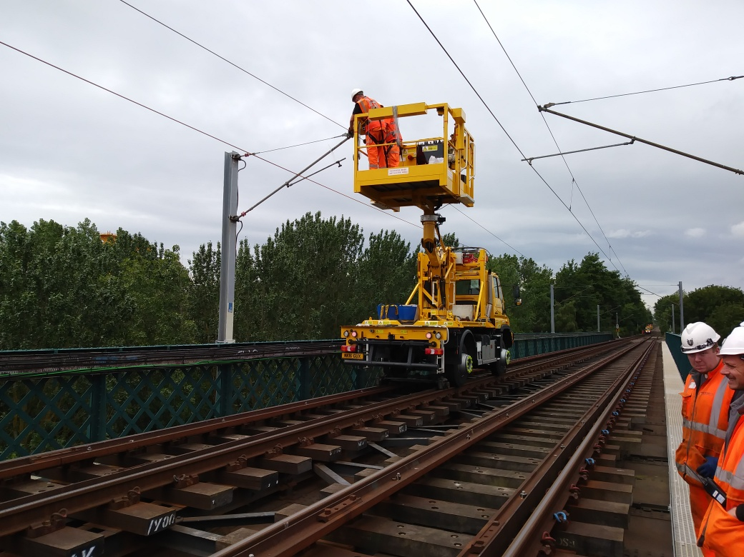
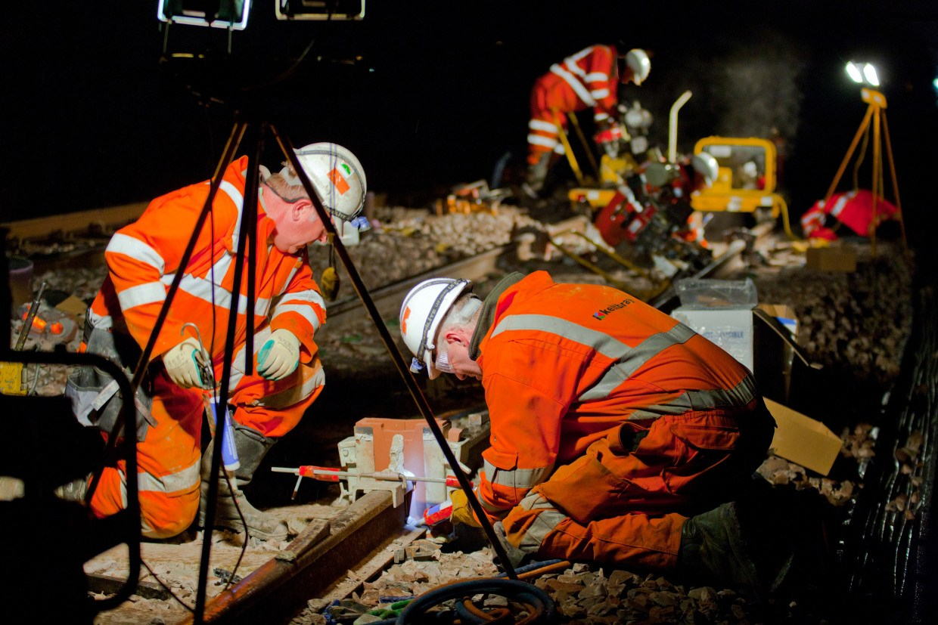
Day
Night
Engineers will be working day and night to replace lines in the busiest Metro area.
Notes:
Our engineers will be working day and night to replace the overhead lines in the busiest area (Central corridor).

Slide 7
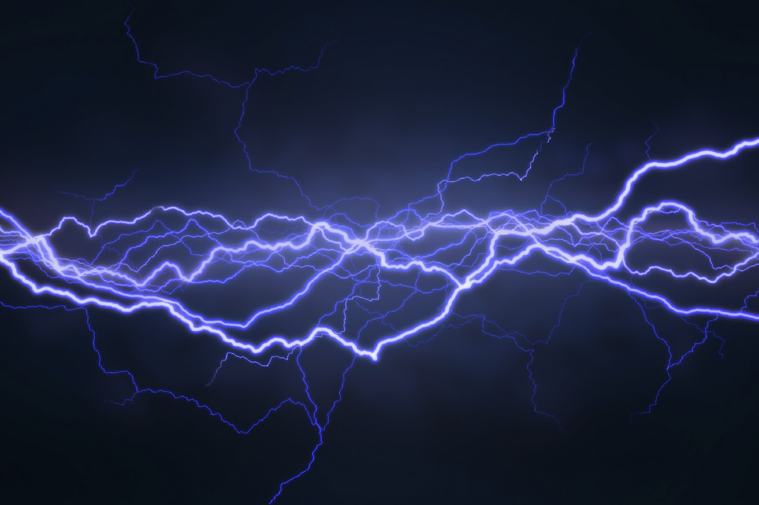

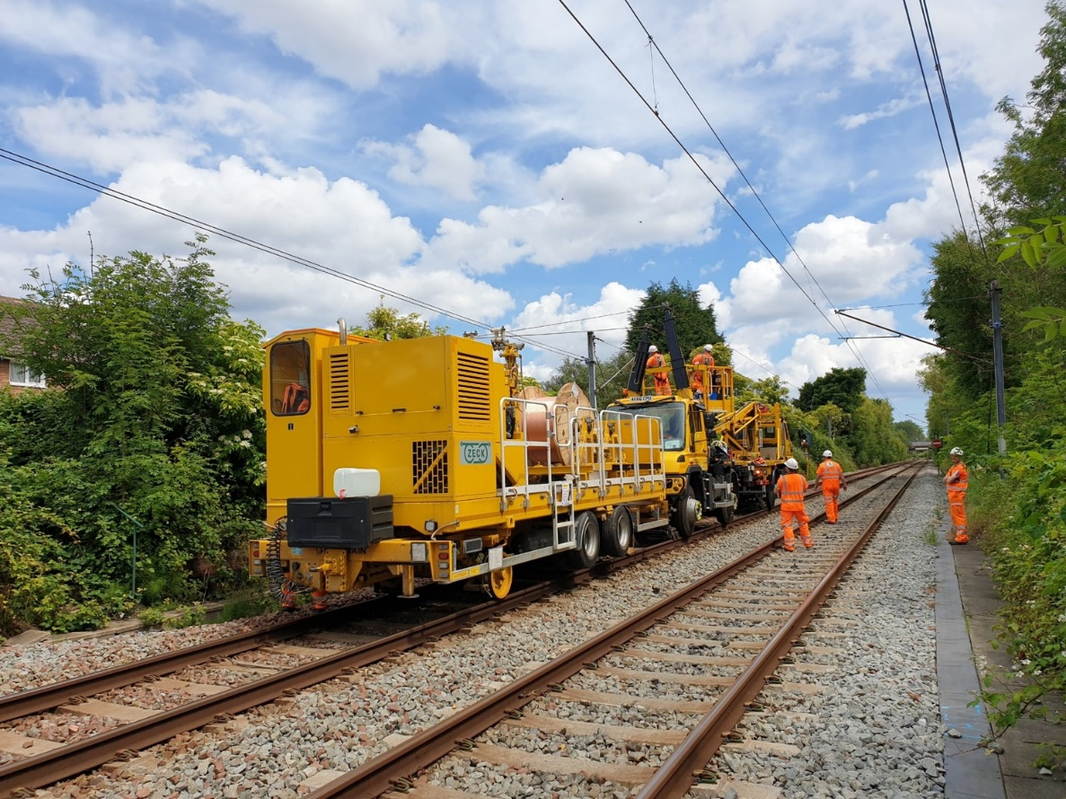
Overhead lines are being replaced.
Do you know what makes the train travel so fast? The electricity in the Overhead lines.

Slide 8
Would it be safe to walk on the track?
Would it be safe to touch the Overhead lines? Why?

Slide 9
What happens when you get electrocuted?
A. A tingling or painful sensation.
B. A painful shock, muscles contract and grip the electrical source so you’re unable to let go.
C. The heart ‘flutters’ (ventricular fibrillation). Burns at entry and exit points and internal damage.
or D. Prolonged exposure or strong muscular contractions stop the heart. Internal organs, tissue and skin burn.
The effects vary depending on the electric current and frequency, but they affect the whole of the body…

Slide 10
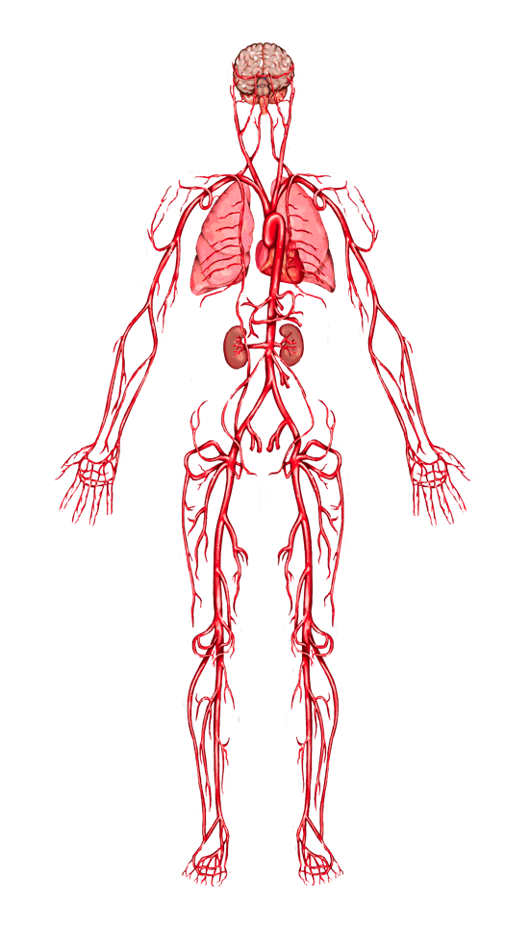
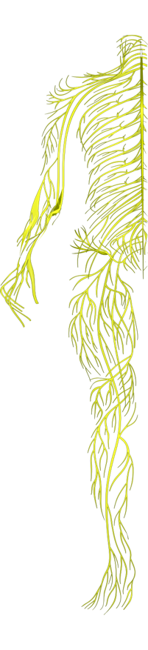
When you get electrocuted all of the things on the last slide can happen.
Lungs: breathing can stop.
Hands, heels, head: points of contact with the electrical source and the ground can be burned.
Heart: ‘flutters’ and fails to pump blood properly. Goes into cardiac arrest, resulting in death.
Nervous system: disrupts the tiny electrical impulses that enable you to sense, move, think, respond and remember.

Slide 11
When you get electrocuted…
Spine/Bones: being thrown by force of the electricity can lead to broken bones or an injured spine.
Muscles: sometimes you grip the electrical source so you can’t let go!
Skin and tissue: electricity burns beneath the skin and skin can melt.
FACT: 9 out of 10 people die from the electric shock received
from getting too close to railway electric overhead lines.

Slide 12
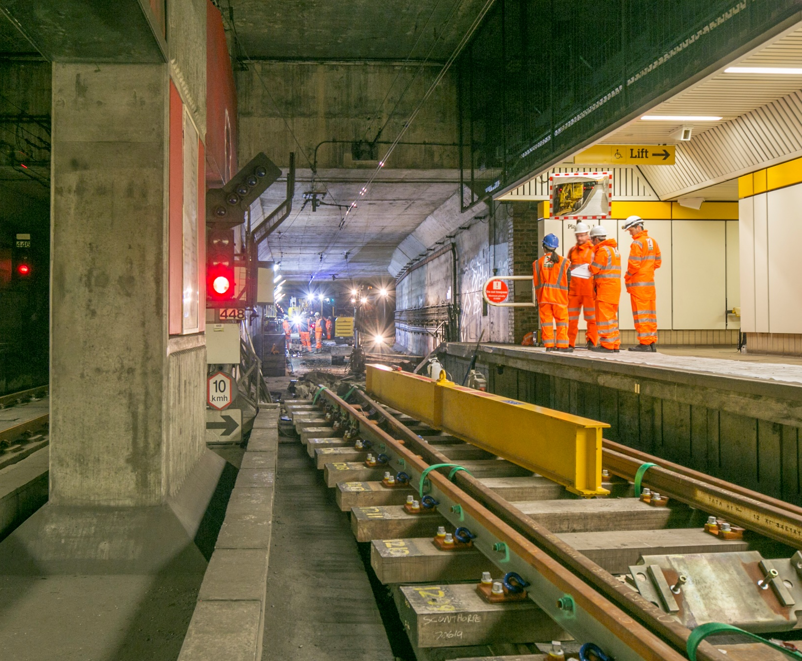

Should we go into Metro stations when they are closed?
Should we go where engineers are working?
Notes:
Engineers working in the underground stations

Slide 13
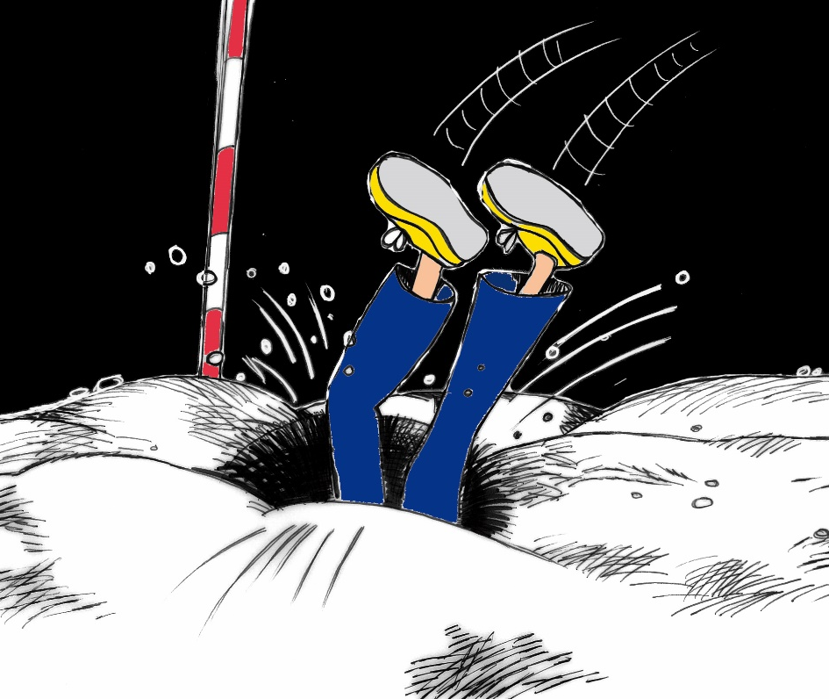
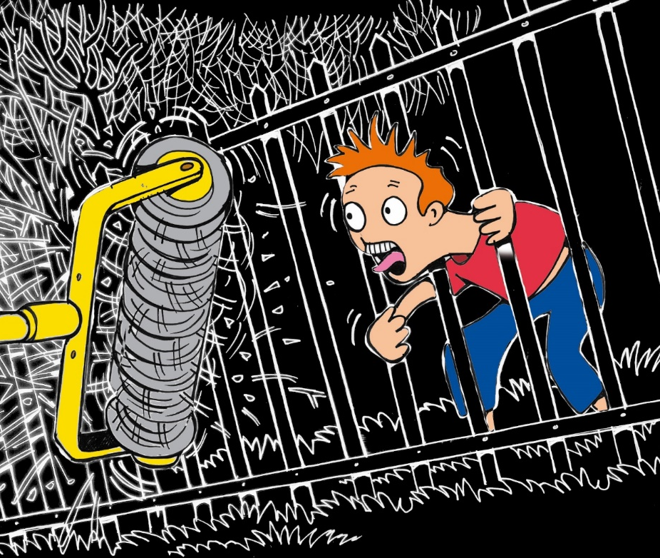
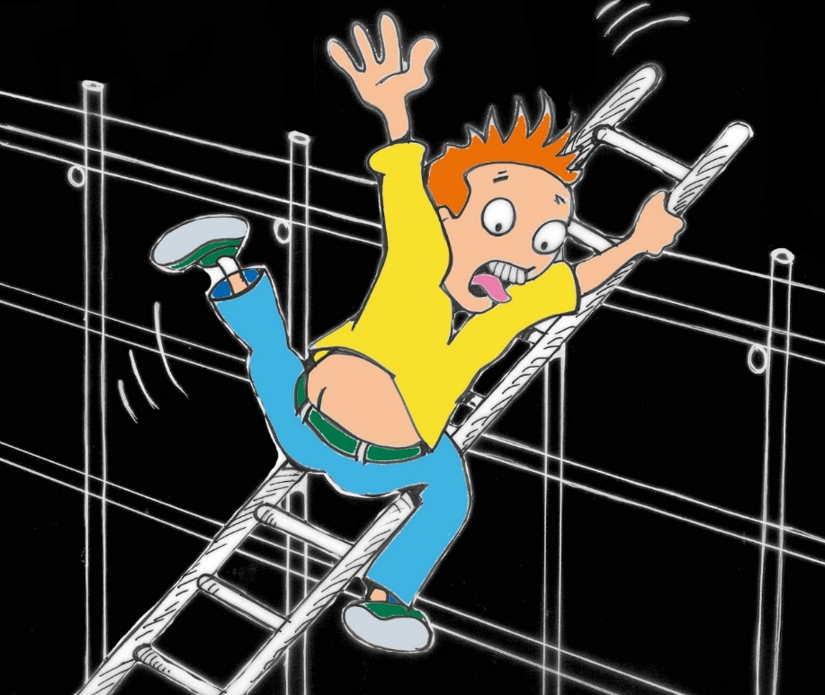
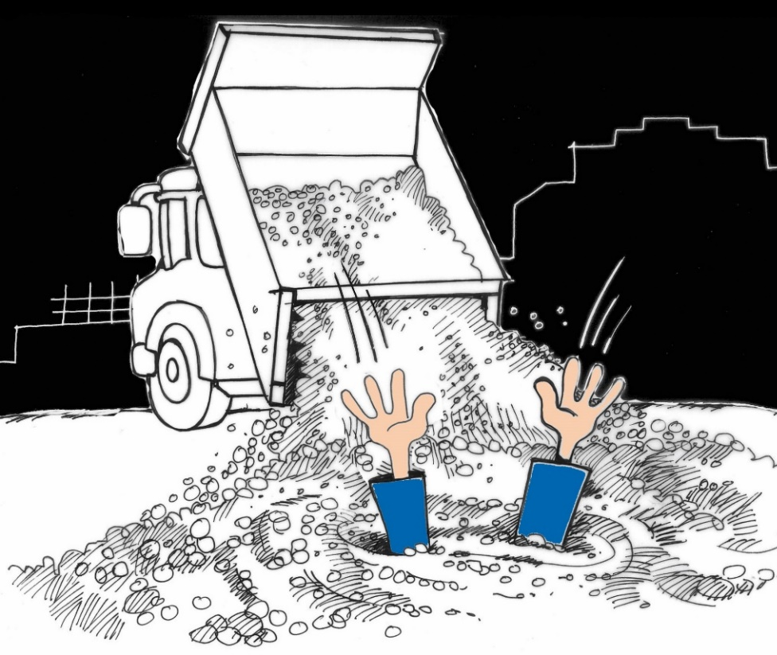
There are lots of dangers on a work site.
Why are engineers allowed to work on the electric lines?
Notes:
Remember our engineers where PPE and are fully trained to work in these areas. We are not allowed in this area and we would be trespassing and could get in trouble with the police ,be hurt or we could be killed.

Slide 14
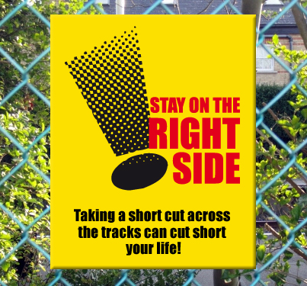
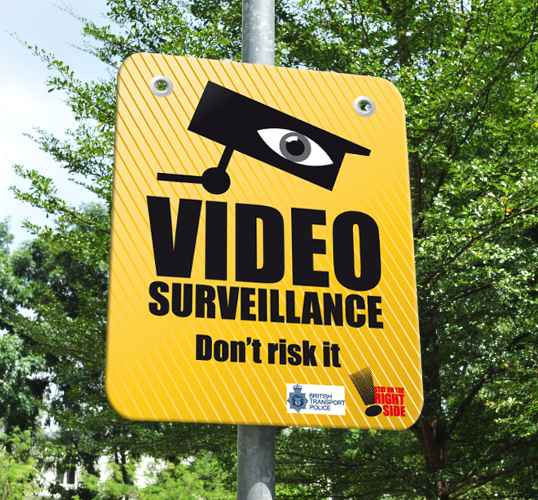
Engineers know how to stay safe around Metro lines. It is their job. Other people on the Metro lines should not be there. This is against the law and called trespassing.
Notes:
Stay on the right side of the fence as short cuts could cost you your life

