Slide 1
RWI Red: Pick it up

Slide 2
f | l | m | n | r | s ss | v | z | sh | th | ng nk
b | c k ck | d | g | h | j | p | qu | t | w | x | y | ch
a | e | i | o | u
Speed Sounds

Slide 3
pick | that | sock | vest
mess
Ditty 1:Story Green Words

Slide 4
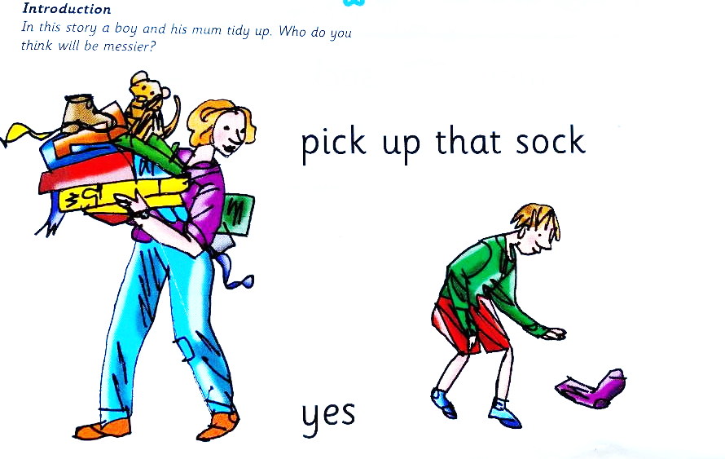
Ditty 1:Pick it up

Slide 5
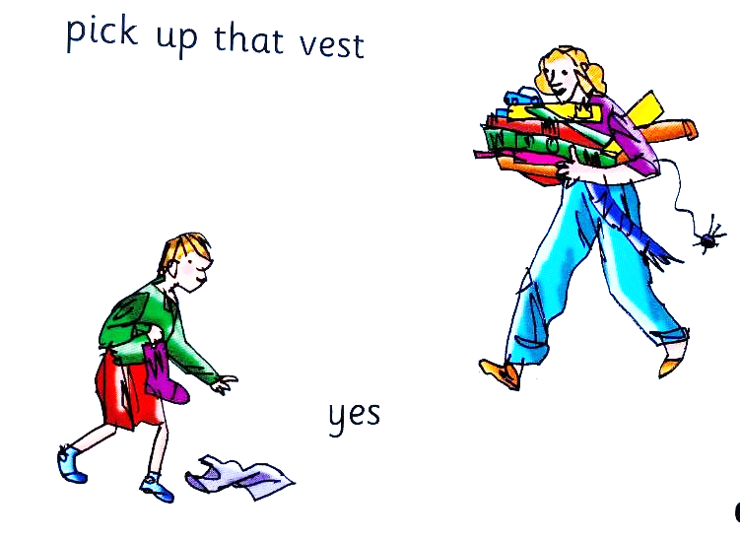
Ditty 1:Pick it up

Slide 6
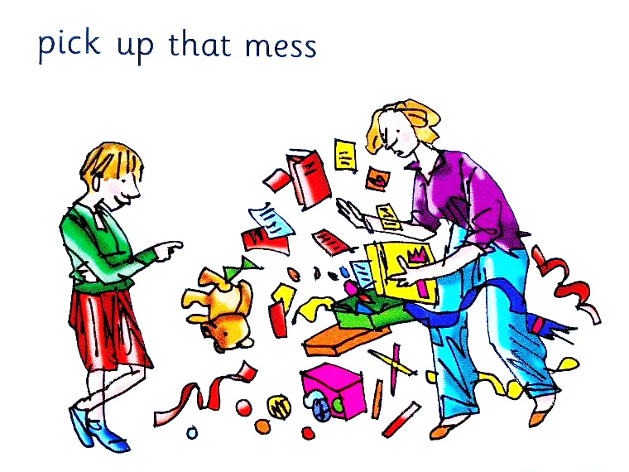
Ditty 1:Pick it up

Slide 7
six | pink | red
long | snap
Ditty 2:Story Green Words

Slide 8
rat -> rats | hat -> hats | croc -> crocs
sock -> socks
Ditty 2:Story Green Words

Slide 9
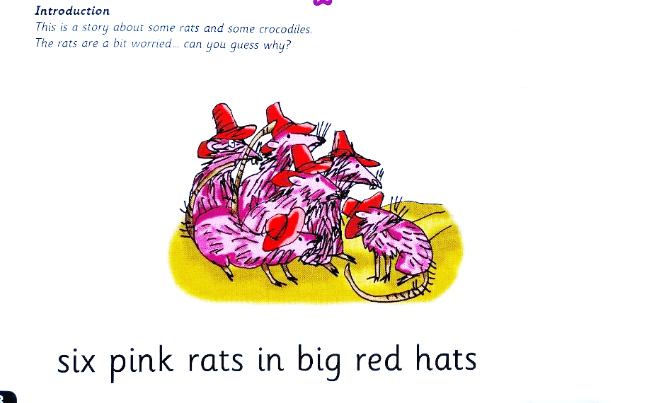
Ditty 2:Snap snap

Slide 10
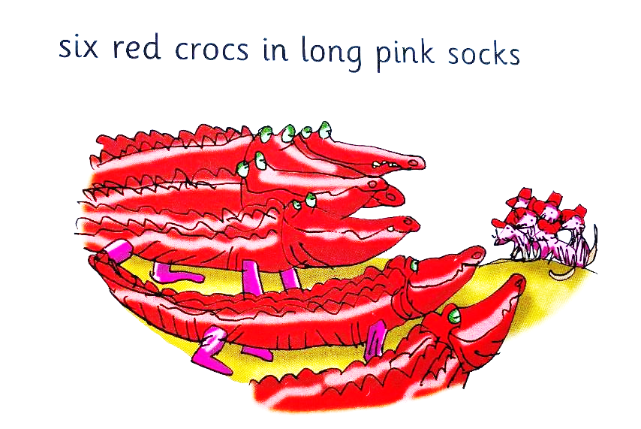
Ditty 2:Snap snap

Slide 11
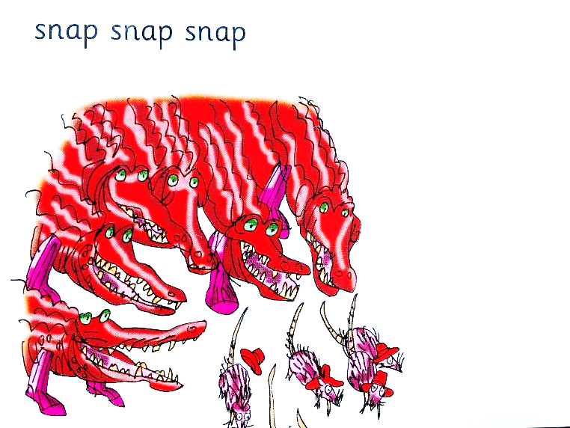
Ditty 2:Snap snap

Slide 12
this | chimp | run | grin
clap | that | win
Ditty 3:Story Green Words

Slide 13
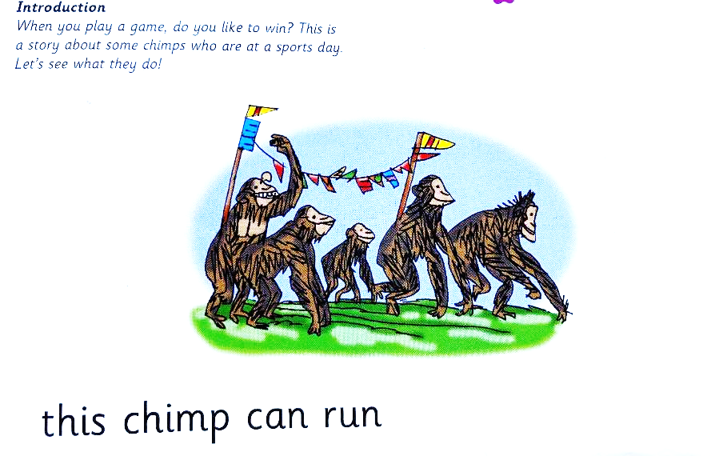
Ditty 3:This chimp can run

Slide 14
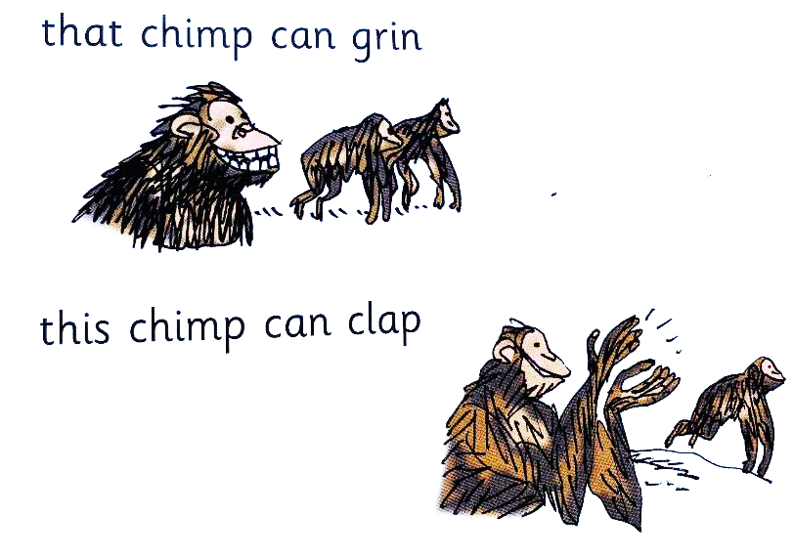
Ditty 3:This chimp can run

Slide 15
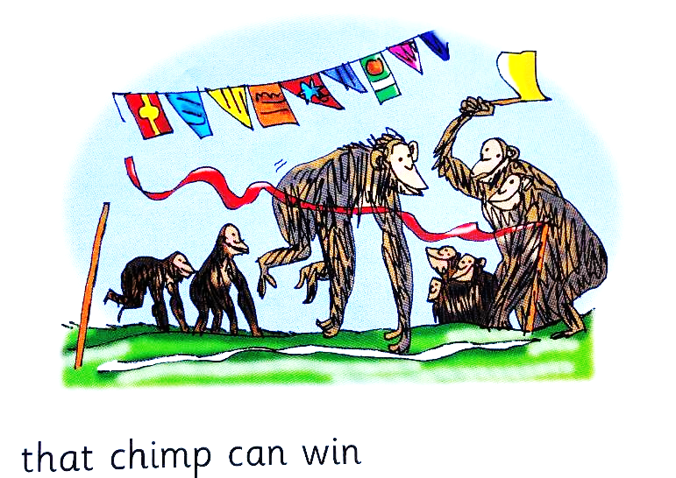
Ditty 3:This chimp can run

