Slide 1
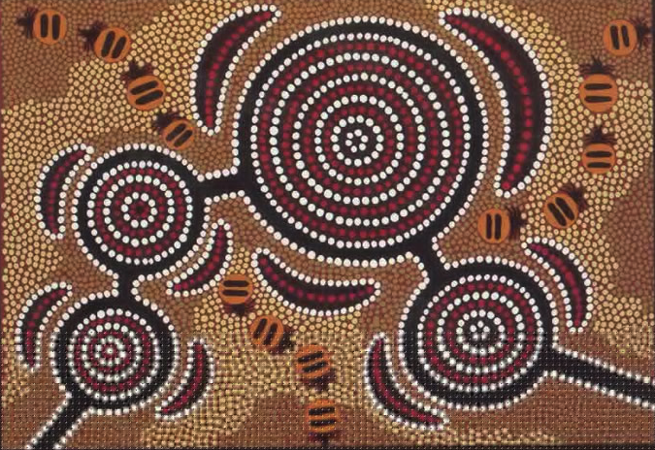
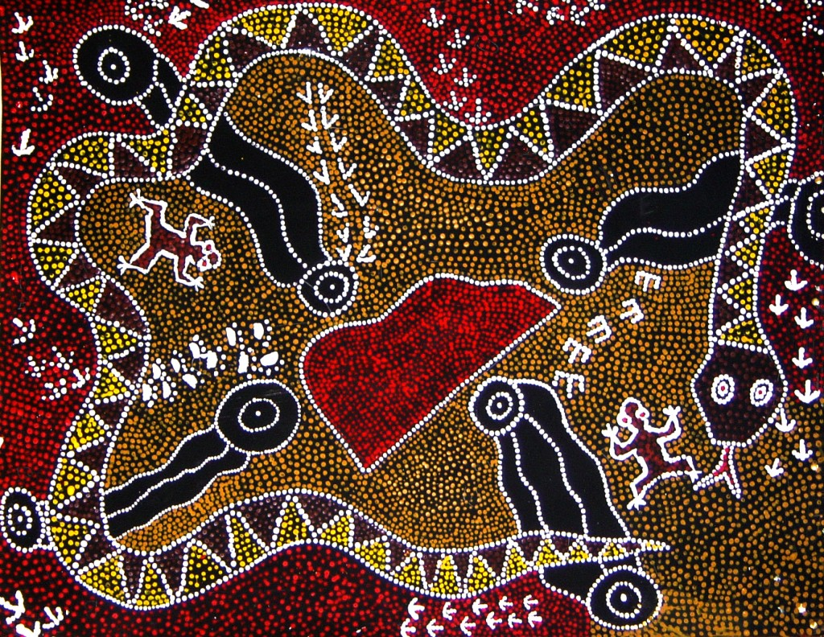
Aboriginal Art

Slide 2
Key vocabulary Design a plan or drawing of your ideas Pattern a repeated decorative design. Symbols a mark, sign or word that represents an idea or object

Slide 3
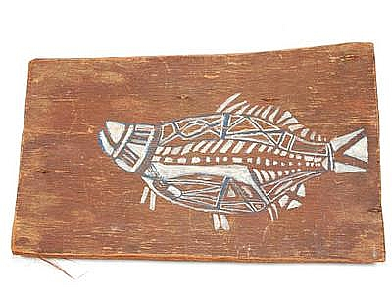
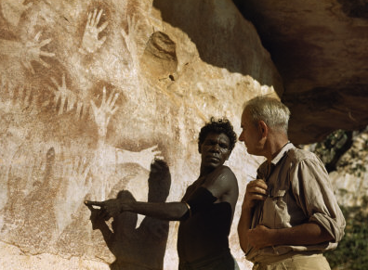
Recapping from last week
Here are three different of Aboriginal Art
Bark painting- X-ray fish
Negative printing - Simple figures
Geometrical

Slide 4
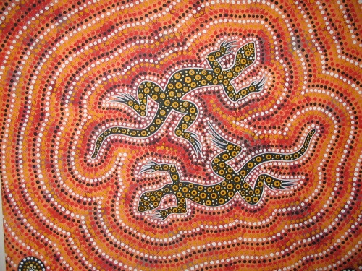
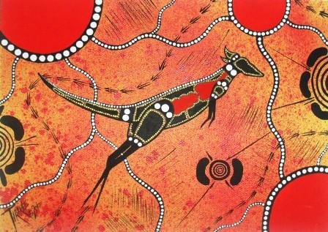
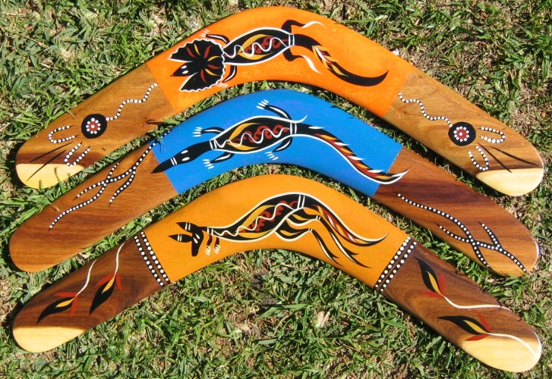
Animals in Aboriginal Art
Objects in Aboriginal Art

Slide 5
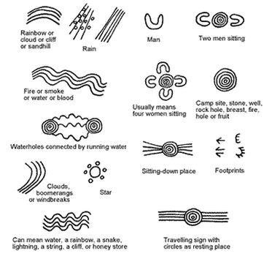

Slide 6
Now it’s your turn
Use your plan where you
Use three symbols that will use to create your storyline and art work.
Create a repeated pattern.
You can draw your design. If you have colours or paint then could add this to your own design.
Look the examples on last week’s powerpoint too to help you.

