Slide 1
Telling the time to the nearest five-minutes. (to)

Slide 2
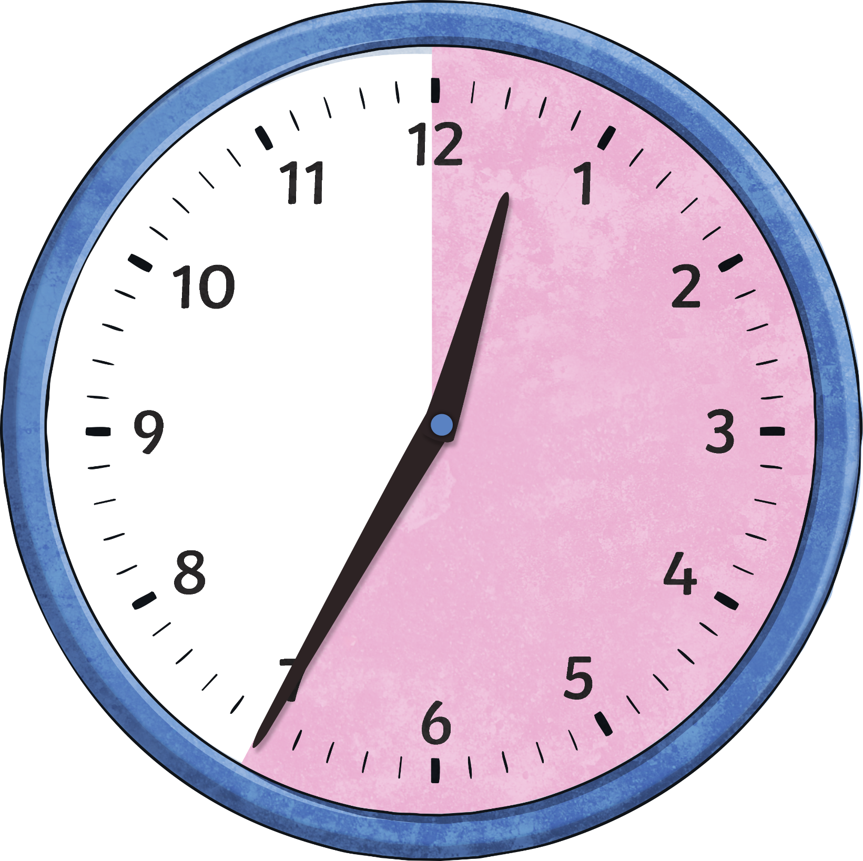
When the big hand points to 7, it means…
25
minutes
to
Click to reveal answer

Slide 3
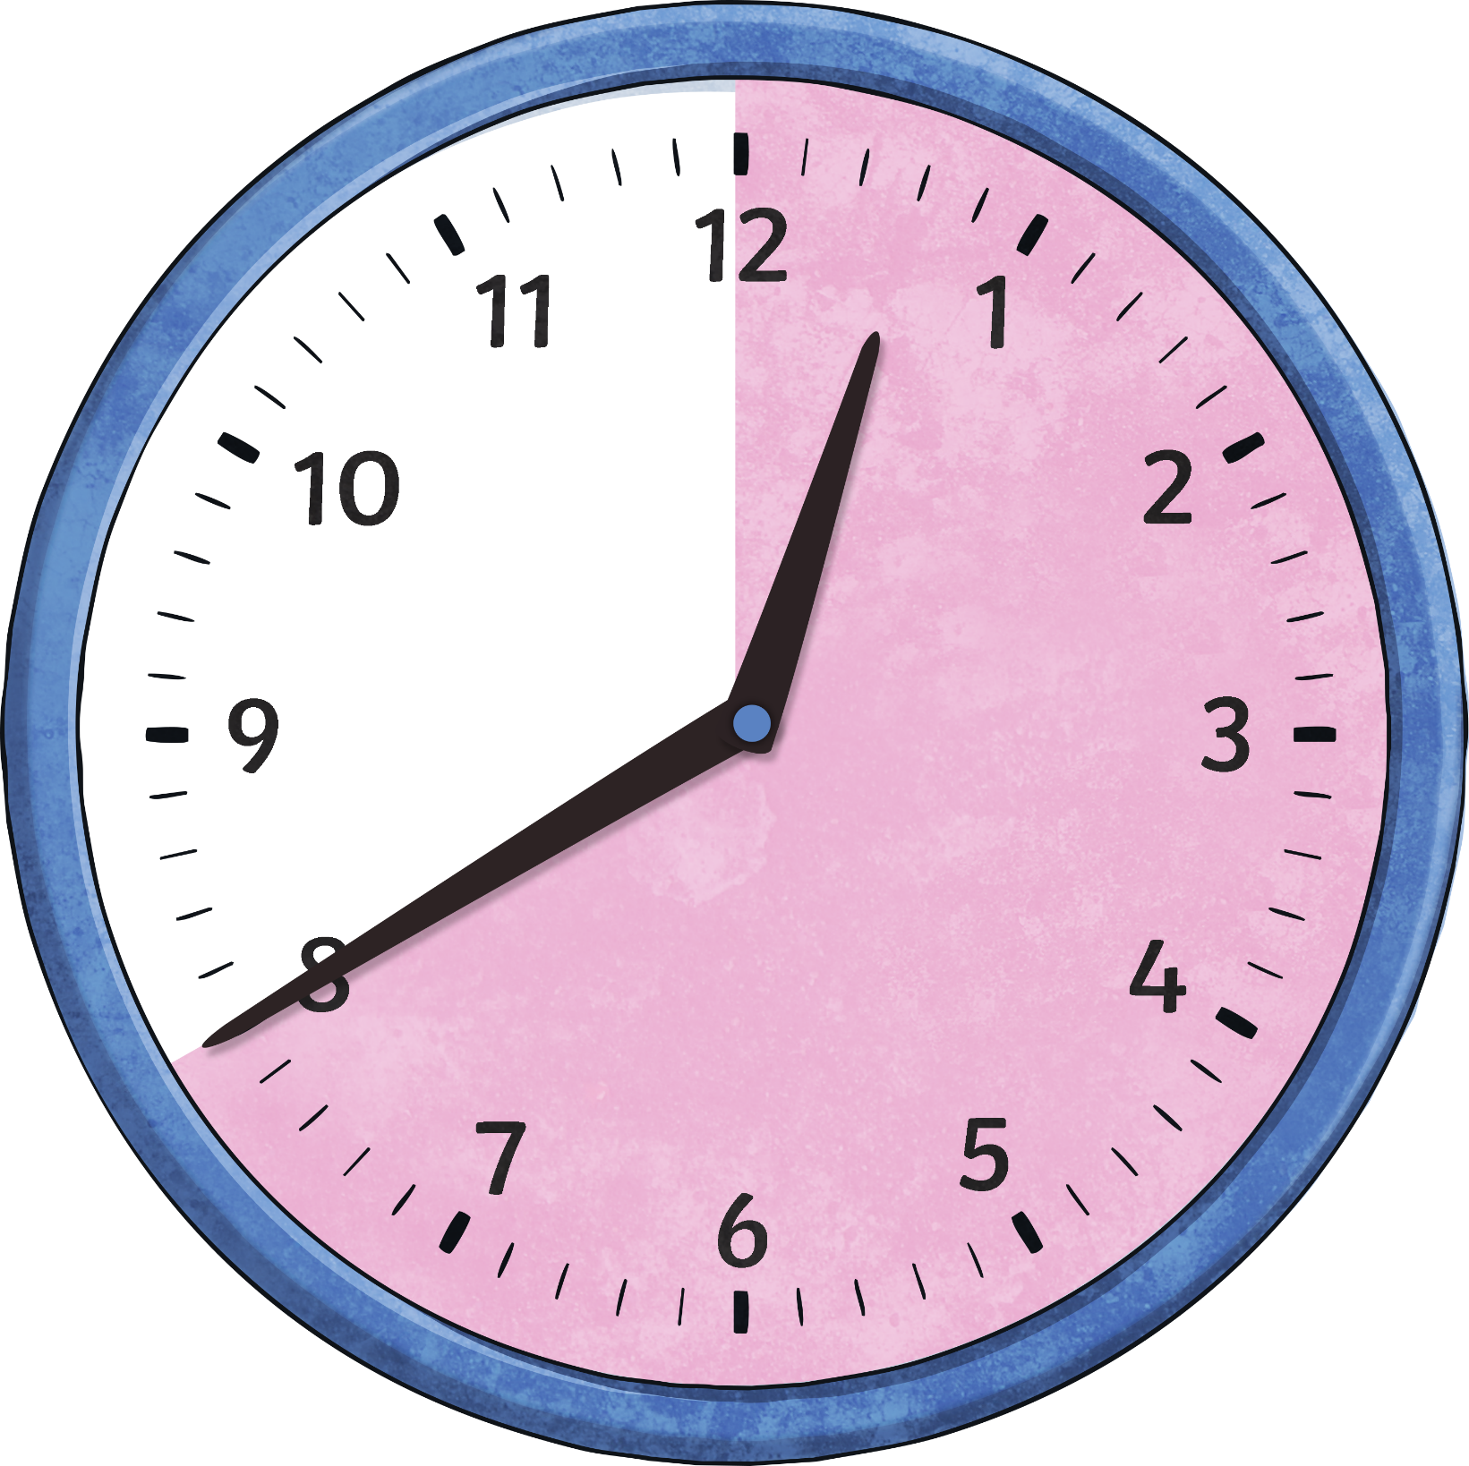
When the big hand points to 8, it means…
20
minutes
to
Click to reveal answer

Slide 4
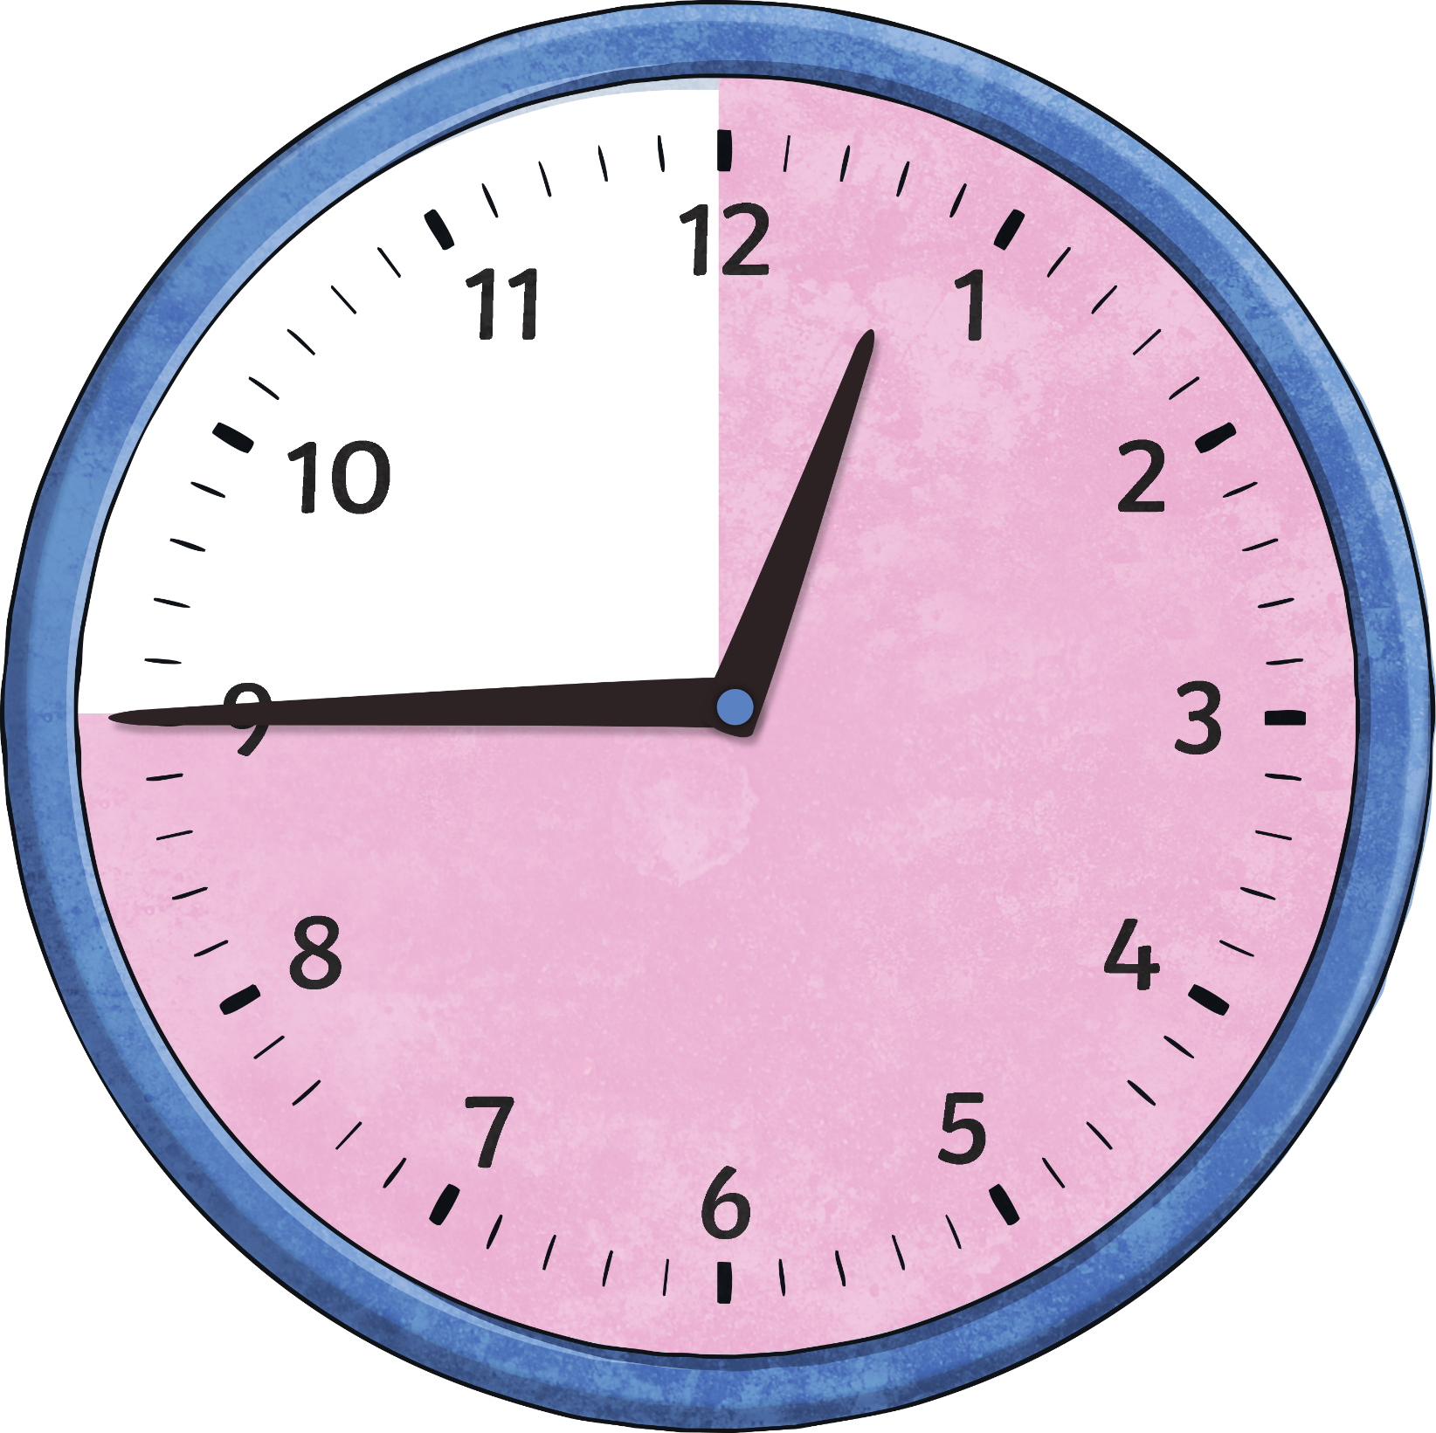
When the big hand points to 9, it means…
15
minutes
to
Click to reveal answer

Slide 5
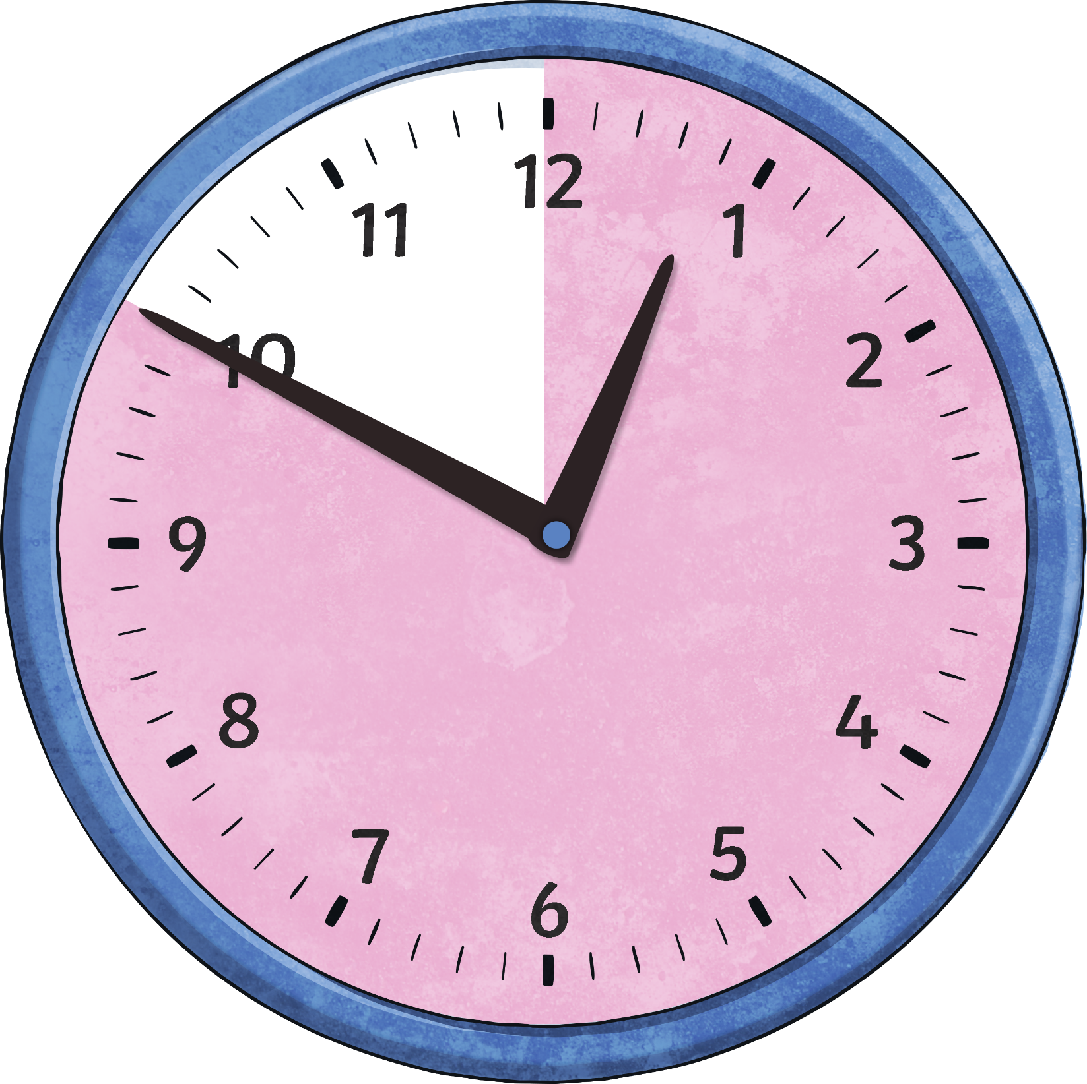
When the big hand points to 10, it means…
10
minutes
to
Click to reveal answer

Slide 6
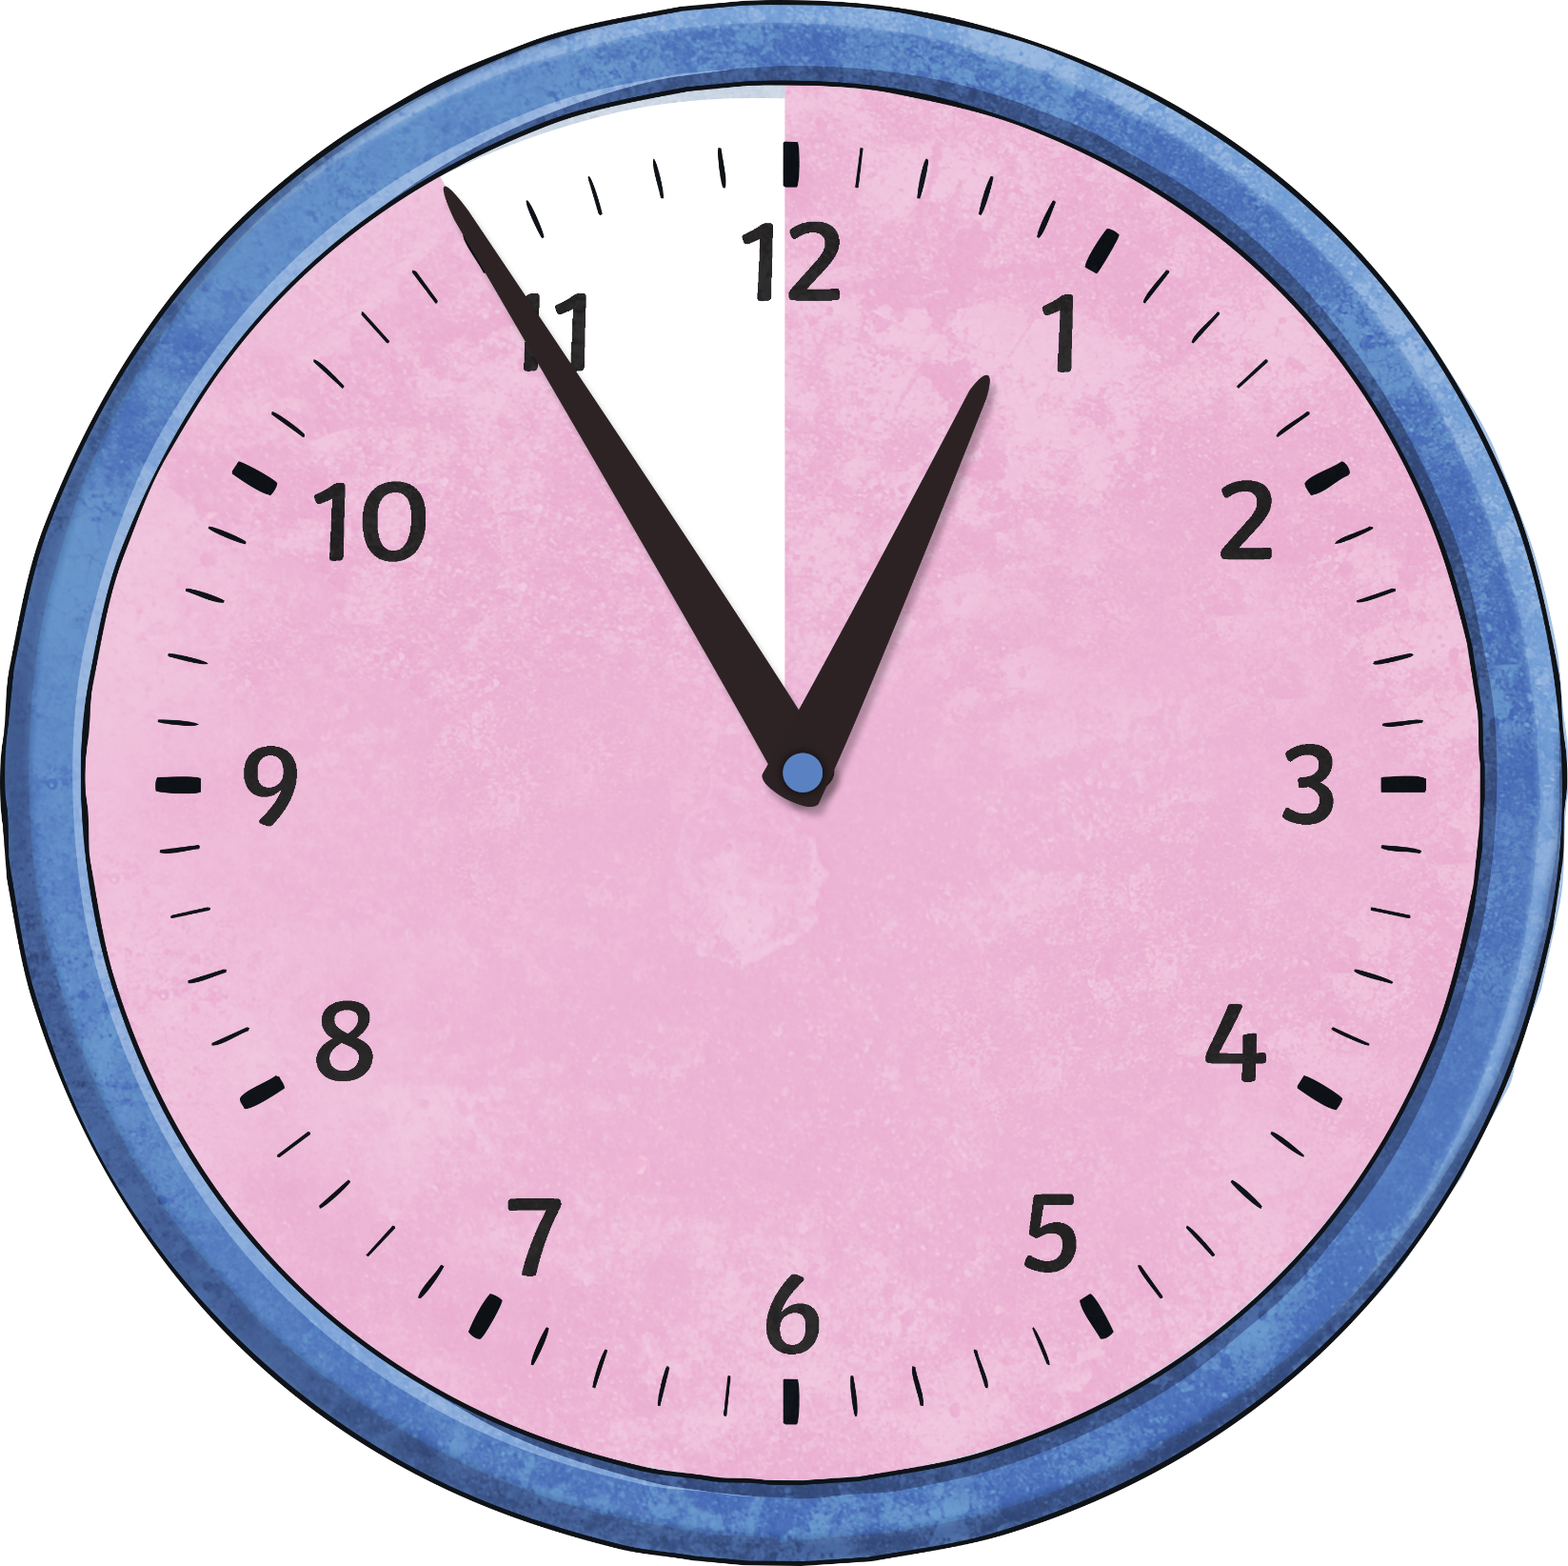
When the big hand points to 11, it means…
5
minutes
to
Click to reveal answer

Slide 7
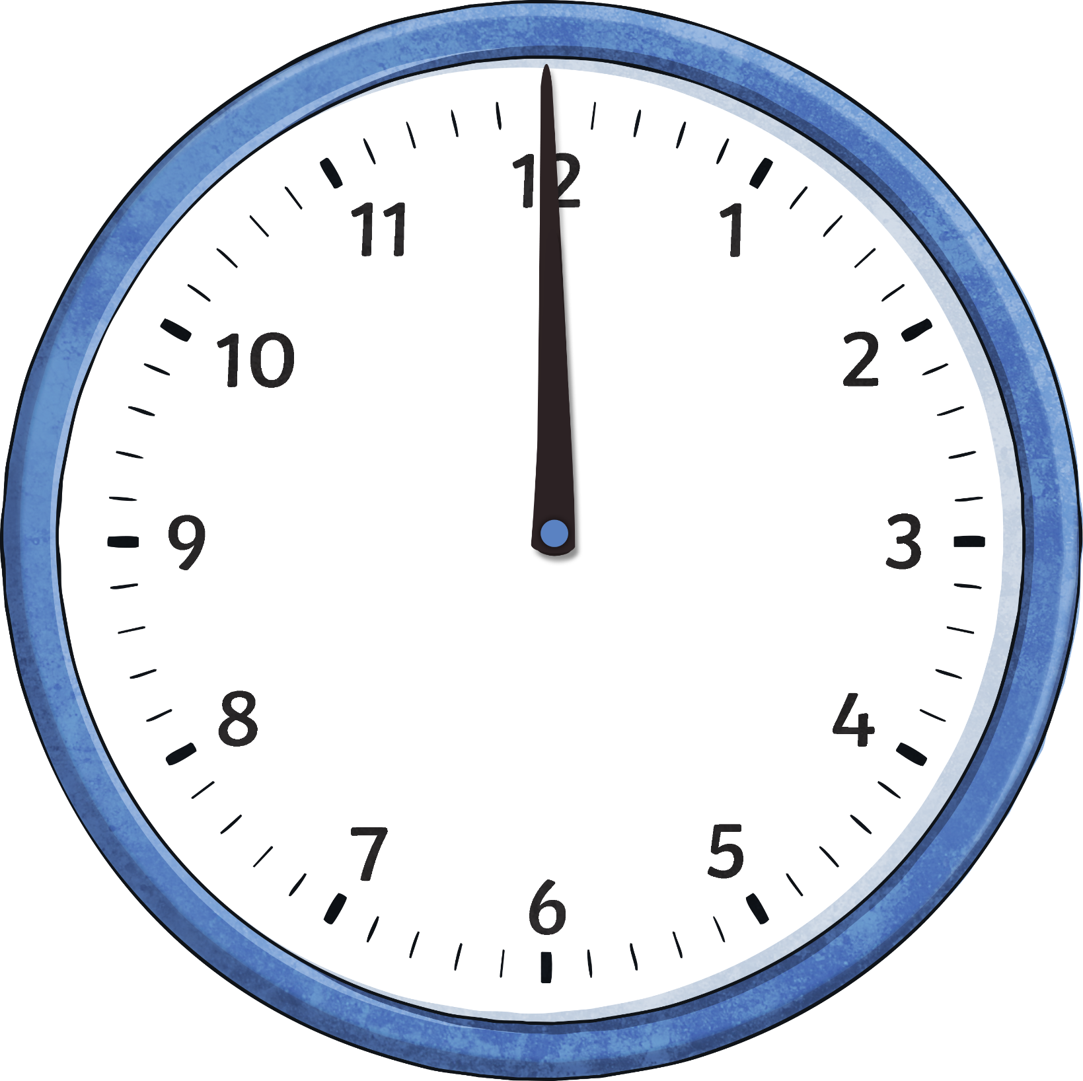
When the big hand points to 12, it means…
o’clock
Click to reveal answer

Slide 8
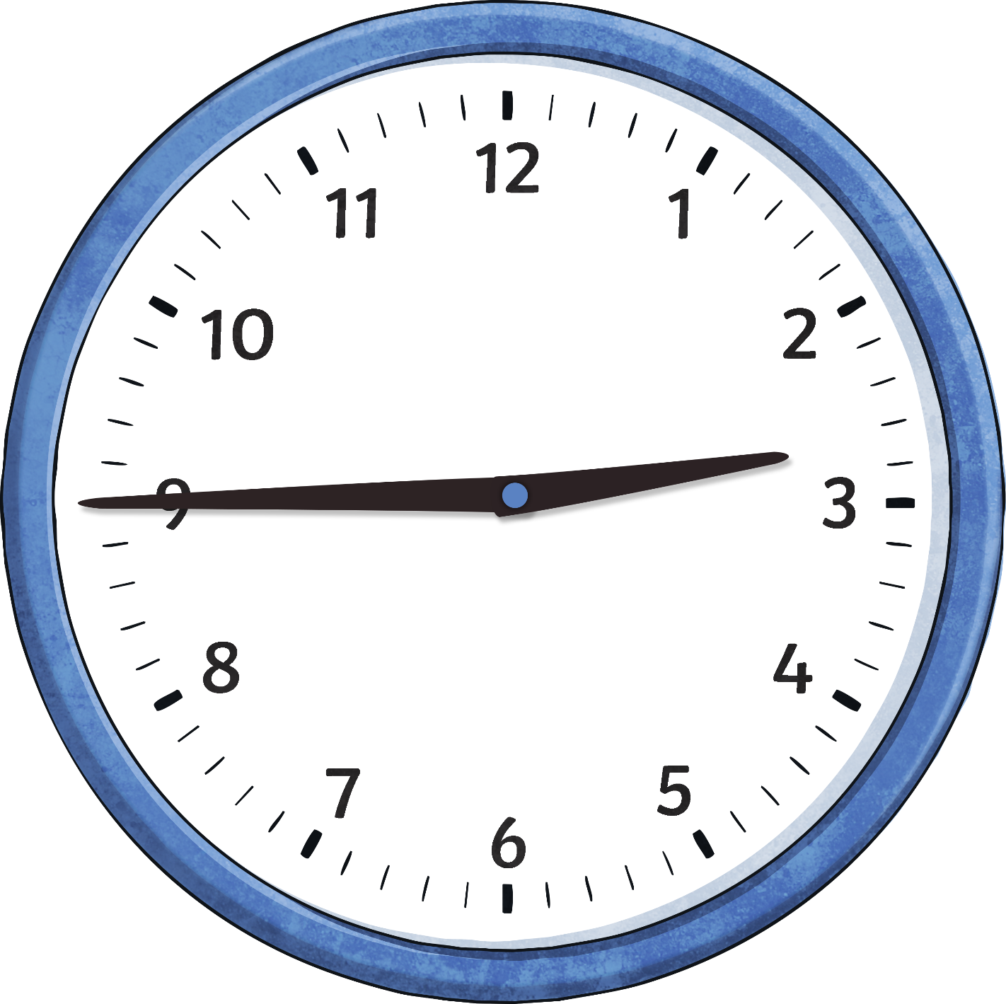
What Time Does it Say on the Clock?
quarter to three

Slide 9
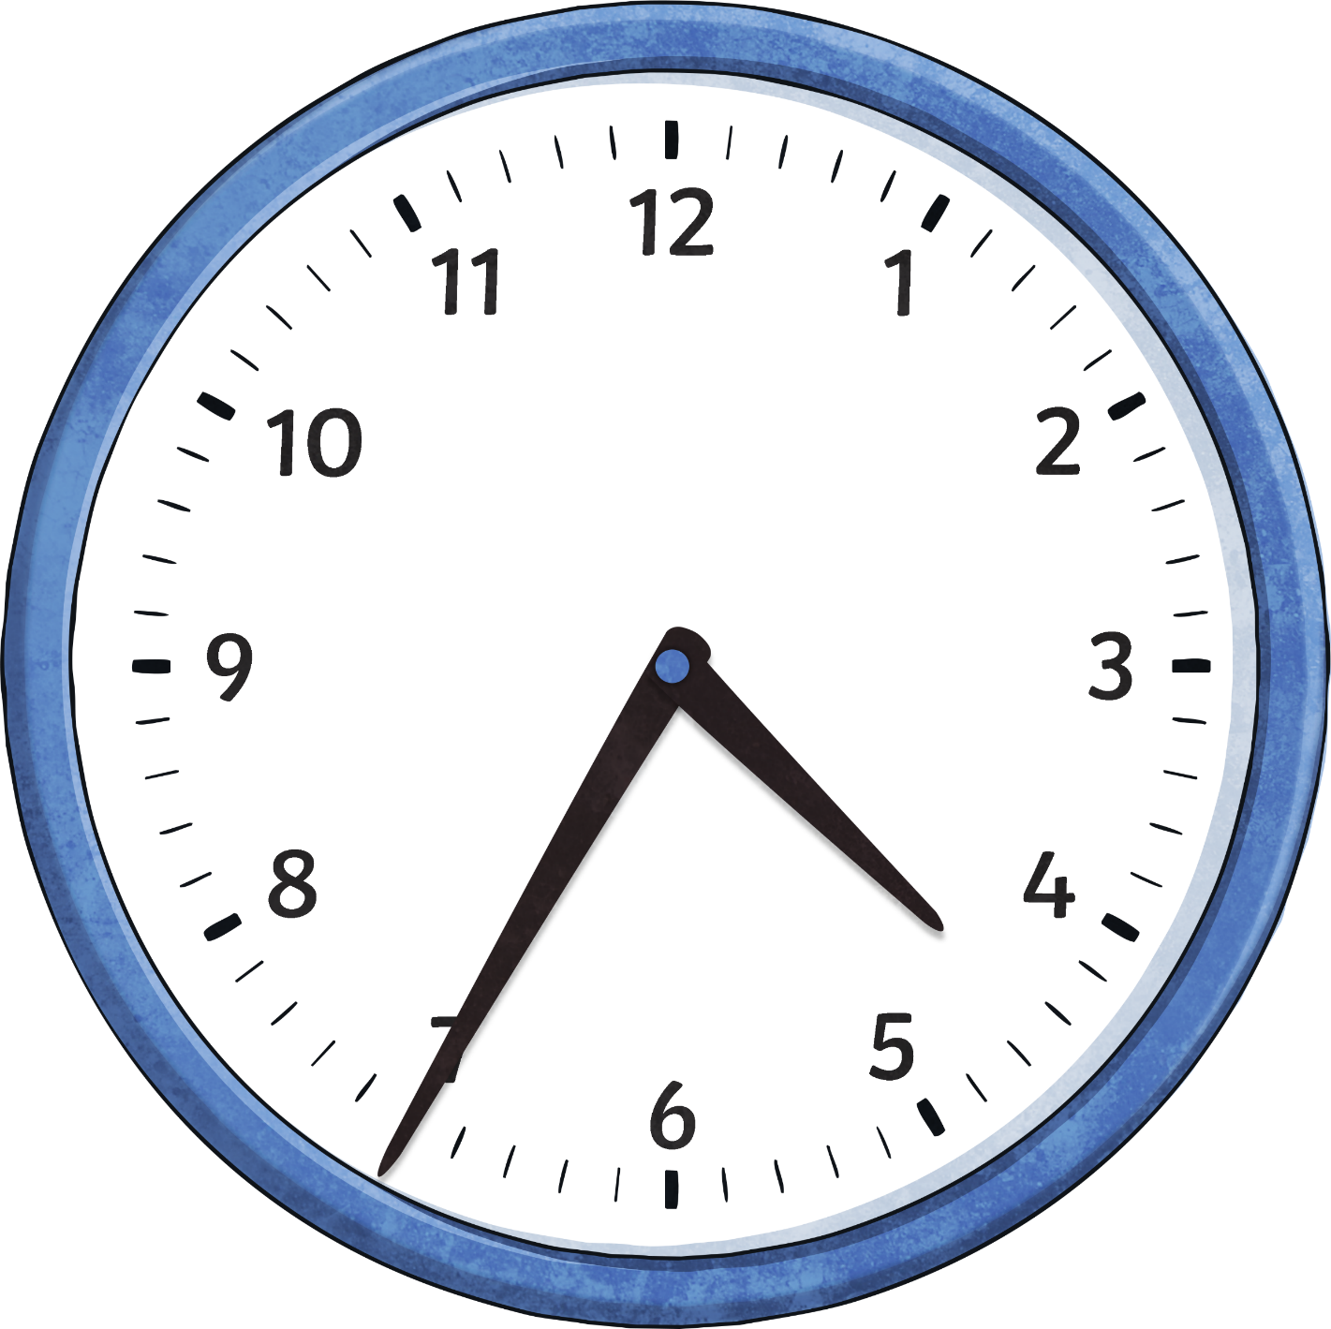
What Time Does it Say on the Clock?
25 minutes to five

Slide 10
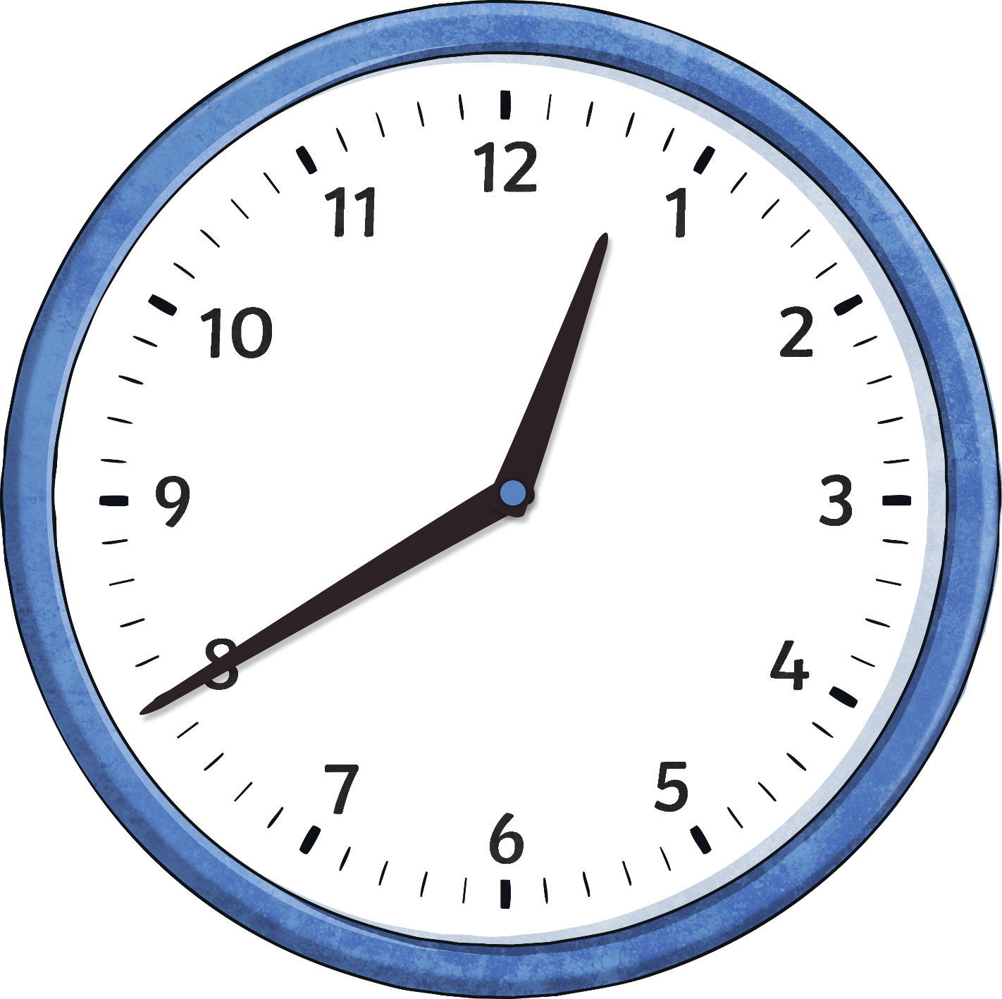
What Time Does it Say on the Clock?
20 minutes to one

Slide 11
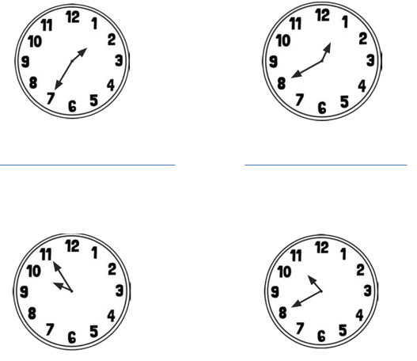
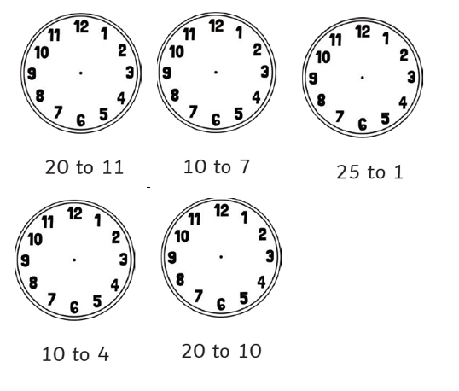
Now complete these on your worksheet. Remember to think about the length and position of hands.

