Slide 1
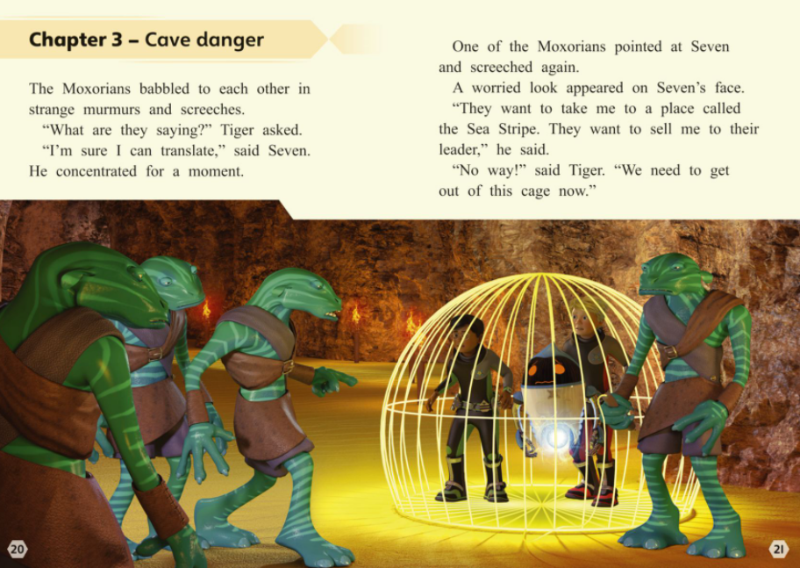
1. Why did the author choose the word babbled to describe how the Moxorians were talking?
2. Why was Seven worried?

Slide 2
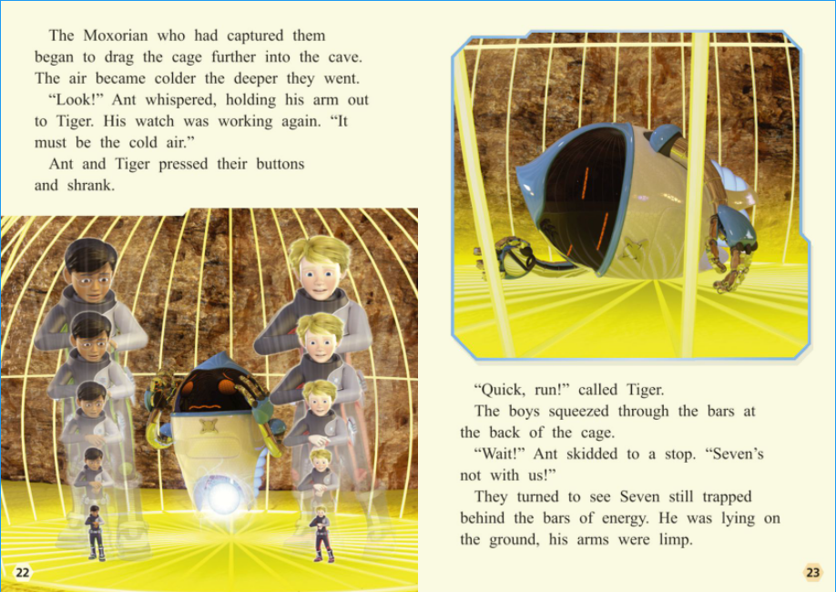
3. How do you think Ant felt when he realised his watch was working again?
4. Why did the boys shrink?
5. What does the sentence ‘his arms were limp’ show about Seven?

Slide 3
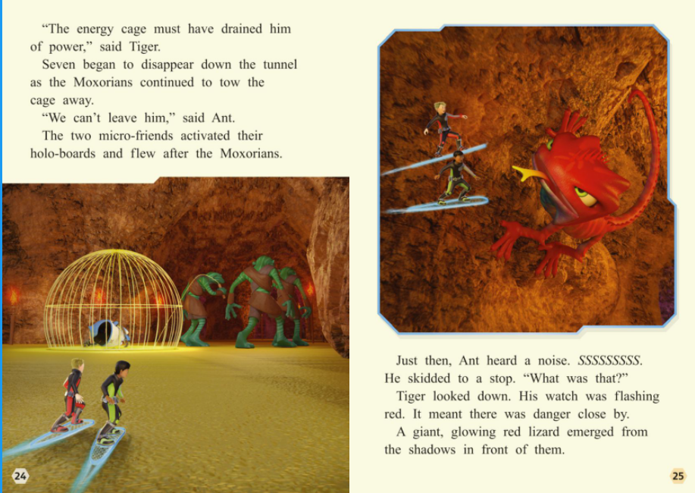
6. How does Tiger feel on page 24? Why and how do you know?
7. What does the word ‘emerged’ mean?

