Slide 1
Set 1 Sounds r

Slide 2
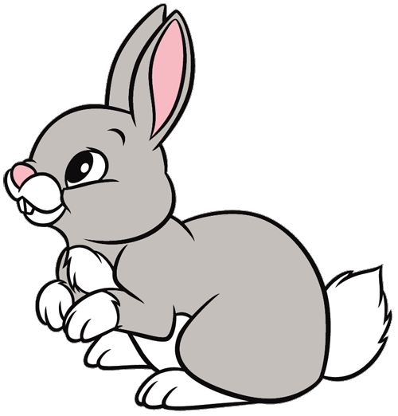

Slide 6
