Slide 1
Year 1 Maths Learning intention: To learn about time

Slide 2
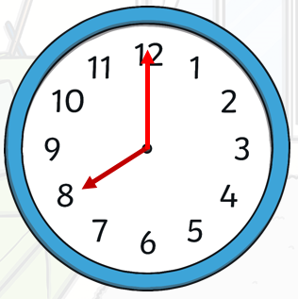
Today we are going to look at how to tell the time using a clock.
This is the hour hand.
It is the shortest hand on the clock.
This is the minute hand.
It is the longest hand on the clock.

Slide 3
When the minute hand is pointing at 12, we call it o’clock.
On this clock, the hour hand is pointing at 8 and the minute hand is pointing at 12.
That means it is 8 o’clock.

Slide 4
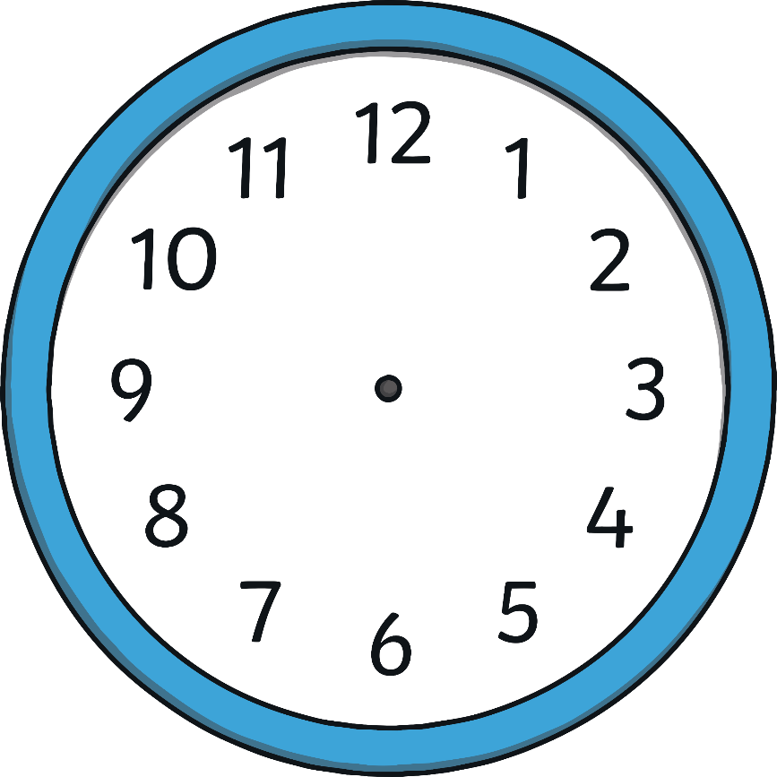
What time is it? Click the o’clock to see what it looks like:
12 o’clock
11 o’clock
1 o’clock
10 o’clock
2 o’clock
9 o’clock
3 o’clock
8 o’clock
4 o’clock
7 o’clock
5 o’clock
6 o’clock

Slide 5
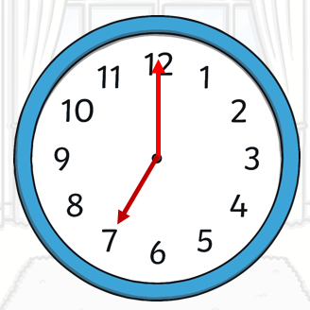
What time is it?
It is 7 o’clock.

Slide 6
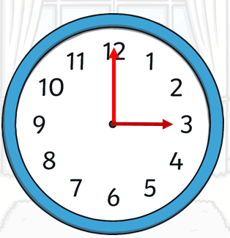
What time is it?
It is 3 o’clock.

Slide 7
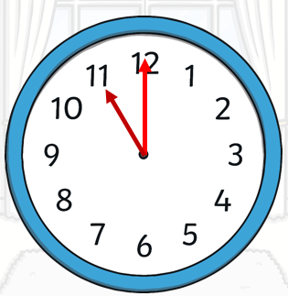
What time is it?
It is 11 o’clock.

Slide 8
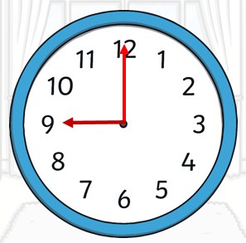
What time is it?
It is 9 o’clock.

Slide 9
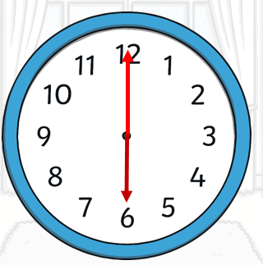
What time is it?
It is 6 o’clock.

Slide 10
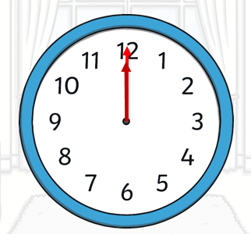
What time is it?
It is 12 o’clock.

Slide 11
What time is it?
Point to the clock that shows 2 o’clock.

Slide 12
What time is it?
Point to the clock that shows 4 o’clock.

Slide 13
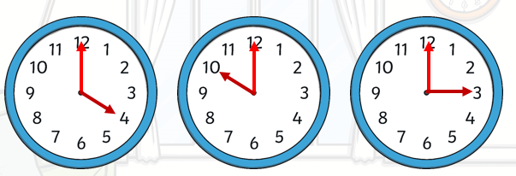
What time is it?
Point to the clock that shows 10 o’clock.

Slide 14
What time is it?
Point to the clock that shows 8 o’clock.

