Slide 1
PE
Notes:
In today‘s PE lesson we will be doing some exercises so it’s important that you ask your grown ups where is best to do it, there’s space around you and that you have a drink of water nearby. Be careful, enjoy and let’s get moving!

Slide 2
Warm up your brain!
foot
leg
hand
arm
knee
Notes:
Before we warm up our body, let’s warm up our brains by thinking about different body parts. Using the words, can you point to the right body part, first on the picture and then on yourself?
There’s leg, foot, arm, hand and knee. Can you think of any more?

Slide 3
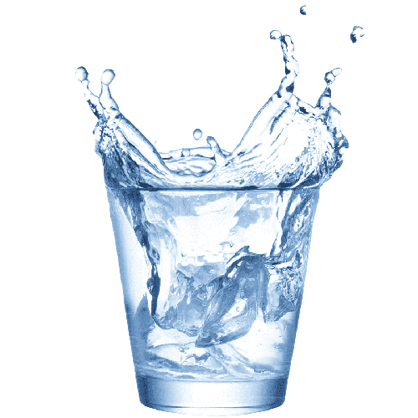
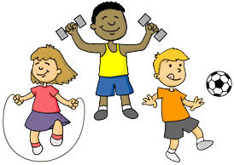
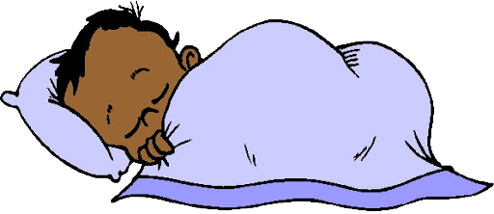
What do our bodies need?
Notes:
Brilliant! You have found parts of the body, our bodies are very special and important. Do you know what our bodies need to stay healthy? That’s right, sleep, water, exercise and food! Today we are going to give our bodies the exercise it needs.

Slide 4
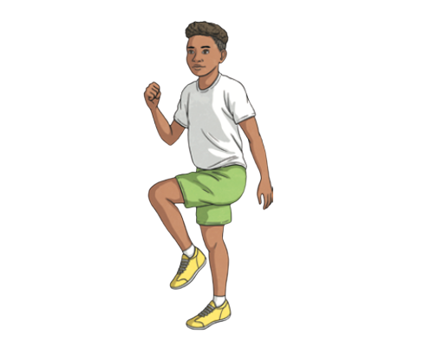
Warm up your body!
Notes:
Let’s warm up our body – march on the spot for 30 seconds, count with me! (Count to 30) Well done! Can you do it even quicker?

Slide 5
We are going to move our bodies and exercise!
10 x star jumps
5 x hops on each leg
Touch your toes slowly
10 x twist and jumps
Notes:
Now that our bodies are warmed up, we can do some different exercises! We are going to start with 10 star jumps, 5 hops on each leg, then we will slowly touch our toes and do 10 twist and jumps. We’re going to do this whole thing twice, if you don’t know what one of the exercises are, don’t worry I’ve done other powerpoint slides to help and show you.

Slide 6
Star Jumps:
Notes:
To do a star jump, stand tall with your arms by your side and knees slightly bent. Jump up, stretching your arms and legs out into a star shape in the air. Land softly, with your knees together and hands by your side. Look at the picture to help you.

Slide 7
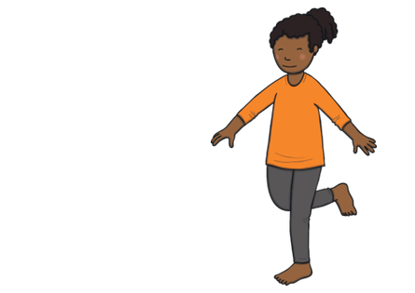
Hop:
Notes:
Next up, are hops. Stand with both feet on the floor. Slowly raise one of your legs slightly, just as much as you can manage. Then try and jump using your other foot that’s still on the floor. If you need to put your arms out to help you, go for it!

Slide 8
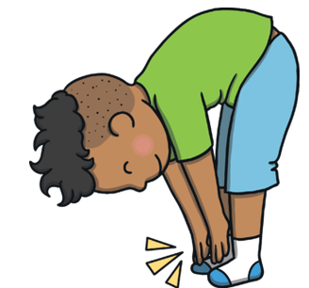
Touch your toes:
Notes:
Now we’re going to slowly touch our toes, so start stood up, feet on the ground and arms relaxed. Take a deep breath in and a deep breath out. Slowly you’re going to bend forward to try and touch your toes. Don’t worry if you can’t touch your toes, not everyone can and practice will help. Keep your legs straight but don’t stretch too far. If it hurts, stop!

Slide 9
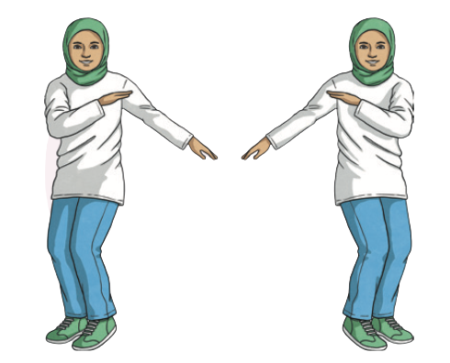
Twist and jump:
Notes:
Finally we have the twist and jumps! Start with your feet slightly pointed to the left. Those knees should be bent and one arm (your left arm) up towards your shoulder and your right arm straight out to the side and you’re going to jump so that your feet point to the right and swap your arms. Jump back and twist, jump back and twist and so on.

Slide 10
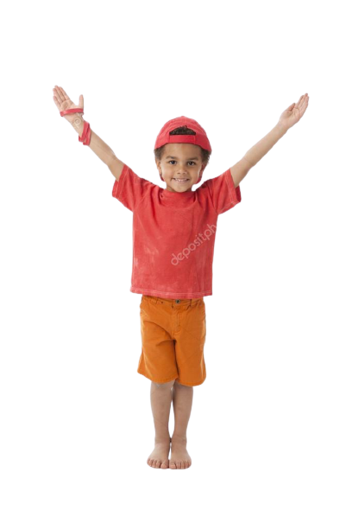
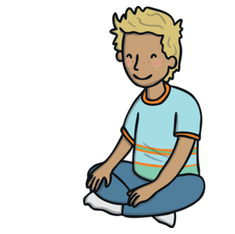
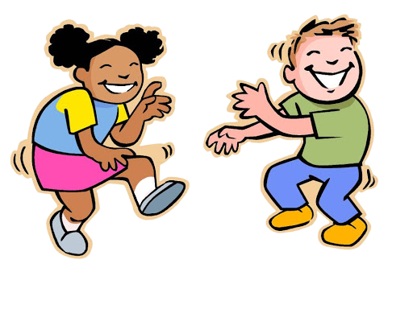
Cool Down
Windstorm:
Imagine that you are a tall tree trapped in a storm! Move with the wind.
Stretch and spell:
Can you move your body to spell your name?
Slow dance:
Can you do your favourite dance moves in slow motion?
Sit still like a frog:
Crouch like a frog and take 10 deep breaths.
Notes:
Well done for completing our exercises. How do different parts of your body feel? Think about your legs and arms, what about your heart? Is it beating quicker or slower? Do you know why?
Here are some cool down exercises to help calm our bodies and heart. First there’s windstorm. Stand tall and wide like a tree, a storm is coming, how will your branches move in the wind… it’s very strong and windy, wow! Now it is slowly calming down to a gentle breeze. Next there’s stretch and spell, can you move your body to spell your name? Then there’s slow dance, can you do your favourite dance moves in slow motion? Do this for 30 seconds. Finally can you sit still like a frog? Crouch or sit and take 10 deep breaths in and out. This one is handy if you’re ever feeling angry too!

