Slide 1
Learning intention: To use division methods.
We will do this as division by sharing.
÷
This means ‘divide by’, which is similar to sharing.

Slide 2
Recap:
8 ÷ 2 =
This means 8 divided by 2.
This is the same as 8 shared into 2 groups.
8 ÷ 2 =
a
The amount being divided The number of groups
or shared

Slide 3
For example:
Miss Thom has 8 books. Miss Thom and Miss Lawson share them equally. How many books do they each get?
8 ÷ 2 =

Slide 4
For example:
Miss Thom has 8 books. Miss Thom and Miss Lawson share them equally. How many books do they each get?
8 ÷ 2 =

Slide 5
For example:
Miss Thom has 8 books. Miss Thom and Miss Lawson share them equally. How many books do they each get?
8 ÷ 2 = 4

Slide 6
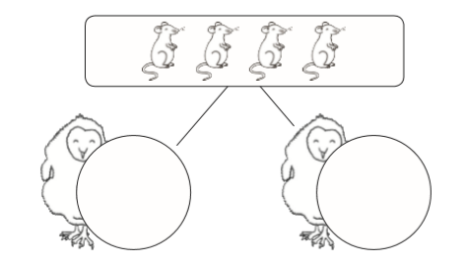
There are four mice. The owls shared them equally. How many mice will they each get?
4 ÷ 2 =

Slide 7
There are four mice. The owls shared them equally. How many mice will they each get?
4 ÷ 2 = 2

Slide 8
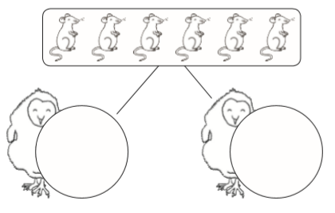
There are six mice. The owls shared them equally. How many mice will they each get?
6 ÷ 2 =

Slide 9
There are six mice. The owls shared them equally. How many mice will they each get?
6 ÷ 2 = 3

