Slide 1
Learning Intention: To recap hand washing hygiene.

Slide 2
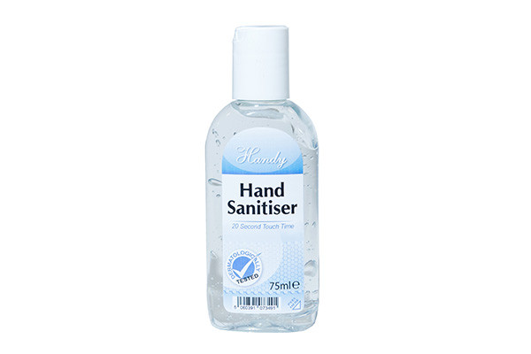
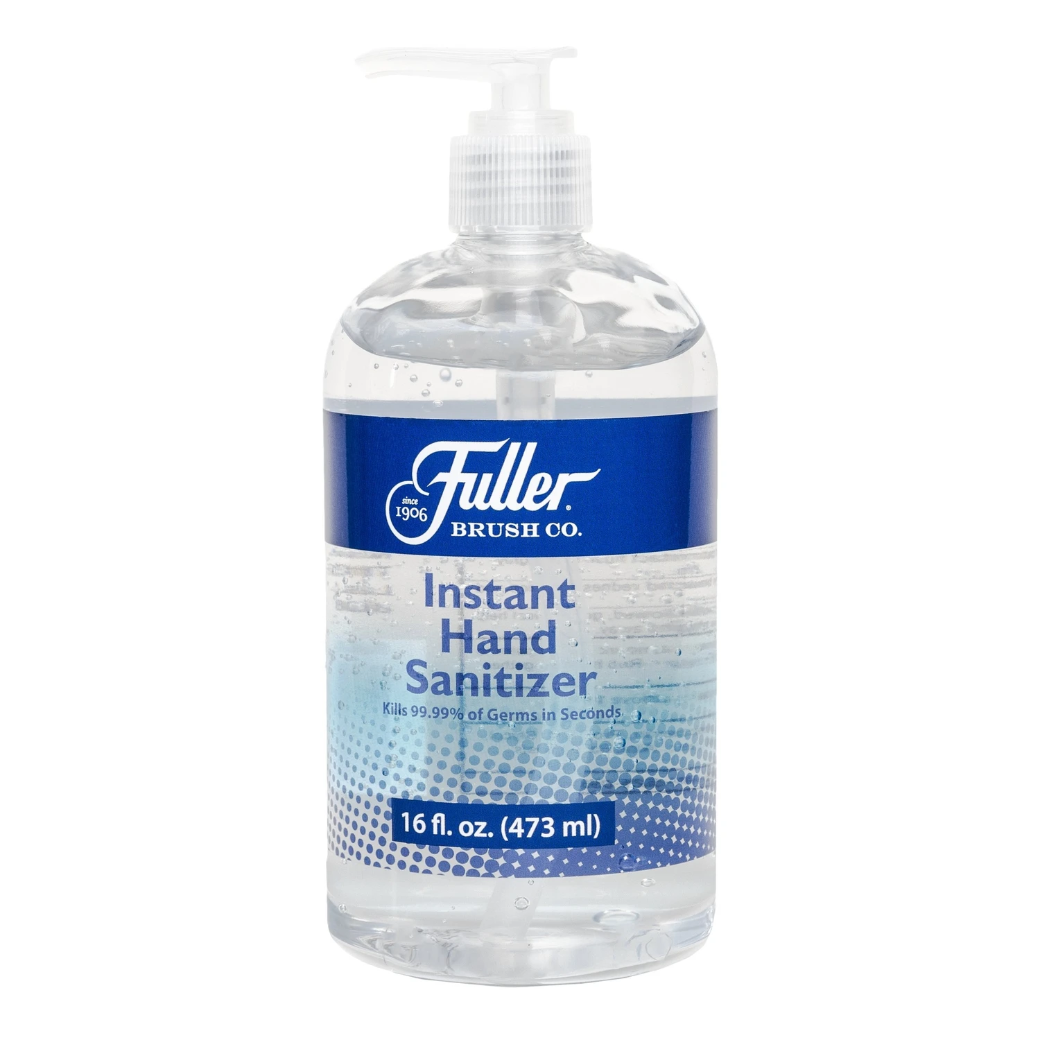
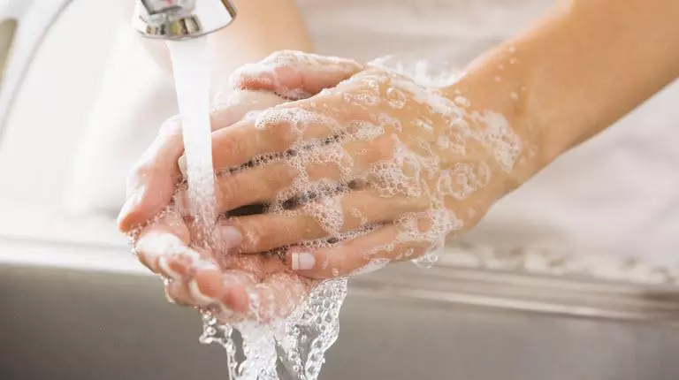
Notes:
Whether we are at home, out and about or at school, it is important to keep our hands clean.

Slide 3
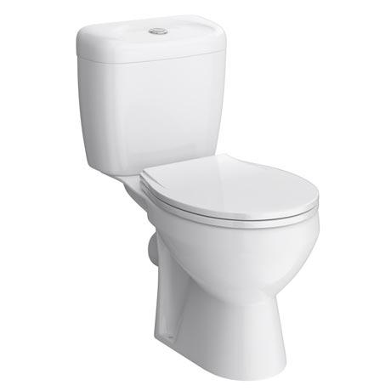
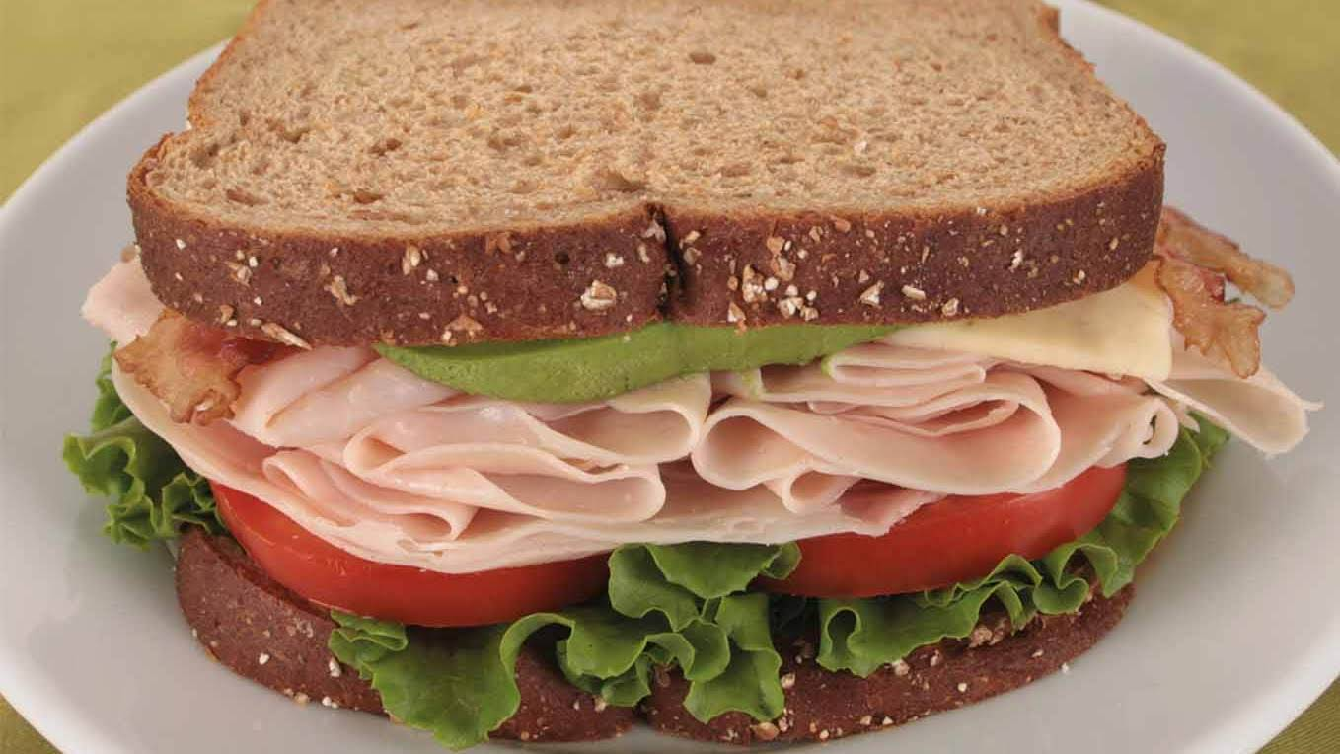
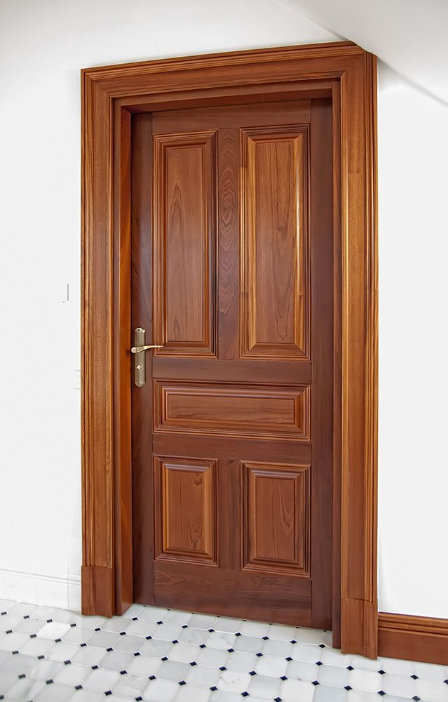
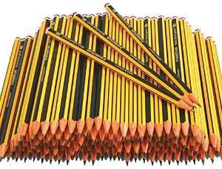
Why?
Notes:
Why? Well, we touch lots of things with our hands, like pencils, toilet seats, doors and food. So it’s important to keep our hands clean regularly.

Slide 4
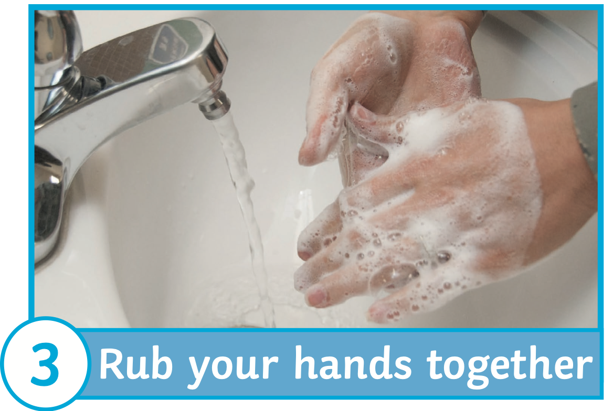
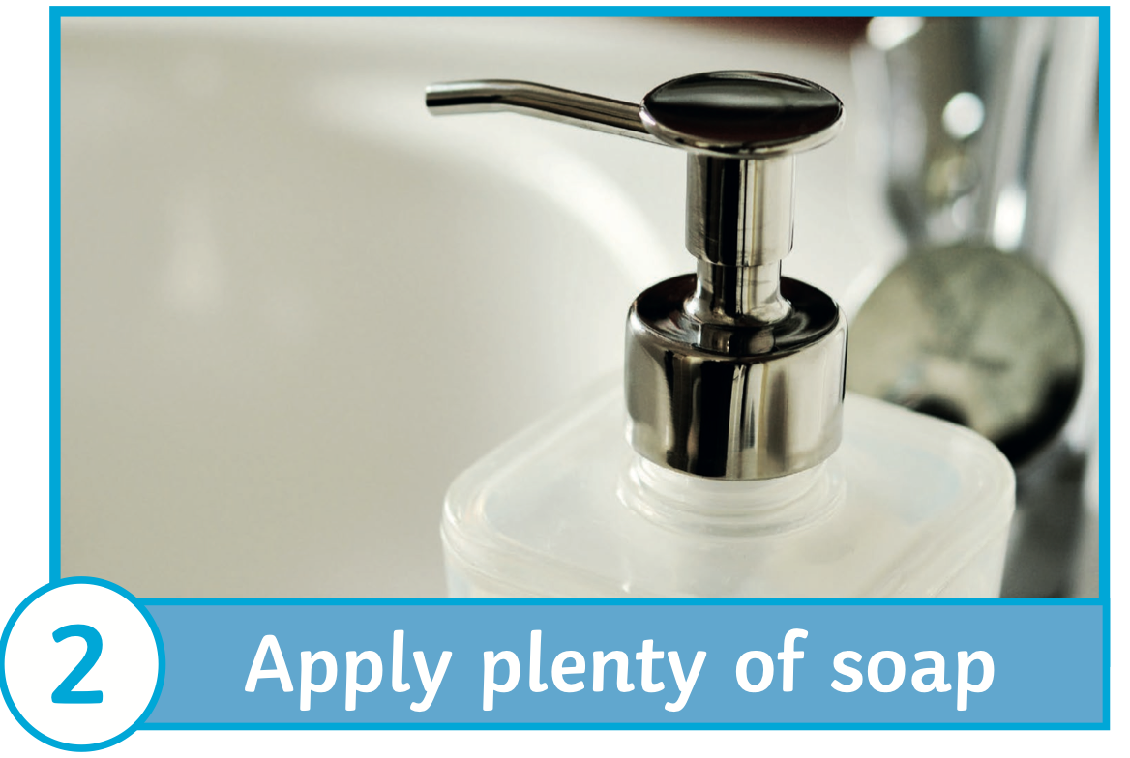
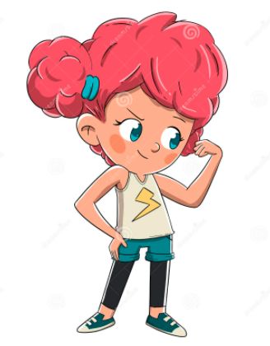
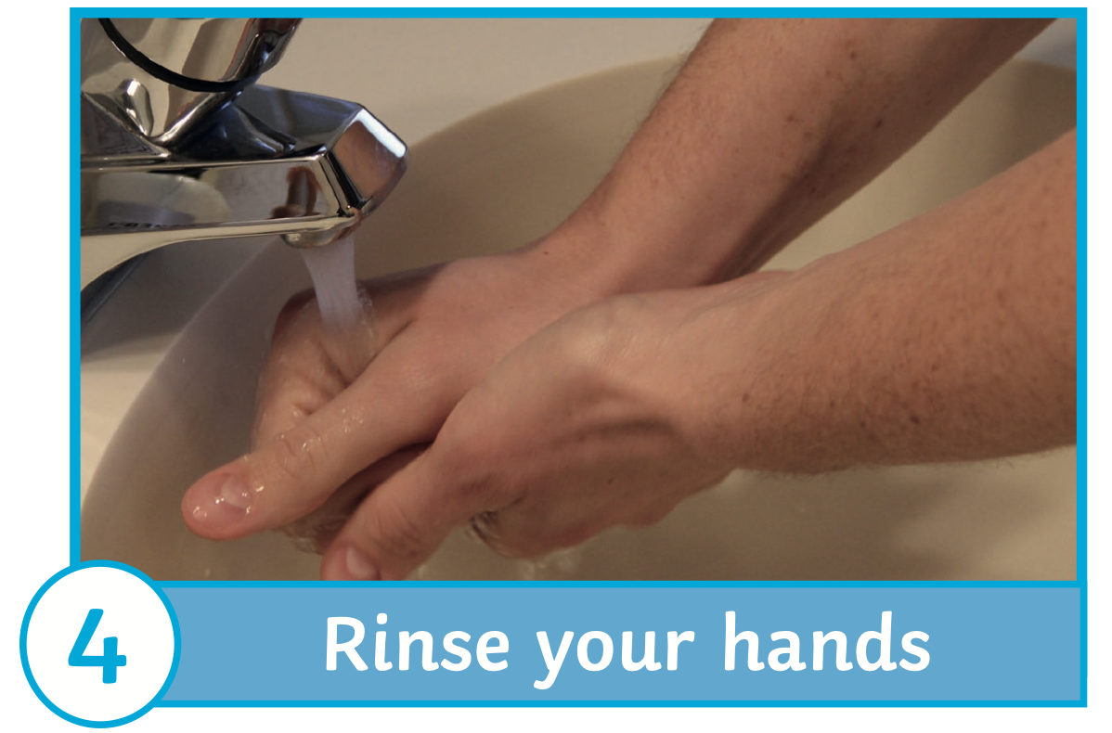
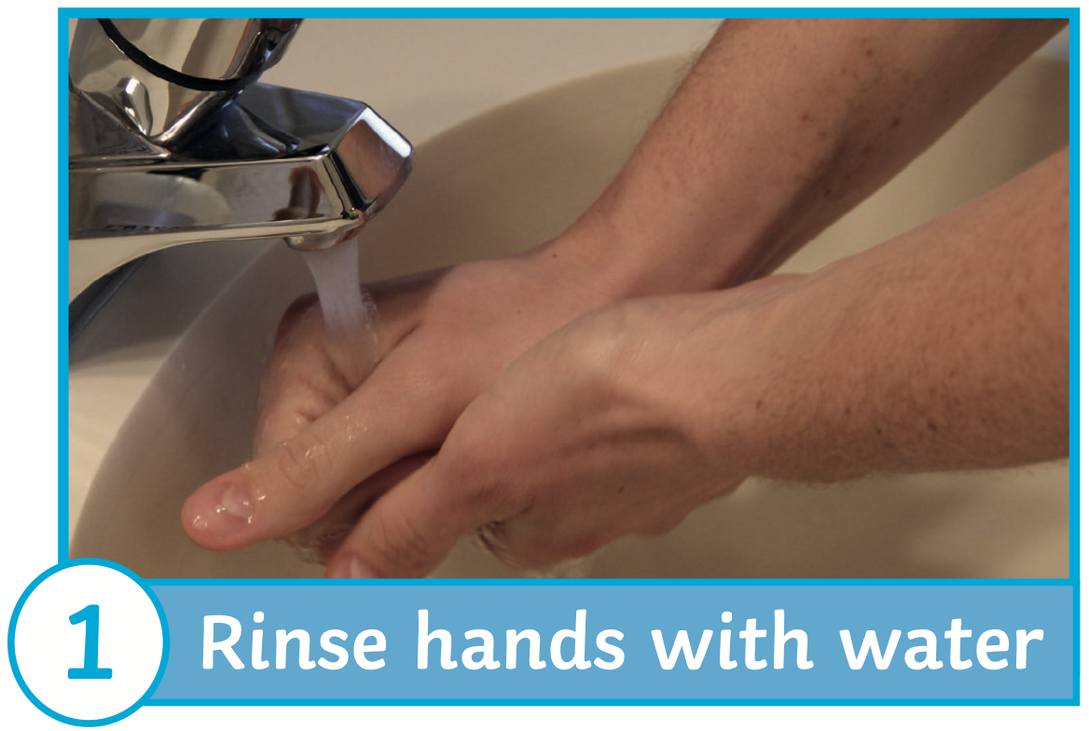
Wash your hands!
1
2
3
4
Notes:
Pip has made a poster to tell people how to wash their hands. Have a look, do you see anything wrong with it? Pip says that first you should rub your hands together with soap. Second, you should add plenty of soap. Third, you should rinse your hands and fourth, you should rinse your hands with water. How does that sound? Yes, they are in the wrong order!

Slide 5
Wash your hands!
1
2
3
4
Notes:
Can you put the numbers 1-4 in to show the correct order?

Slide 6
Wash your hands!
Notes:
Here are the answers!

Slide 7
Your turn:
Can you make a poster to show the correct order to wash your hands in?
Use this PowerPoint to help you if you need it.

Slide 8
Commentary:
Slide 2:
Whether we are at home, out and about or at school, it is important to keep our hands clean.
Slide 3:
Why? Well, we touch lots of things with our hands, like pencils, toilet seats, doors and food. So it’s important to keep our hands clean regularly.
Slide 4:
Pip has made a poster to tell people how to wash their hands. Have a look, do you see anything wrong with it? Pip says that first you should rub your hands together with soap. Second, you should add plenty of soap. Third, you should rinse your hands and fourth, you should rinse your hands with water. How does that sound? Yes, they are in the wrong order!
Slide 5:
Can you put the numbers 1-4 in to show the correct order?
Slide 6:
Here are the answers!

