Slide 1
Year 1 Geography - Seasons

Slide 2
The seasons There are 4 seasons, can you name them?

Slide 3
That’s right!
Spring Summer Autumn Winter

Slide 4
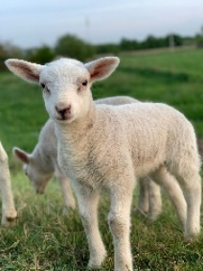
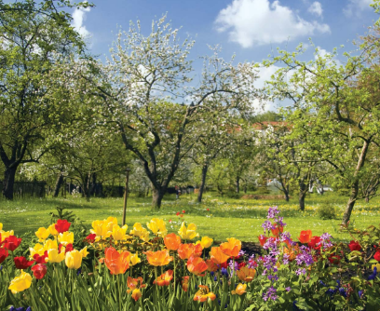
Spring
In spring the weather starts to get warmer and trees begin to grow their leaves. plants start to flower and young animals such as chicks and lambs are born.

Slide 5
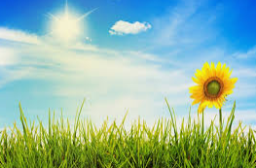
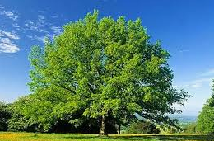
Summer
In summer the weather is usually warm, trees have full green leaves and the amount of time is it light for during the day is longer.

Slide 6
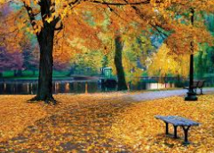
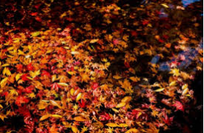
Autumn
In Autumn the weather begins to get colder some trees shed their leaves. The leaves change from green to red, orange, yellow or brown before falling. In addition, there is less sunlight because the days are shorter.

Slide 7
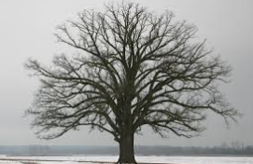
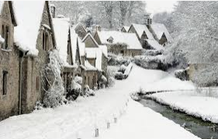
Winter
In winter we have colder weather, sometimes snow and frost, the trees have no leaves and the amount of time it is light during the day is at its shortest.

Slide 8
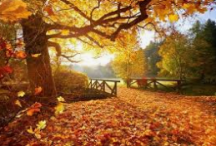
Here is a picture of Autumn, can you describe it to your grown up?

Slide 9
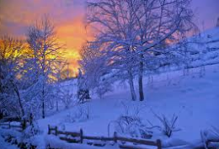
Here is a picture of Winter, can you describe it to your grown up?

Slide 10
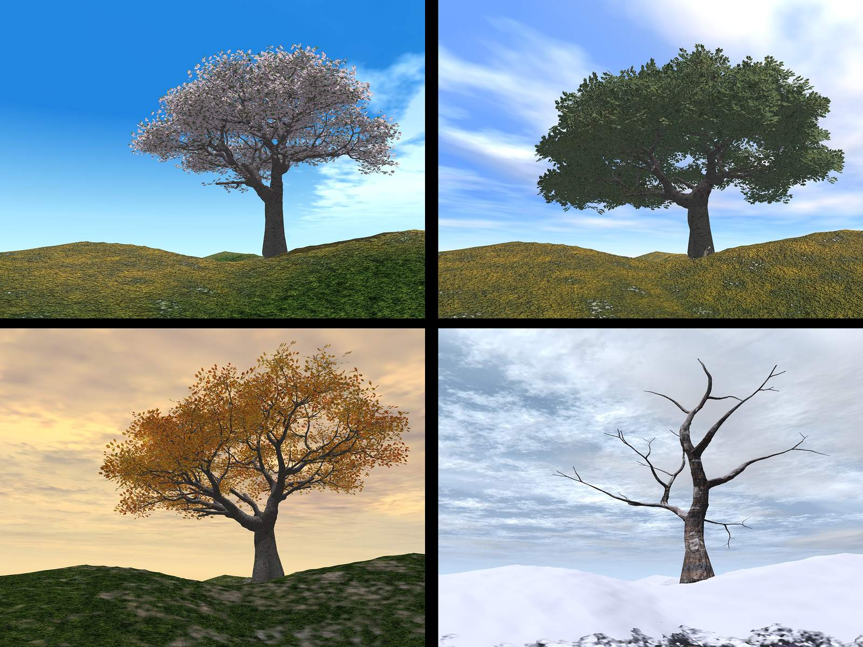
Trees in the seasons. Tell your grown up which season each tree is in.

Slide 11
That’s right.
Spring
Summer
Autumn
Winter

Slide 12
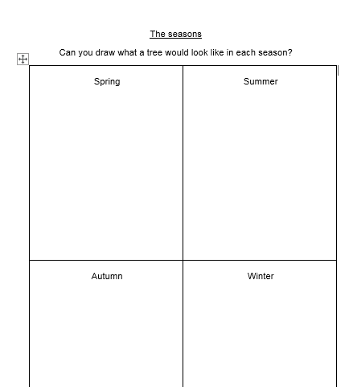
Now, have a go at the worksheet.

Slide 13
Slide 1 – Hello year 1, today we are going to recapping the seasons.
Slide 2 – There are 4 seasons, can you name them?
Slide 3 – That’s right, spring, summer, autumn and winter.
Slide 4 – Lets look at spring first. In spring the weather starts to get warmer and trees begin to grow their leaves. plants start to flower and young animals such as chicks and lambs are born.
Slide 5 - After spring it is summer. In summer the weather is usually warm, trees have full green leaves and the amount of time is it light for during the day is longer.
Slide 6 – Next it is autumn. In Autumn the weather begins to get colder some trees shed their leaves. The leaves change from green to red, orange, yellow or brown before falling. In addition, there is less sunlight because the days are shorter.
Slide 7 – Finally winter. In winter we have colder weather, sometimes snow and frost, the trees have no leaves and the amount of time it is light during the day is at its shortest.
Slide 8 - Here is a picture of autumn, can you describe it to your grown up?
Slide 9 - Here is a picture of winter, can you describe it to your grown up?
Slide 10- Here are trees in the 4 seasons. Tell your grown up which season each tree is in.
Slide 11- That’s right, spring, summer, autumn and winter.
Slide 12 – Now have a go at the worksheet.

