Slide 1
Learning intention – To observe and understand world population over time

Slide 2
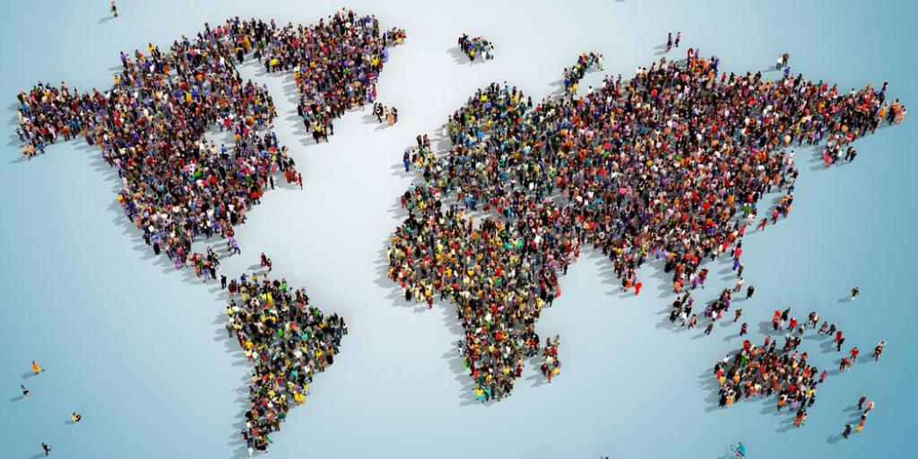
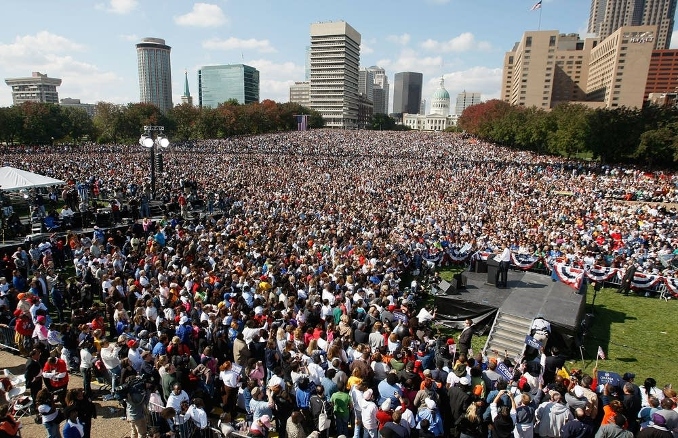
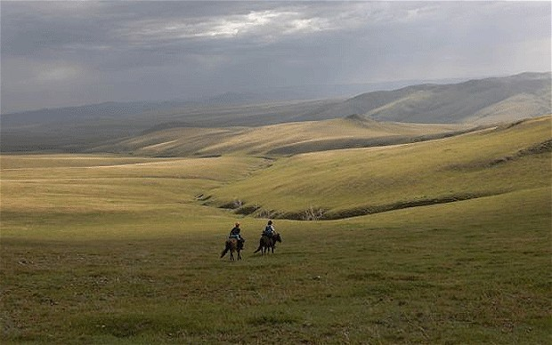
Key Vocabulary
Population - the whole number of people living in a country, city, or area.
Dense - The population density of a country or city or other place is a number showing how crowded that place is.
Sparse - The population is thinly scattered across a country or city.
Growth - Population growth is the increase in the number of individuals in a population.

Slide 3
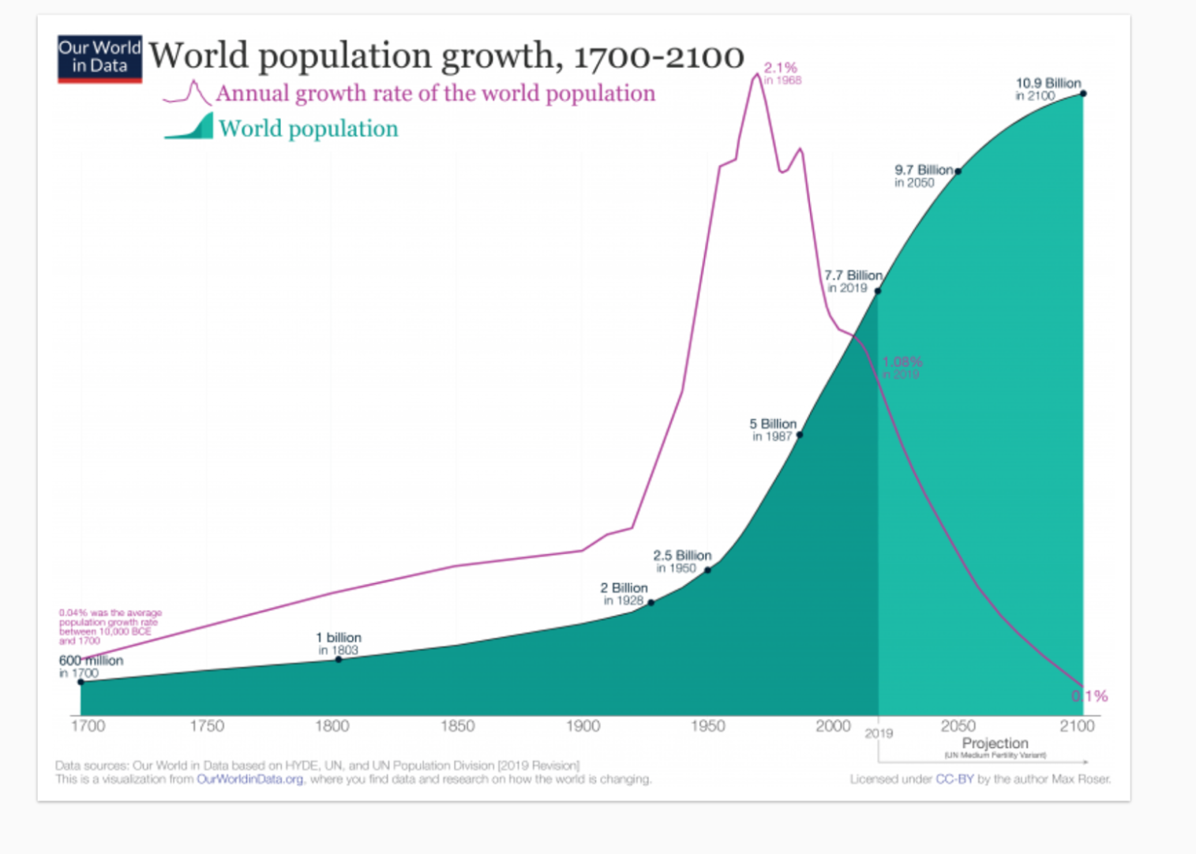
Look at the graph below and analyse the information to identify the true and false statements.

