Slide 1
Year 1
PSHE Keeping safe on the metros
Learning intention: To learn about how to keep safe near rail tracks

Slide 2
Notes:
What is this?

Slide 3
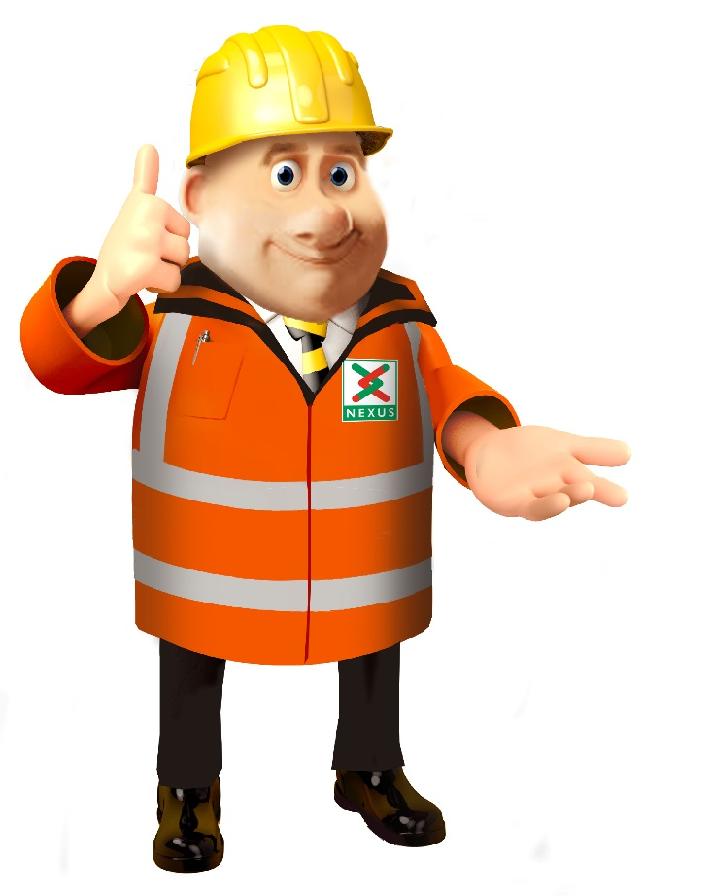
Notes:
That’s right, it’s the Nexus Metro Map. This is Ben, he works for Nexus and he has an important announcement to make.

Slide 4
15 Feb
28 Feb
Notes:
Between the 15th February and 28th February, the trains between some platforms have to STOP!

Slide 5
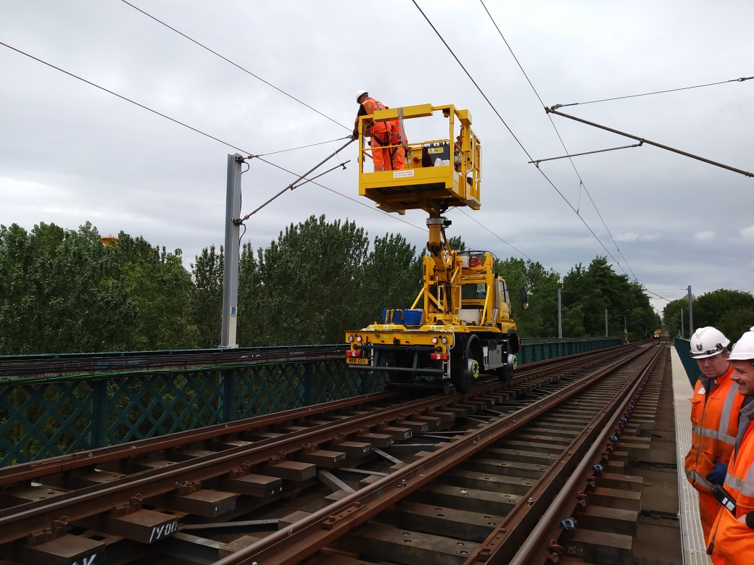
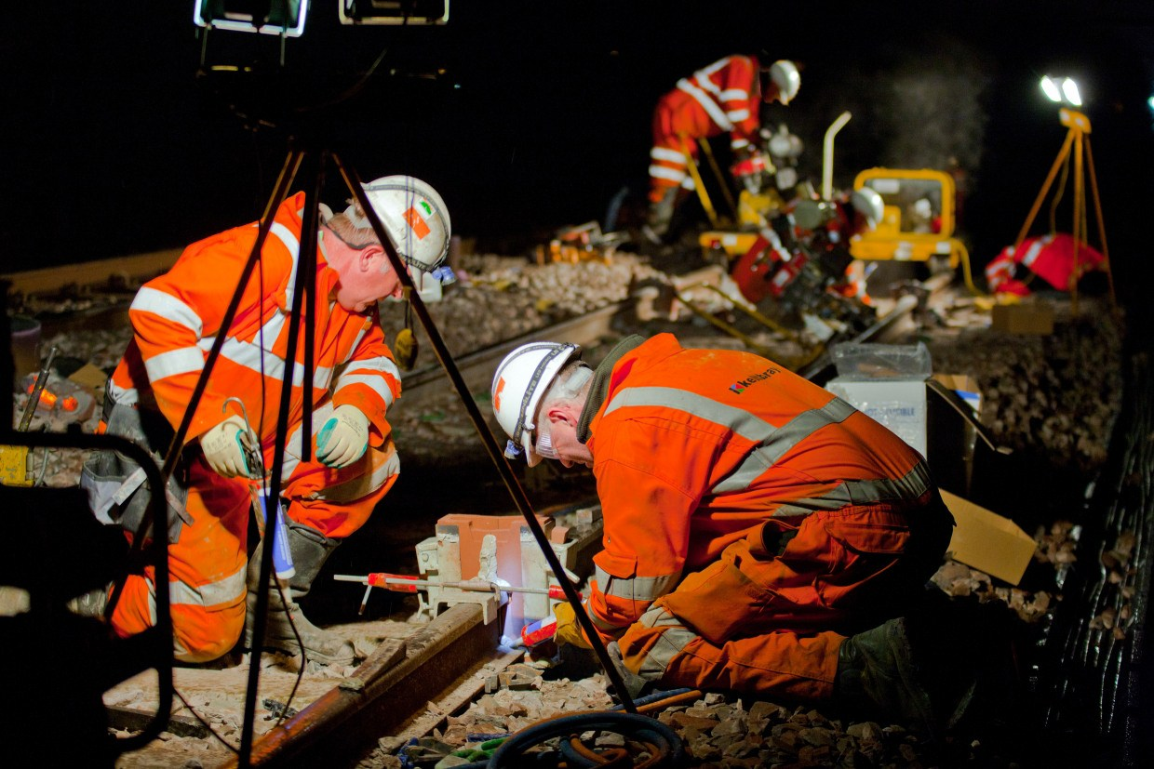
Day
Night
Notes:
The engineers will be working day and night in the busiest area of the Metro, they call it the central corridor.

Slide 6
What do you think we are going to be doing?

Slide 7
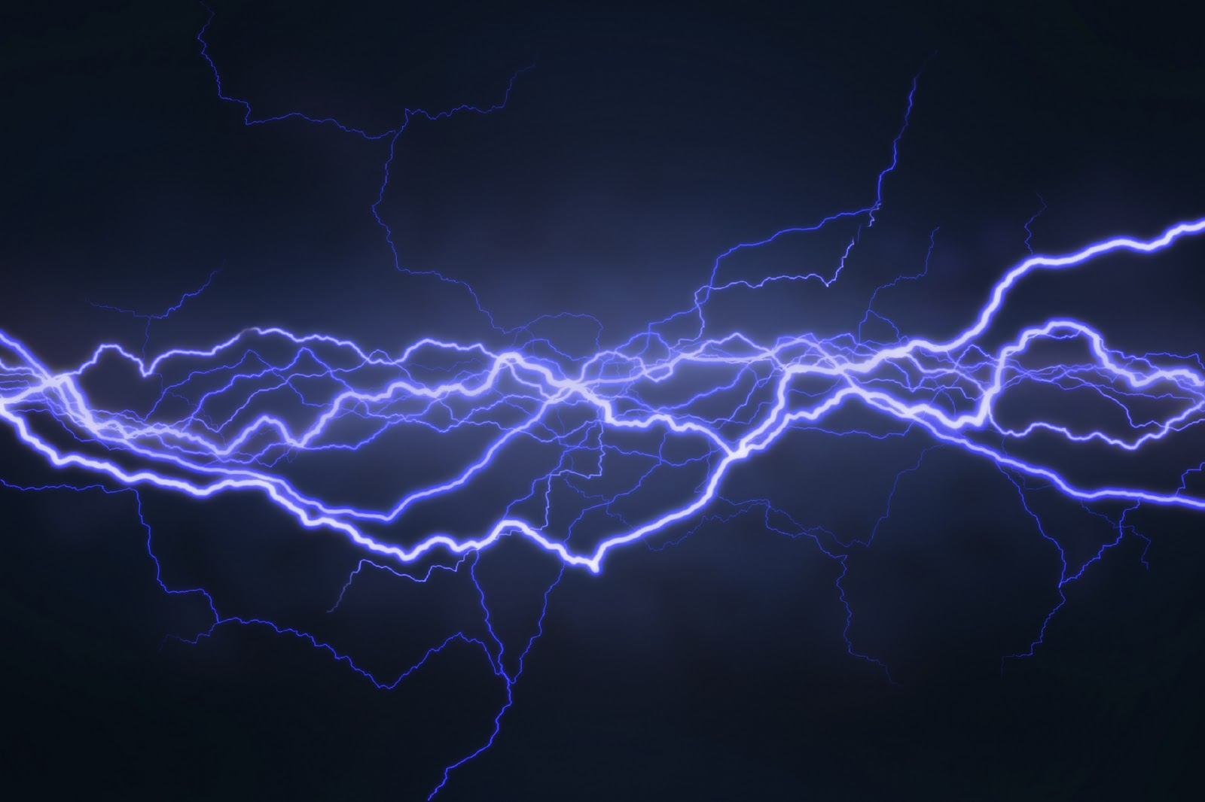
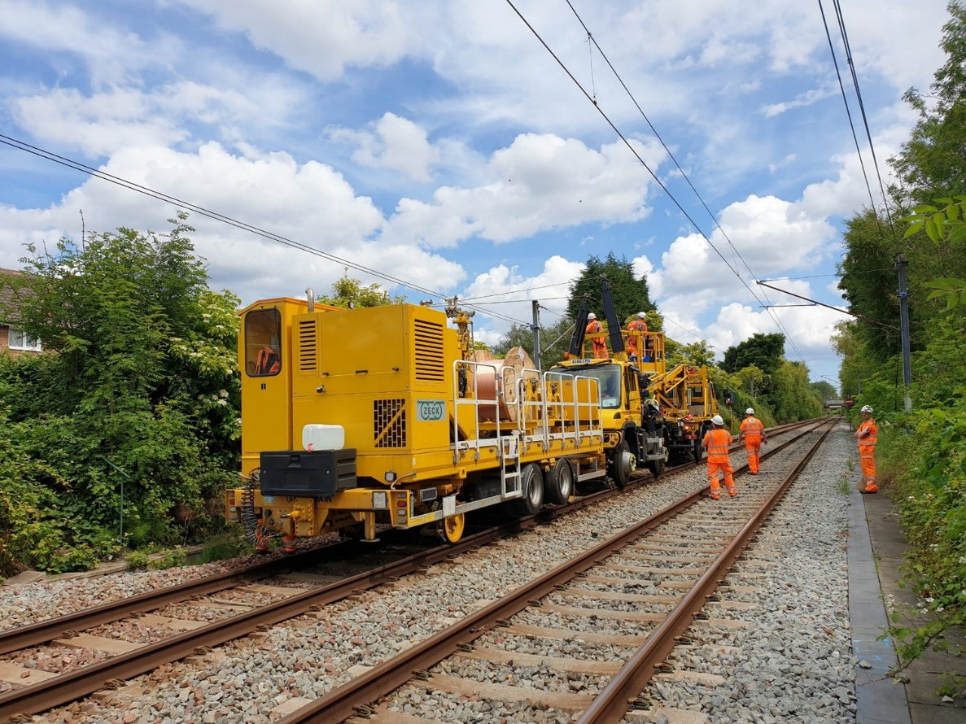
We need to replace the overhead lines.
Electricity →
Overhead Lines
Notes:
Electricity is carried in overhead lines. Just like lightening it can jump up to 1 metre.
We need to replace them to help the metro work well.

Slide 8
Overhead lines carry electricity to help the trains move.
Notes:
Overhead lines carry electricity to help the trains move, but wait a minute…

Slide 9
Electricity is very strong.
What might happen if you touched an overhead line?
Notes:
Electricity is very strong, powerful and dangerous. What might happen if you touched an overhead line? Remember, they have electricity running through them!

Slide 10
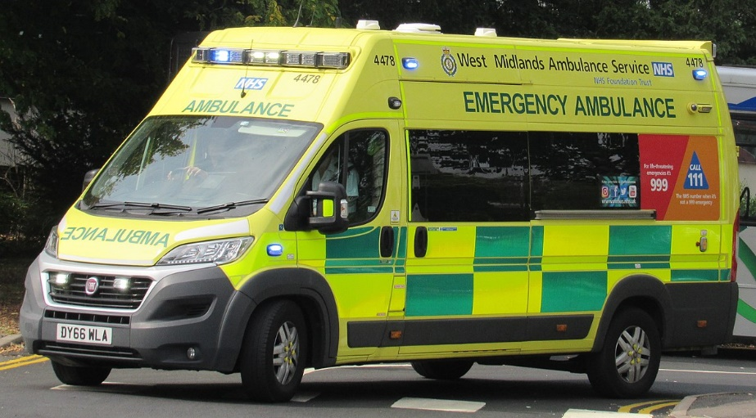
We all need to keep safe!
How can we do it?
Notes:
That’s right, you could get hurt and in trouble and nobody wants that. So, we all need to keep safe. I wonder, how can we do that?

Slide 11
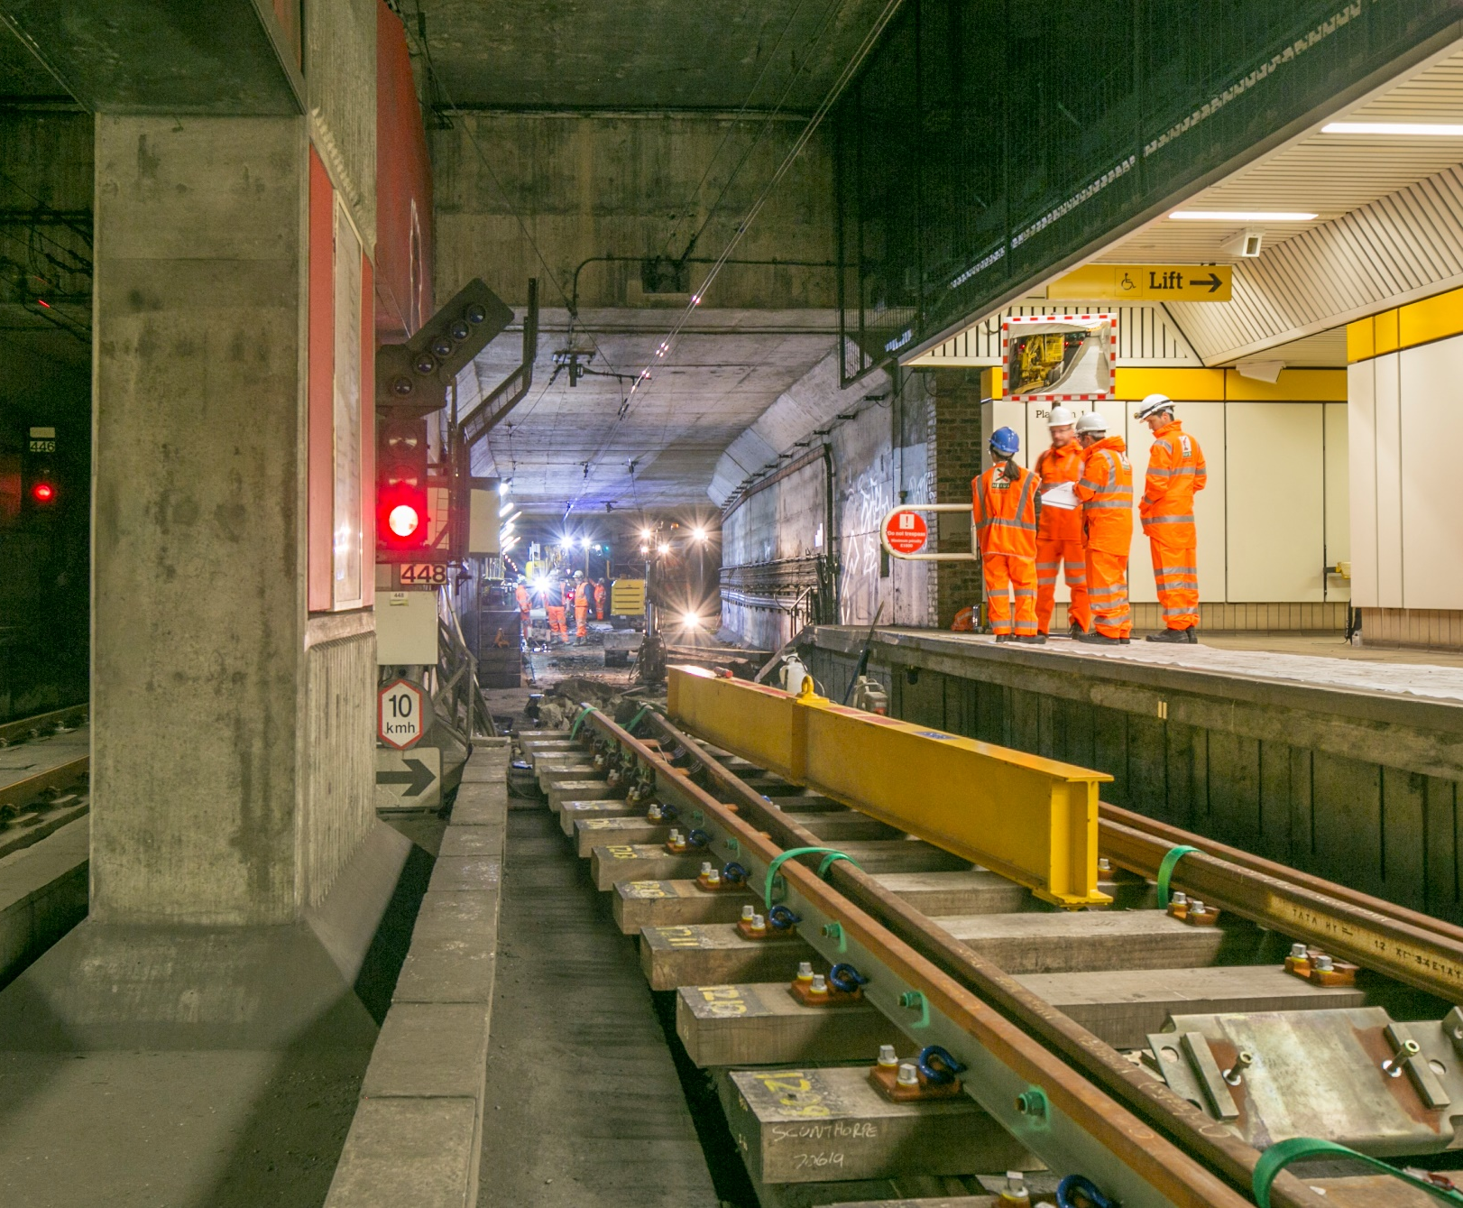
Notes:
The engineers working wear helmets, strong shoes, special gloves and clothes that are bright and safe. They go in and out of the tunnels, so they need to be seen by the driver. We don’t need to wear them when we go to the metro, because we stay on the platform.

Slide 12
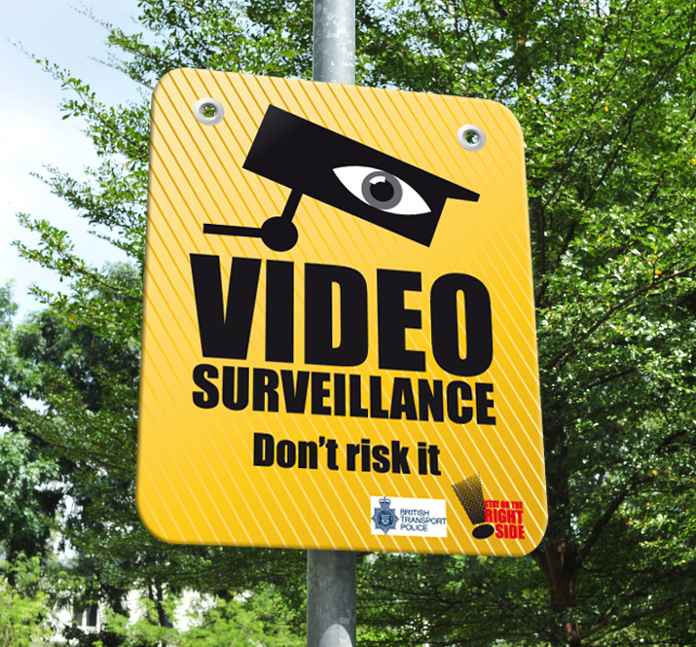
Notes:
Nexus have lots of CCTV Cameras that watch to make sure no-one is doing anything dangerous like touching wires and electrics.

Slide 13
Notes:
Signs are around the Metro to tell people to stay on the right side of the fences and stay away from electricity in the wires.

Slide 14
Can you help us design a poster to help people keep safe?

Slide 15
Commentary:
Slide 2 – What is this?
Slide 3 - That’s right, it’s the Nexus Metro Map. This is Ben, he works for Nexus and he has an important announcement to make.
Slide 4 - Between the 15th February and 28th February, the trains between some platforms have to STOP!
Slide 5 - The engineers will be working day and night in the busiest area of the Metro, they call it the central corridor.
Slide 7 - Electricity is carried in overhead lines. Just like lightening it can jump up to 1 metre.
We need to replace them to help the metro work well.
Slide 11 - The engineers working wear helmets, strong shoes, special gloves and clothes that are bright and safe. They go in and out of the tunnels, so they need to be seen by the driver. We don’t need to wear them when we go to the metro, because we stay on the platform.
Slide 12 - Nexus have lots of CCTV Cameras that watch to make sure no-one is doing anything dangerous like touching wires and electrics.
Slide 13 - Signs are around the Metro to tell people to stay on the right side of the fences and stay away from electricity in the wires.

