Slide 1
Year 5
Science: Friction

Slide 2
Can you remember what a force is?
push
pull
twist
Science.

Slide 3
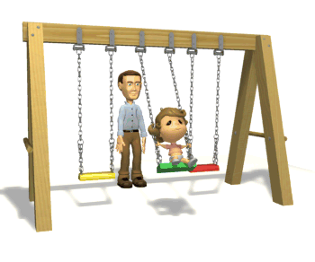
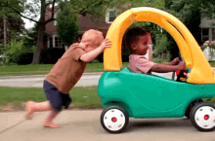
What can a force do?
move
speed
direction
Science.

Slide 4
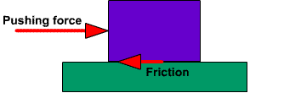
Friction
Science.

Slide 5
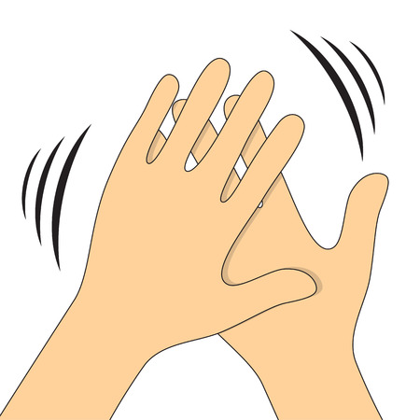
Friction
Science.

Slide 6
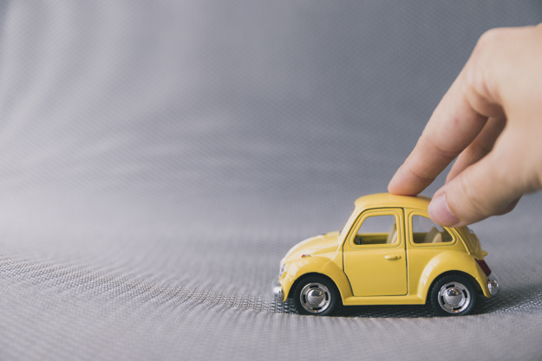
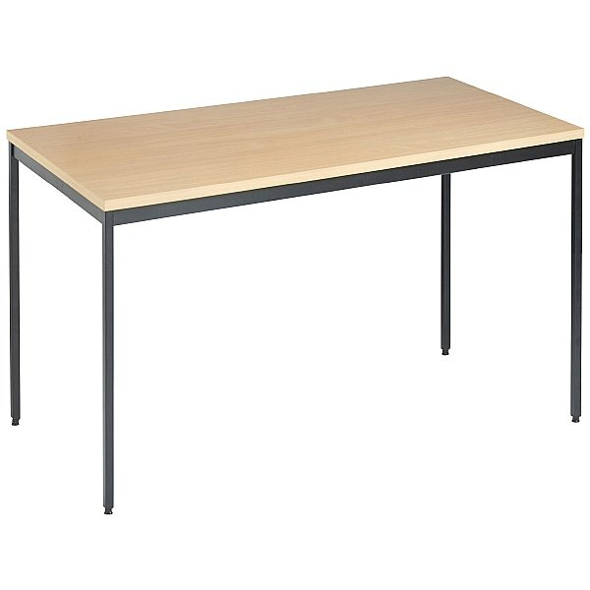
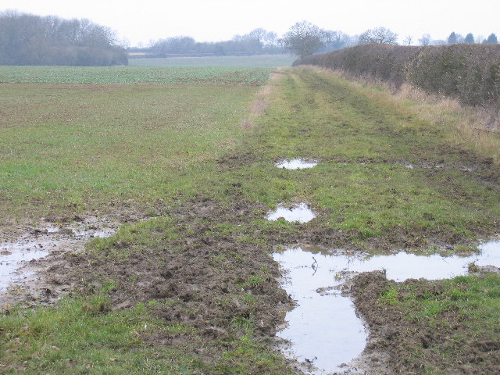
Make a prediction.
Science.

Slide 7
Science.

Slide 8
Time for a quiz.
What is a force?
Push
Pull
Twist
Science.

Slide 9
Time for a quiz.
True or false?
Friction is a force which pushes in the same direction as a moving object.
False!
Friction always pushes in the opposite direction to the way the object is moving.
Science.

Slide 10
Time for a quiz.
True or false?
Friction slows objects down.
True!
Friction always slows objects down and it never speeds them up.
Science.

Slide 11
Time for a quiz.
True or false?
There is more friction on smooth surfaces.
False!
There is less friction on smooth surfaces so objects move quicker and easier on them.
Science.

