Slide 2
THINK
What do you know about the
rainforest?
Where are rainforests located
on Earth?
3. What animals live there?

Slide 3
Which is the largest rainforest in the world?

Slide 4
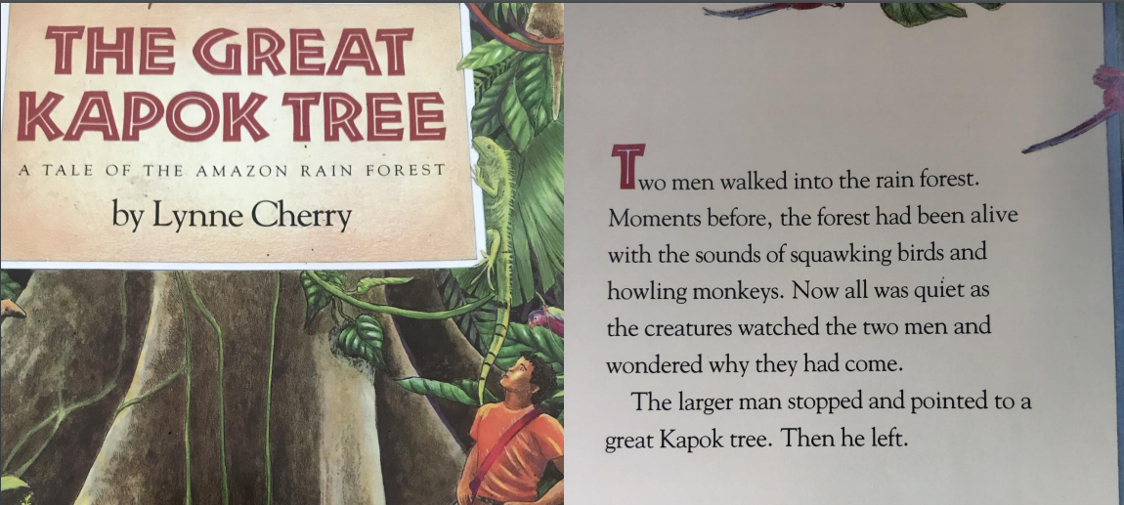
Sounds of the rainforest

Slide 5
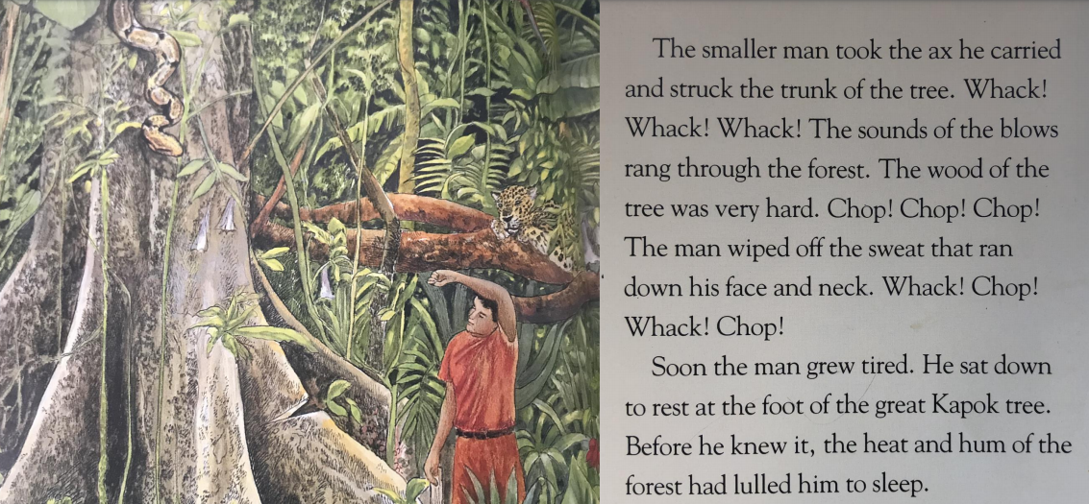

Slide 6
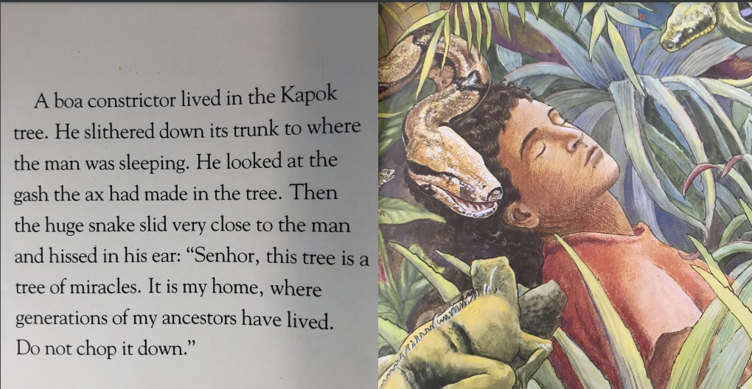

Slide 7
Now it’s your turn
In the Amazon ………1………. it is always hot and in the ……2……. everything grows, and grows and grows. The tops of the trees in the rainforest are called the canopy. It is a sunny place that ……3……… the sky. The animals that live there like lots of light. Colourful parrots ……. 4……. from tree to tree. Monkeys …… 5……from branch to branch. The bottom of the rainforest is called the understory. The animals that live there like …… 6……...
There silent snakes curl around hanging …….7……. Graceful jaguars watch and wait. In this hot …….8……. the great Kapok tree grows up through the forest and ….9………above the canopy.
darkness leap heat
branches fly
grows touches
rainforest place

