Slide 1
Learning intention: To order and arrange combinations of mathematical objects in patterns and sequences.

Slide 4
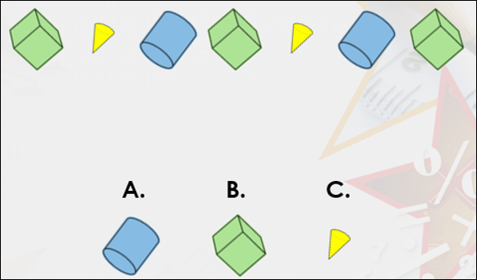
Which shape will come next in the pattern?

Slide 6
True or false?
Say the name of the shape as you look at the pattern.

Slide 7
True or false?
Say the name of the shape as you look at the pattern.

Slide 8
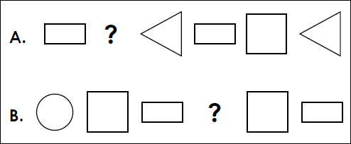
What would the missing shape be?
Say the pattern out loud to help you then you can tell an adult the answer or draw it on a piece of paper.

