Slide 1
LI: To explore the story of Chinese New Year

Slide 2
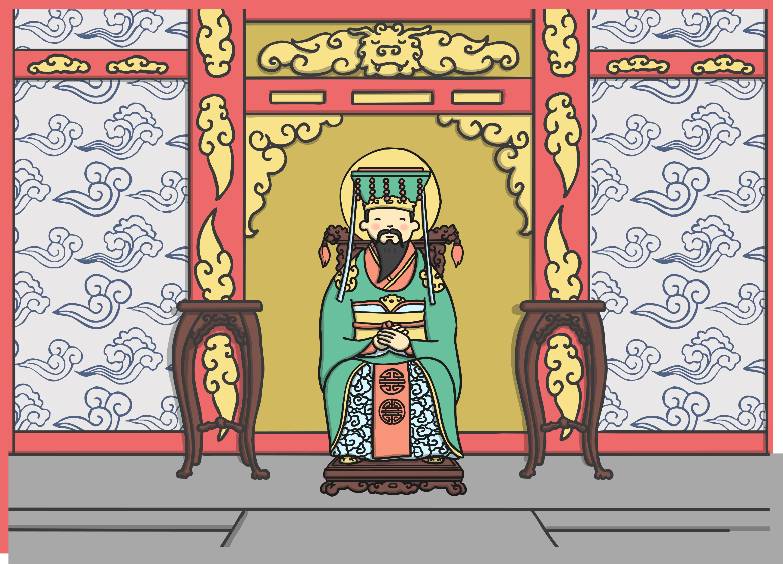
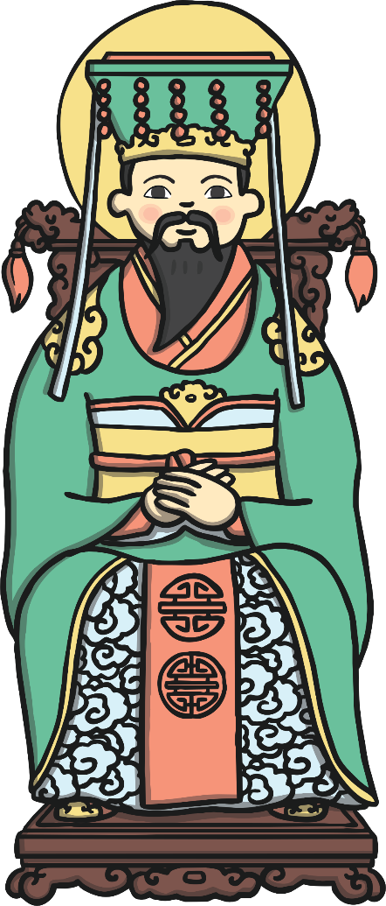
A long time ago, in China, the Jade Emperor decided there should be a way to measure time. He told the animals that they were to compete in a race. The first twelve animals would be rewarded by having a year named after them.

Slide 3
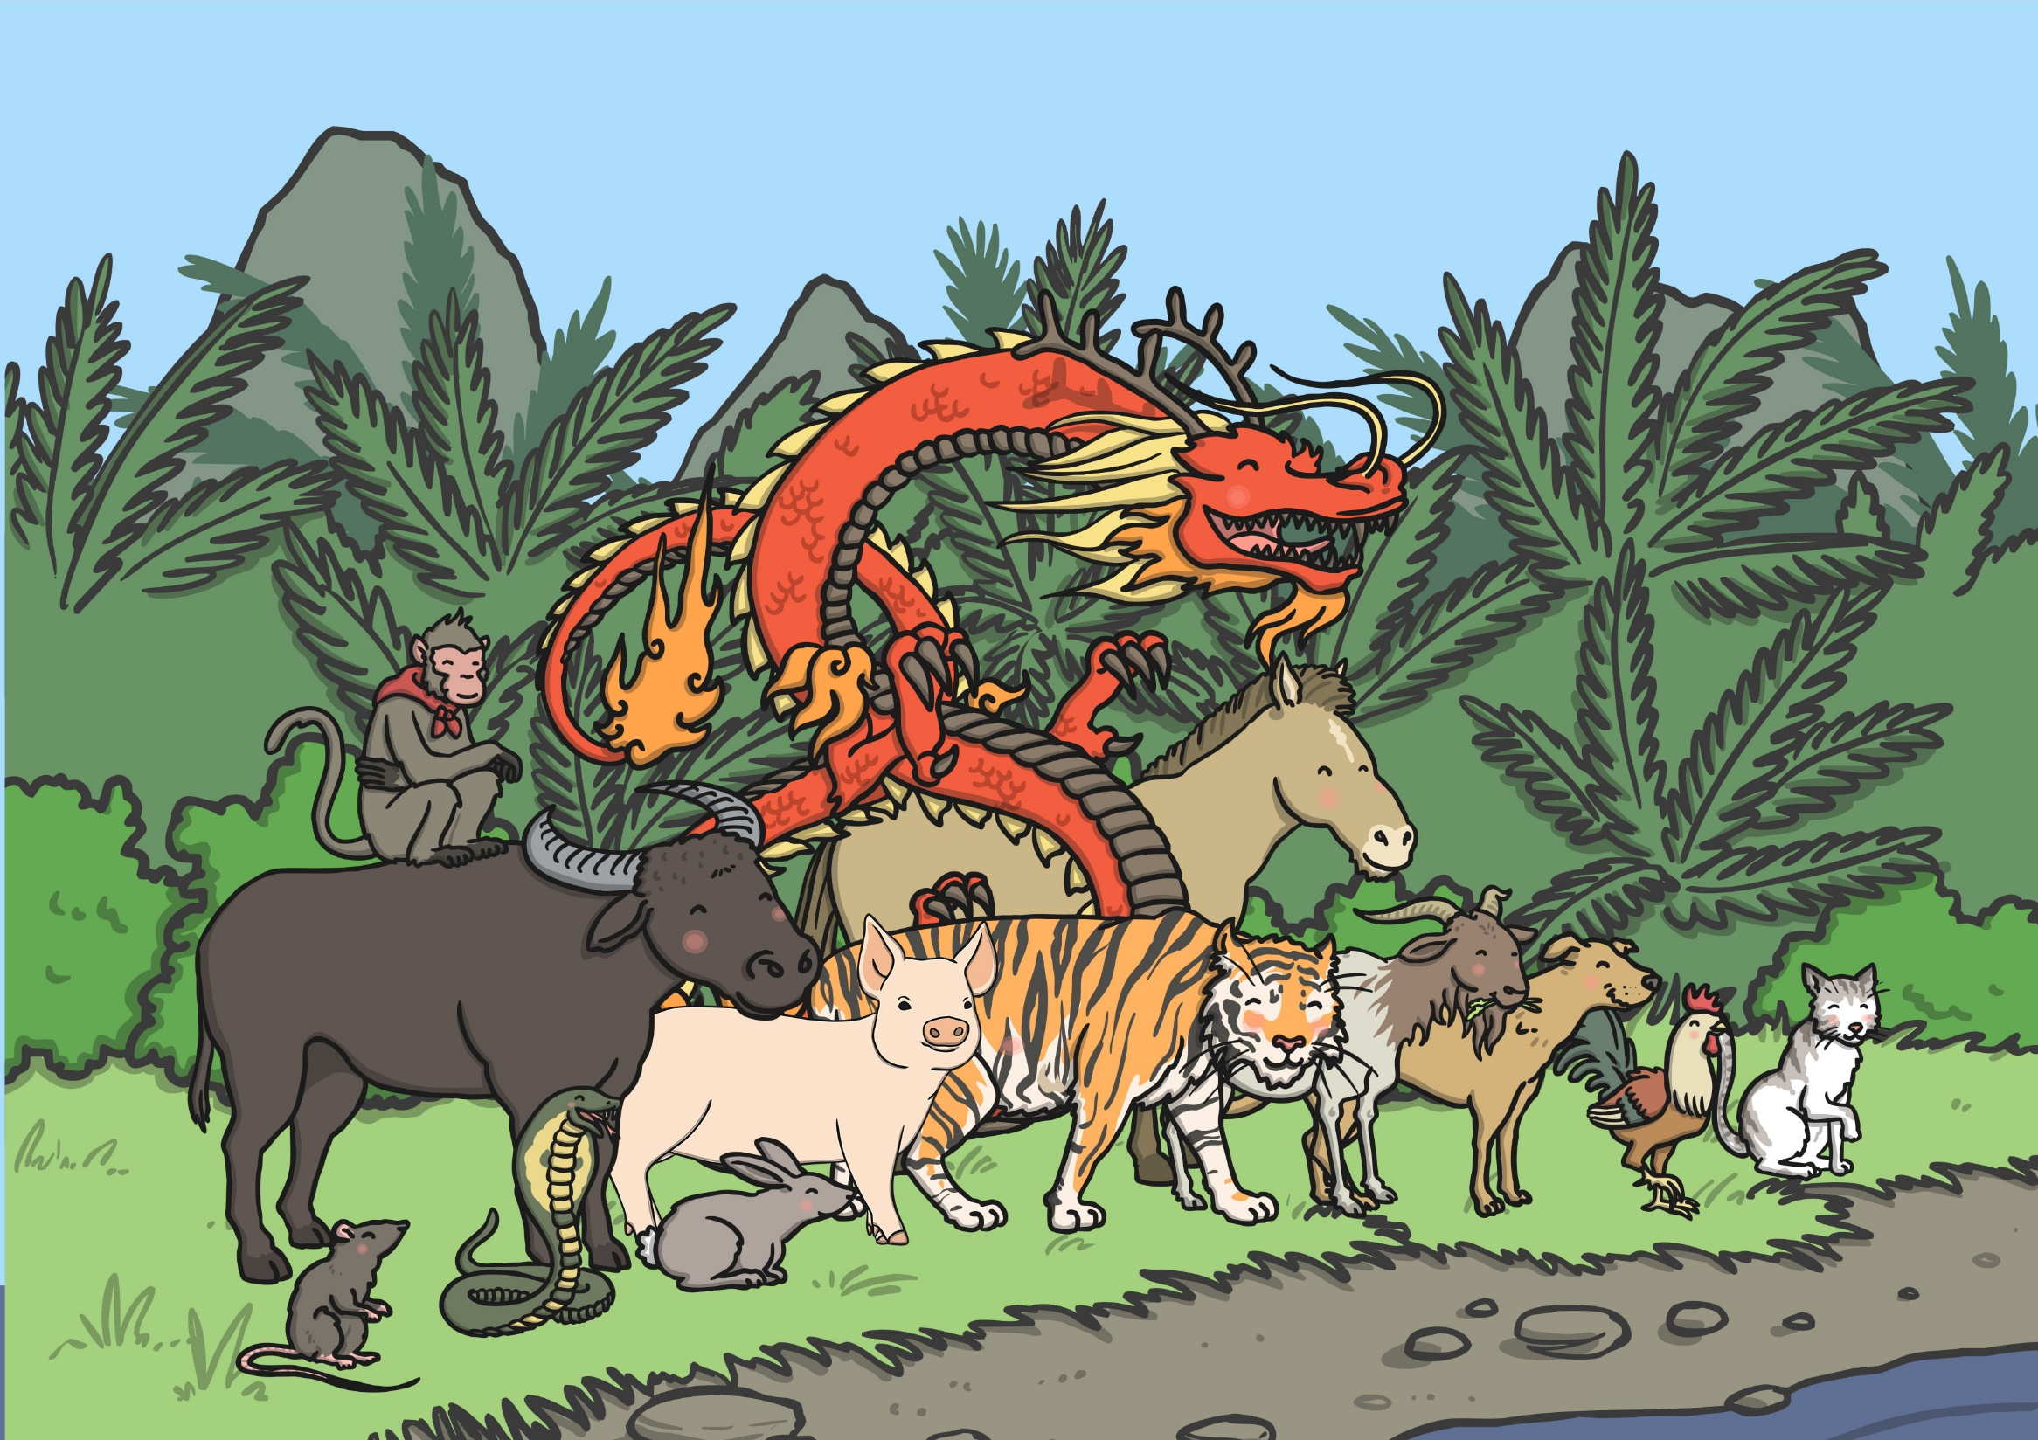
On the day of the race, all the animals lined up beside the river. The rat and the cat, who were good friends, were worried as they were not very good at swimming. They asked the ox if he would carry them across on his back.

Slide 4
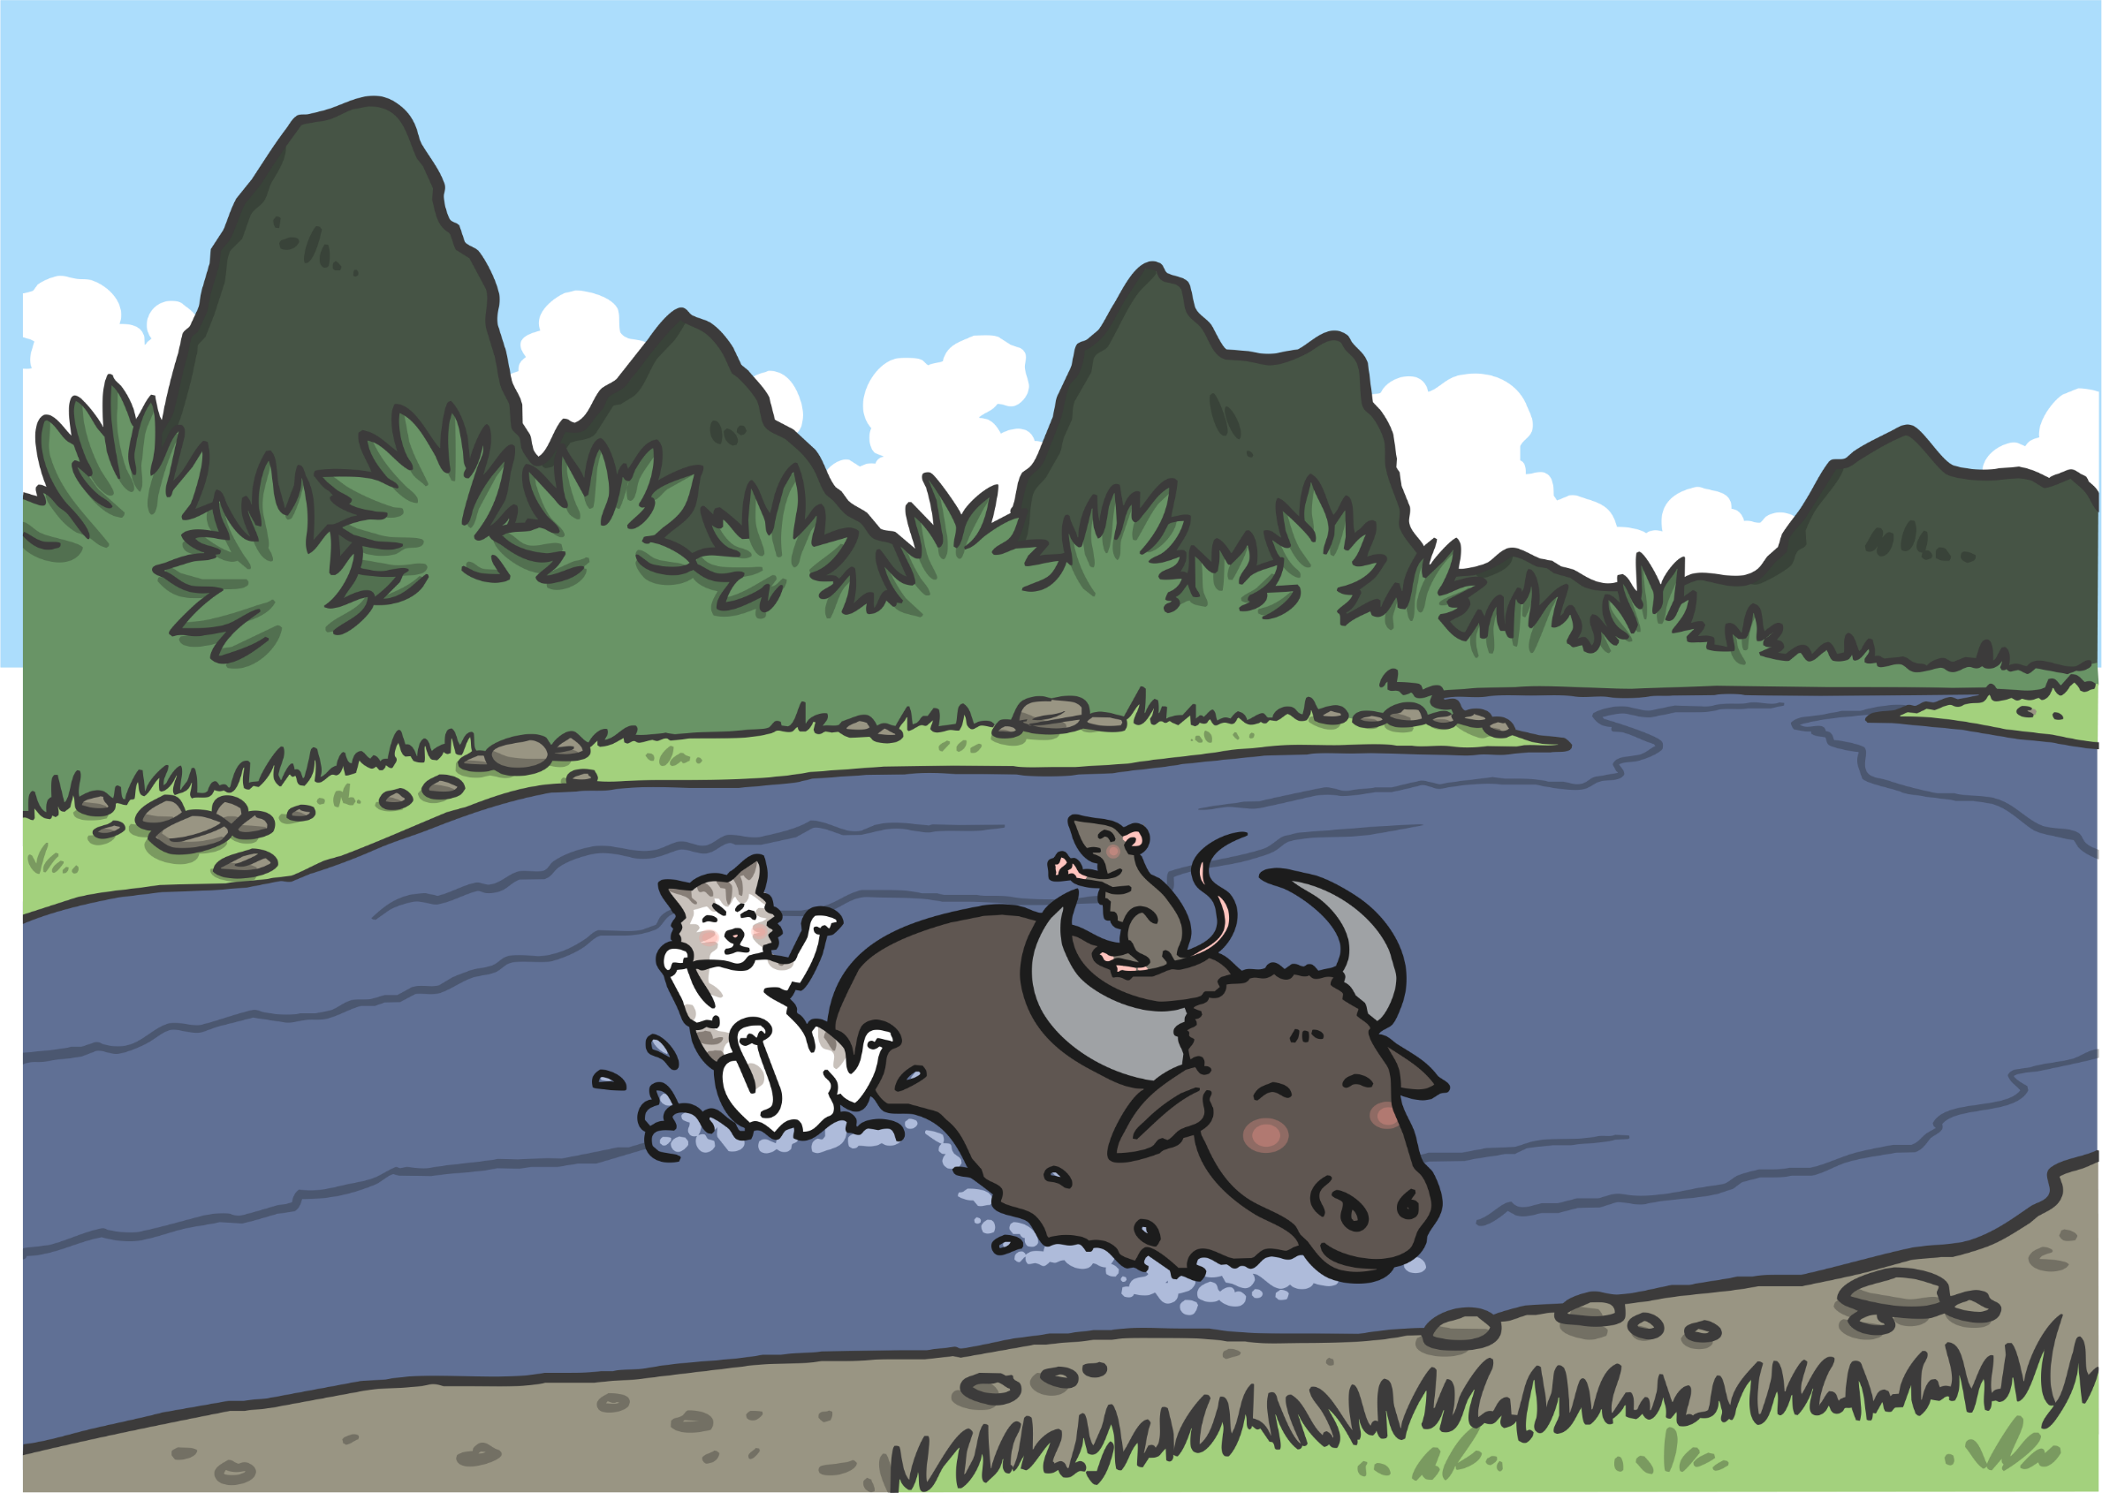
The ox agreed and they jumped on his back. When the race started, the rat and the cat were very pleased that the ox had taken the lead. They were almost across at the other side when the rat pushed the cat into the water and jumped on the bank to finish first!

Slide 5
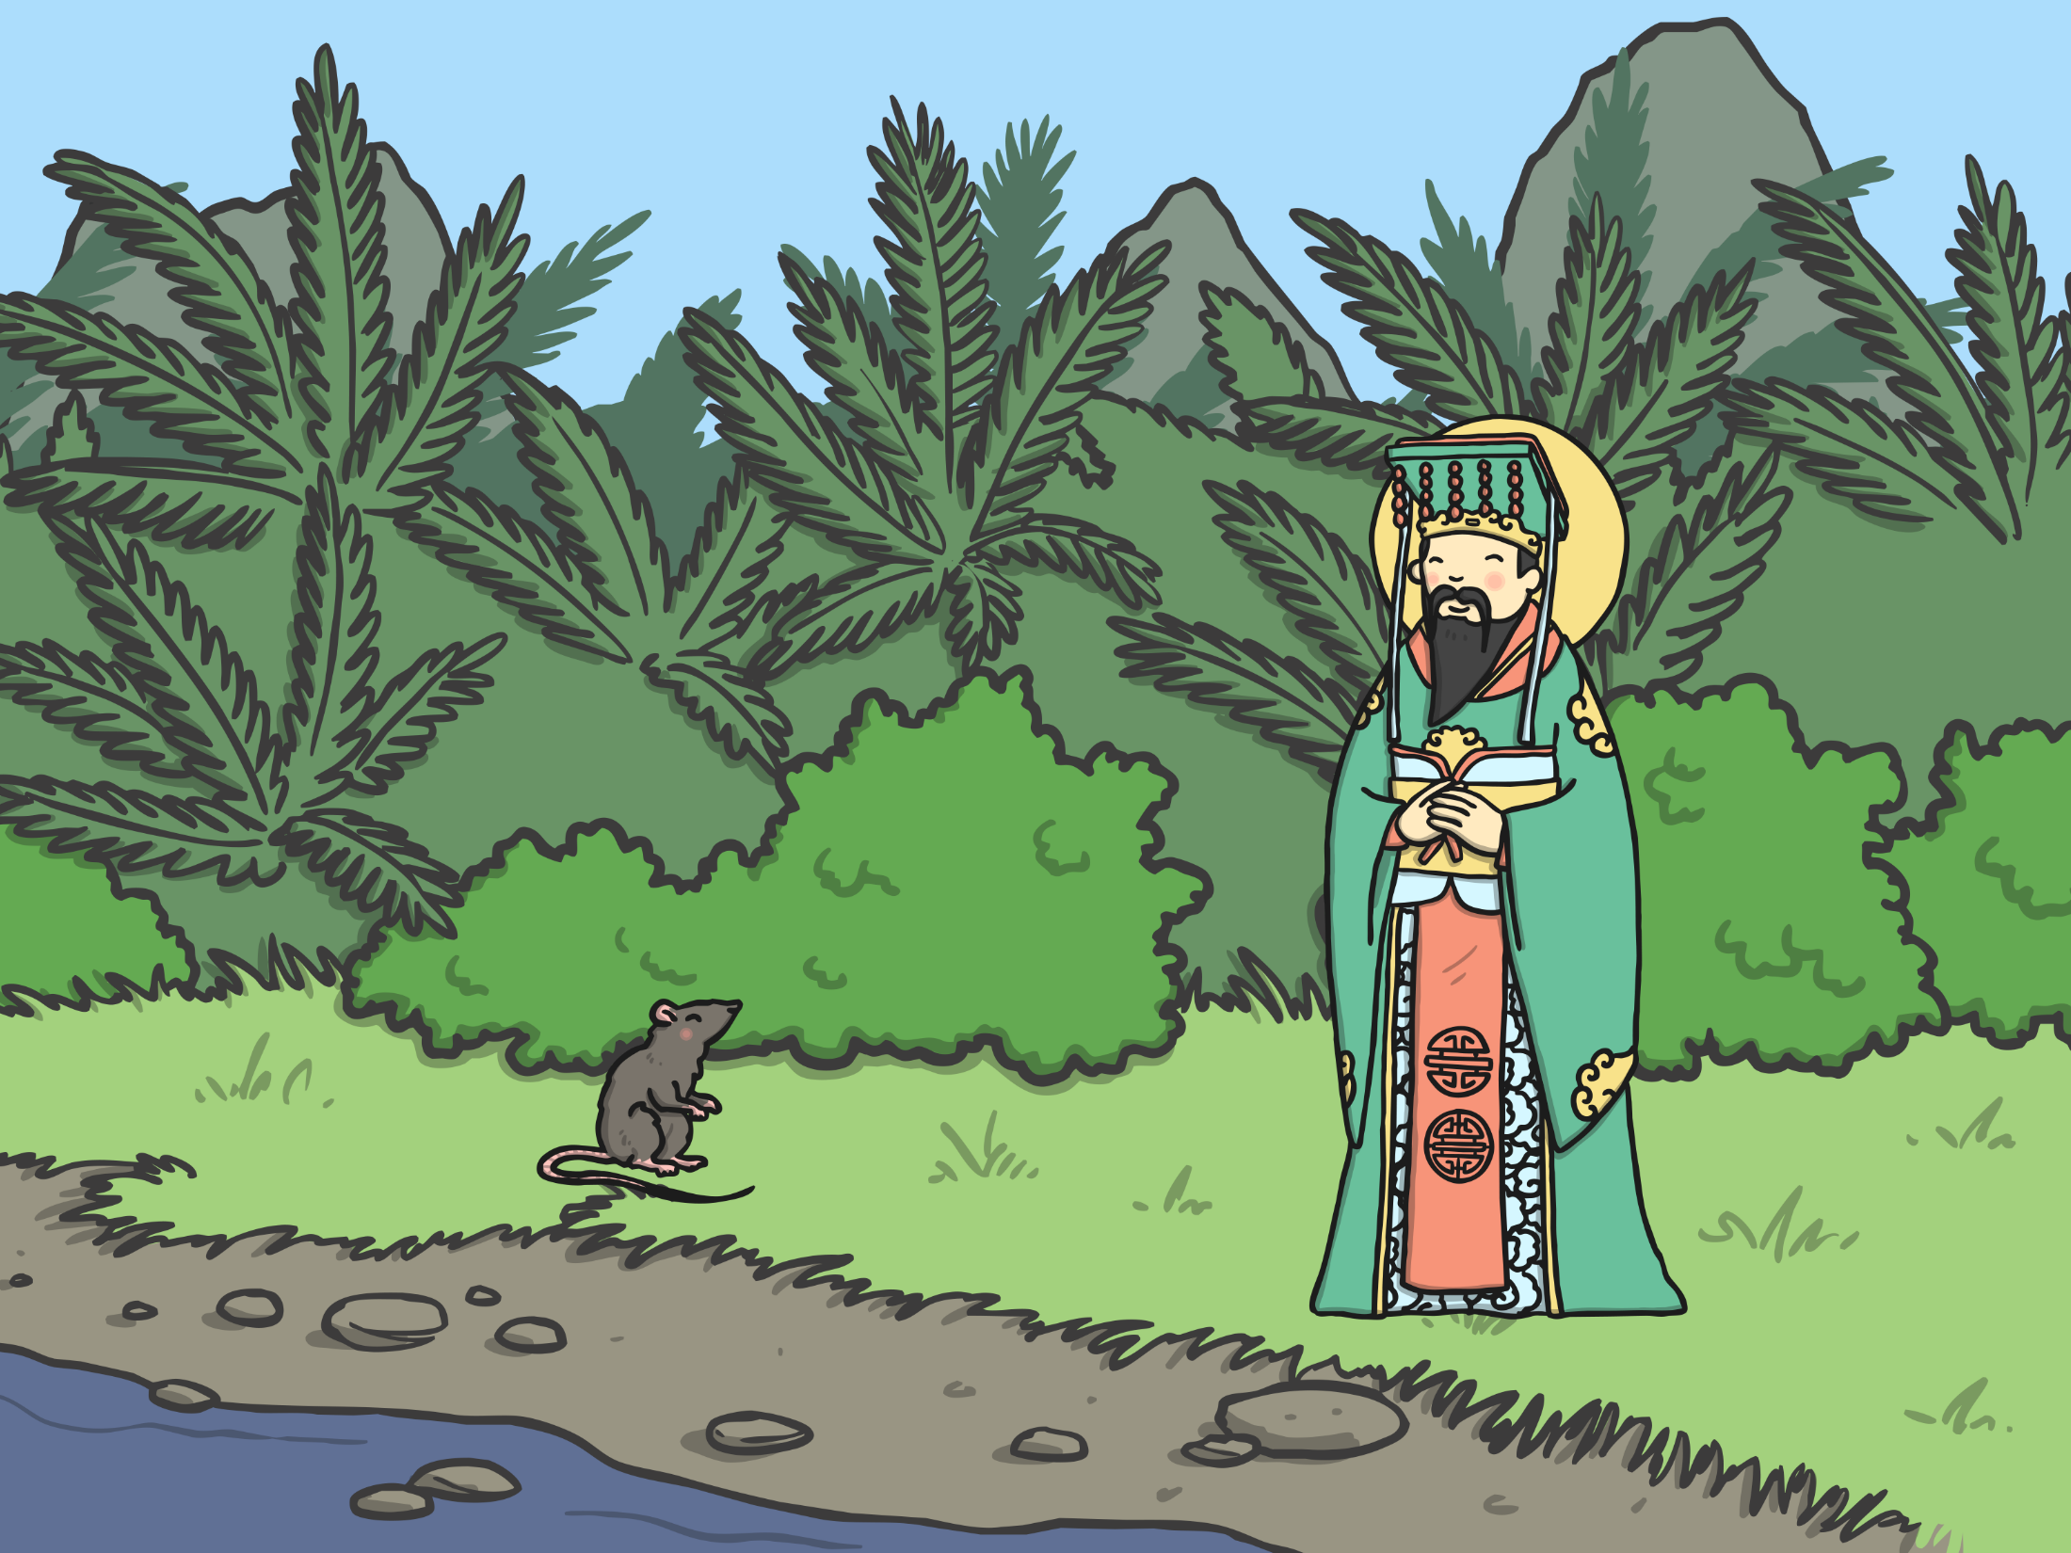
“Well done!” said the Jade Emperor to the rat. “The first year of the Zodiac will be named after you.” The poor ox was tricked into second place and so the second year of the Zodiac was named after him.

Slide 6
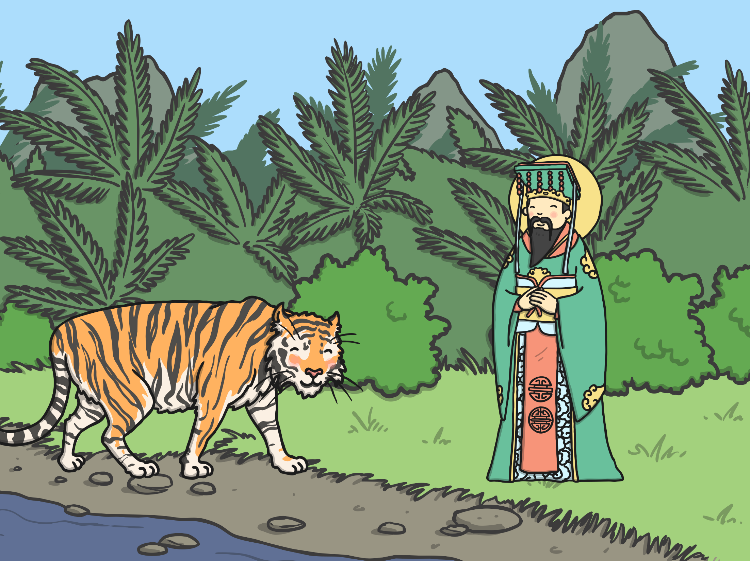
Shortly after, the exhausted tiger arrived on the river bank. Swimming the river had been very difficult, as he had to fight strong currents.

Slide 7
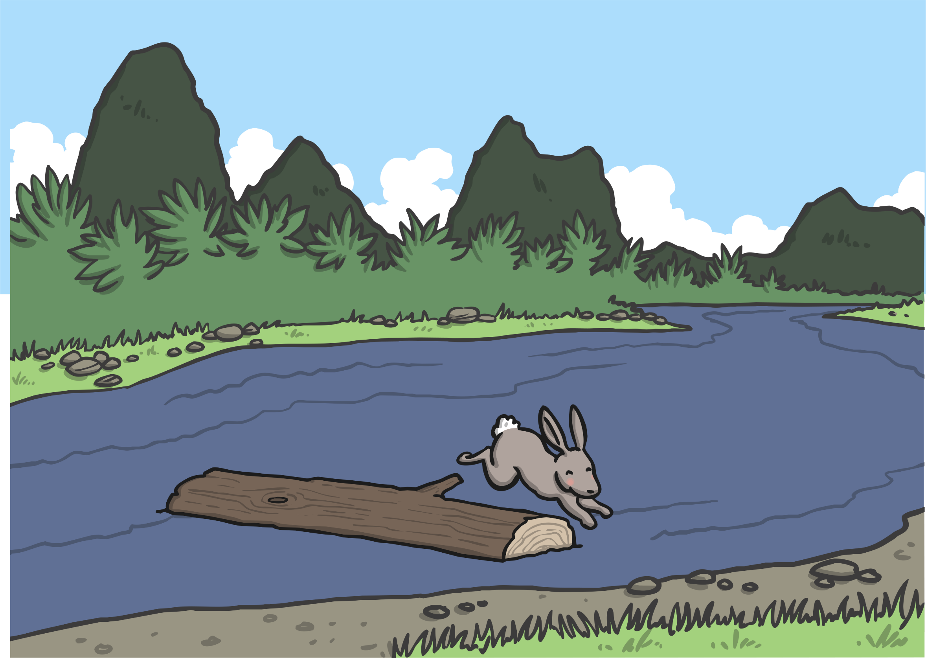
The next to arrive was the rabbit, who hadn’t swum across but hopped across on some stepping stones and then onto a floating log which carried him to the river bank. “I shall call the fourth year after you,” the surprised Jade Emperor said.

Slide 8
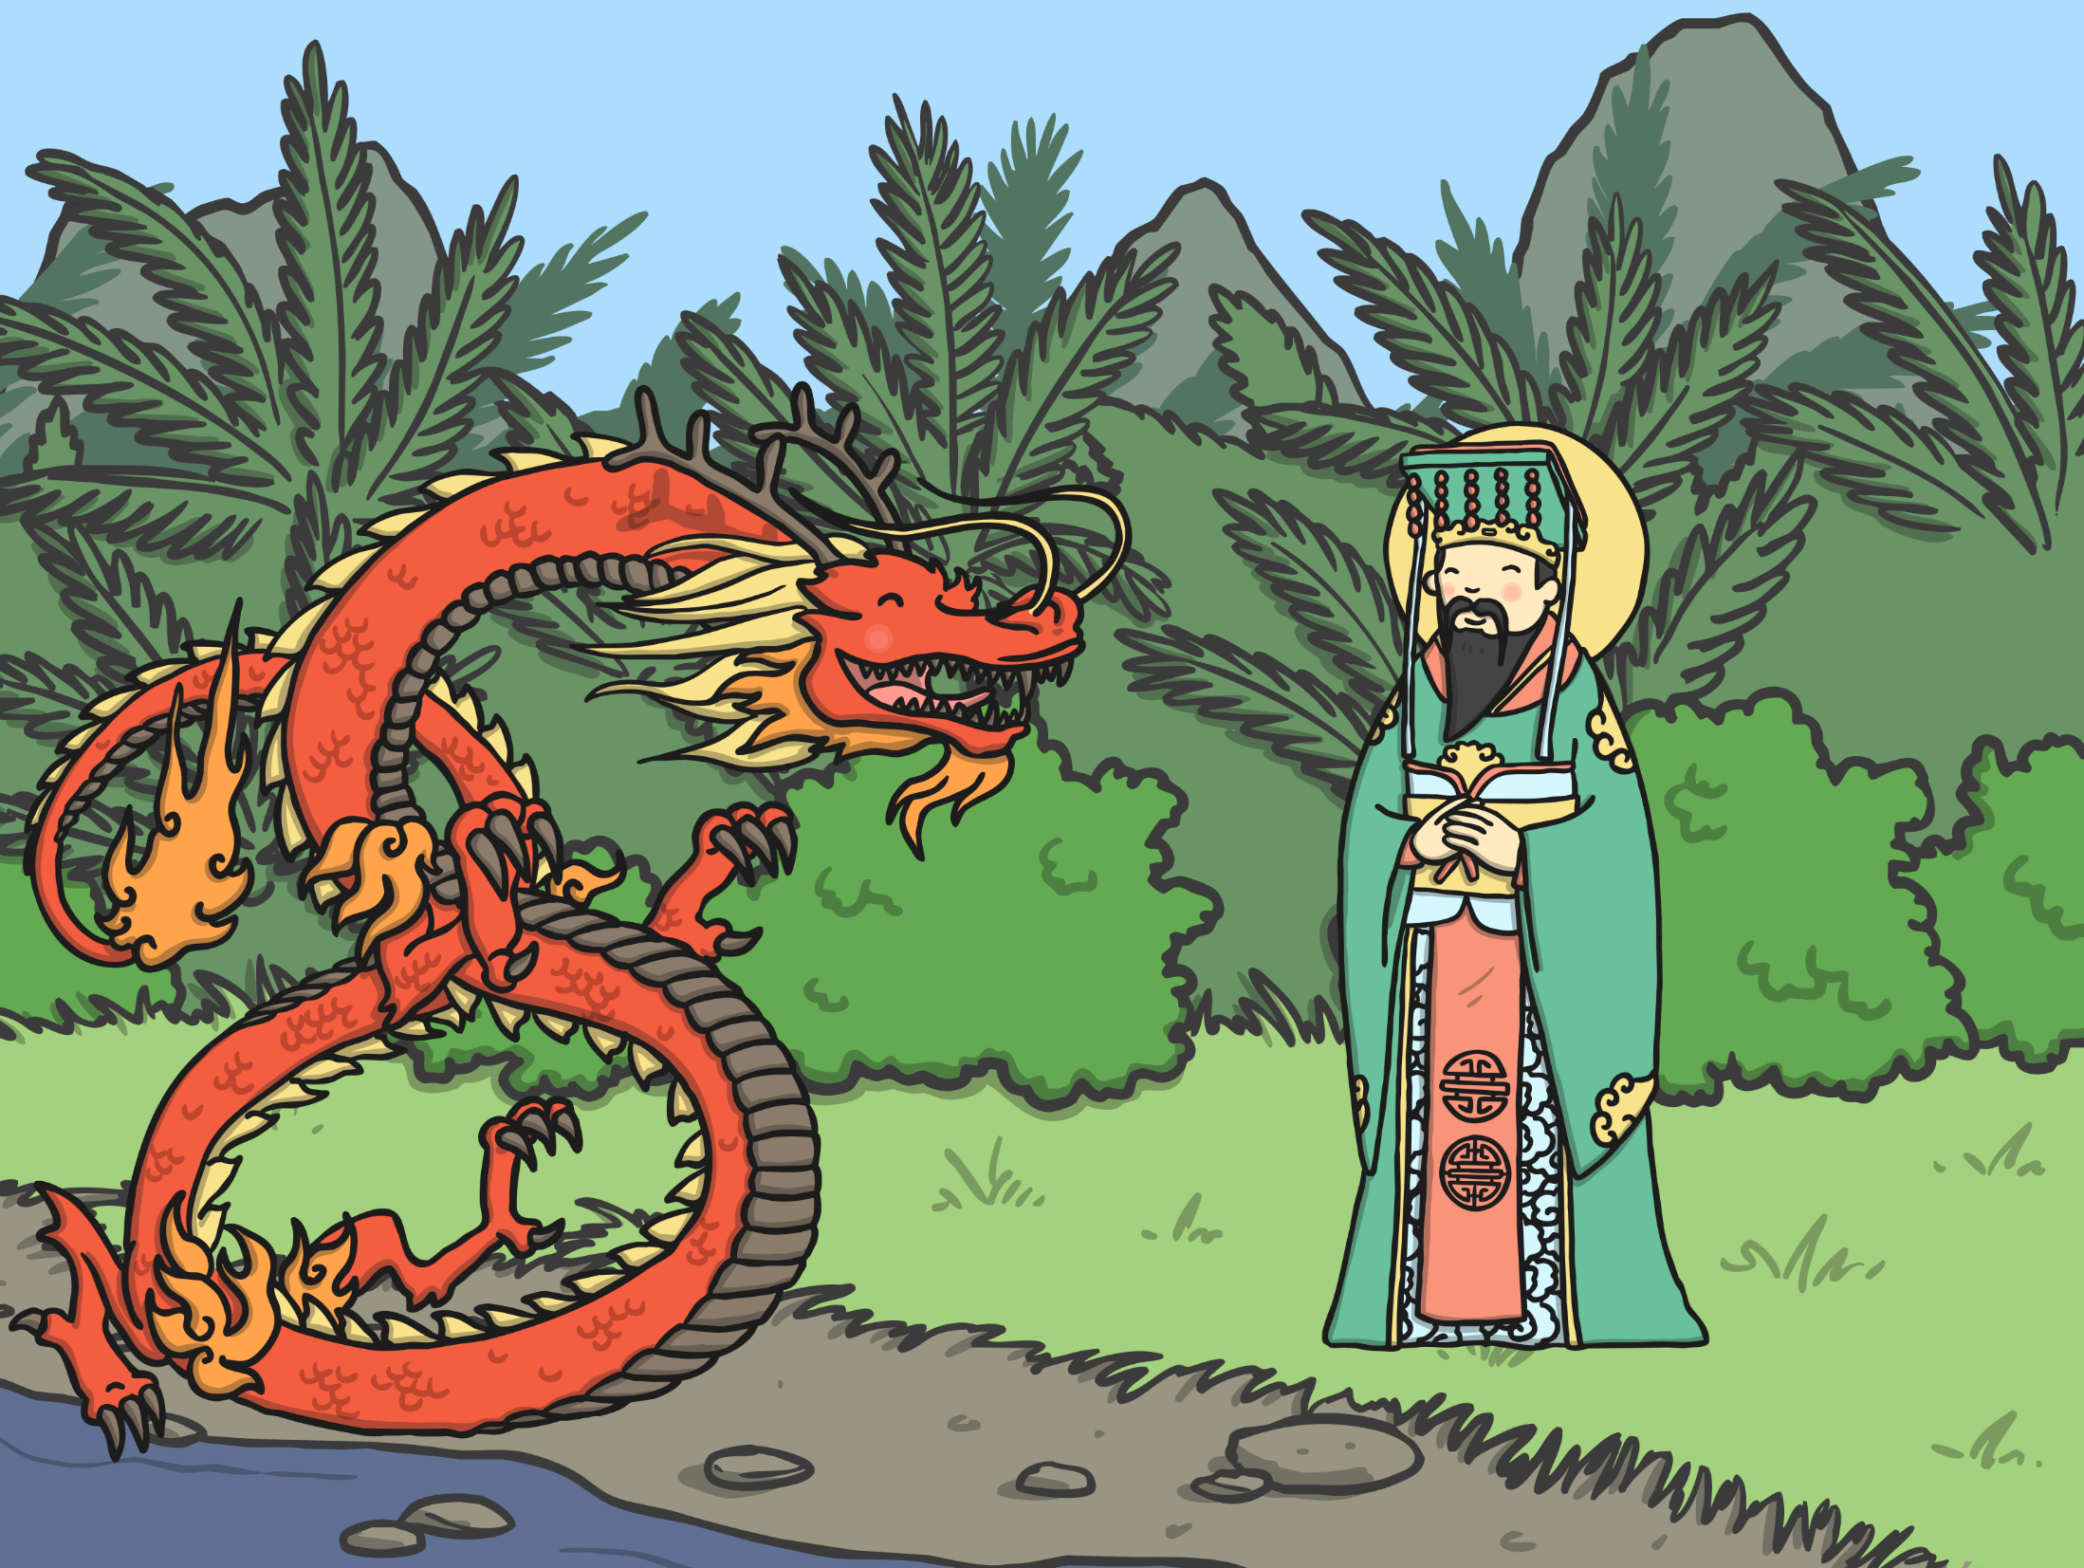
Taking fifth place was the dragon. “How come you didn’t win the race, when you could fly across?” the Emperor asked.
“I stopped to help some animals,” the dragon explained.

Slide 9
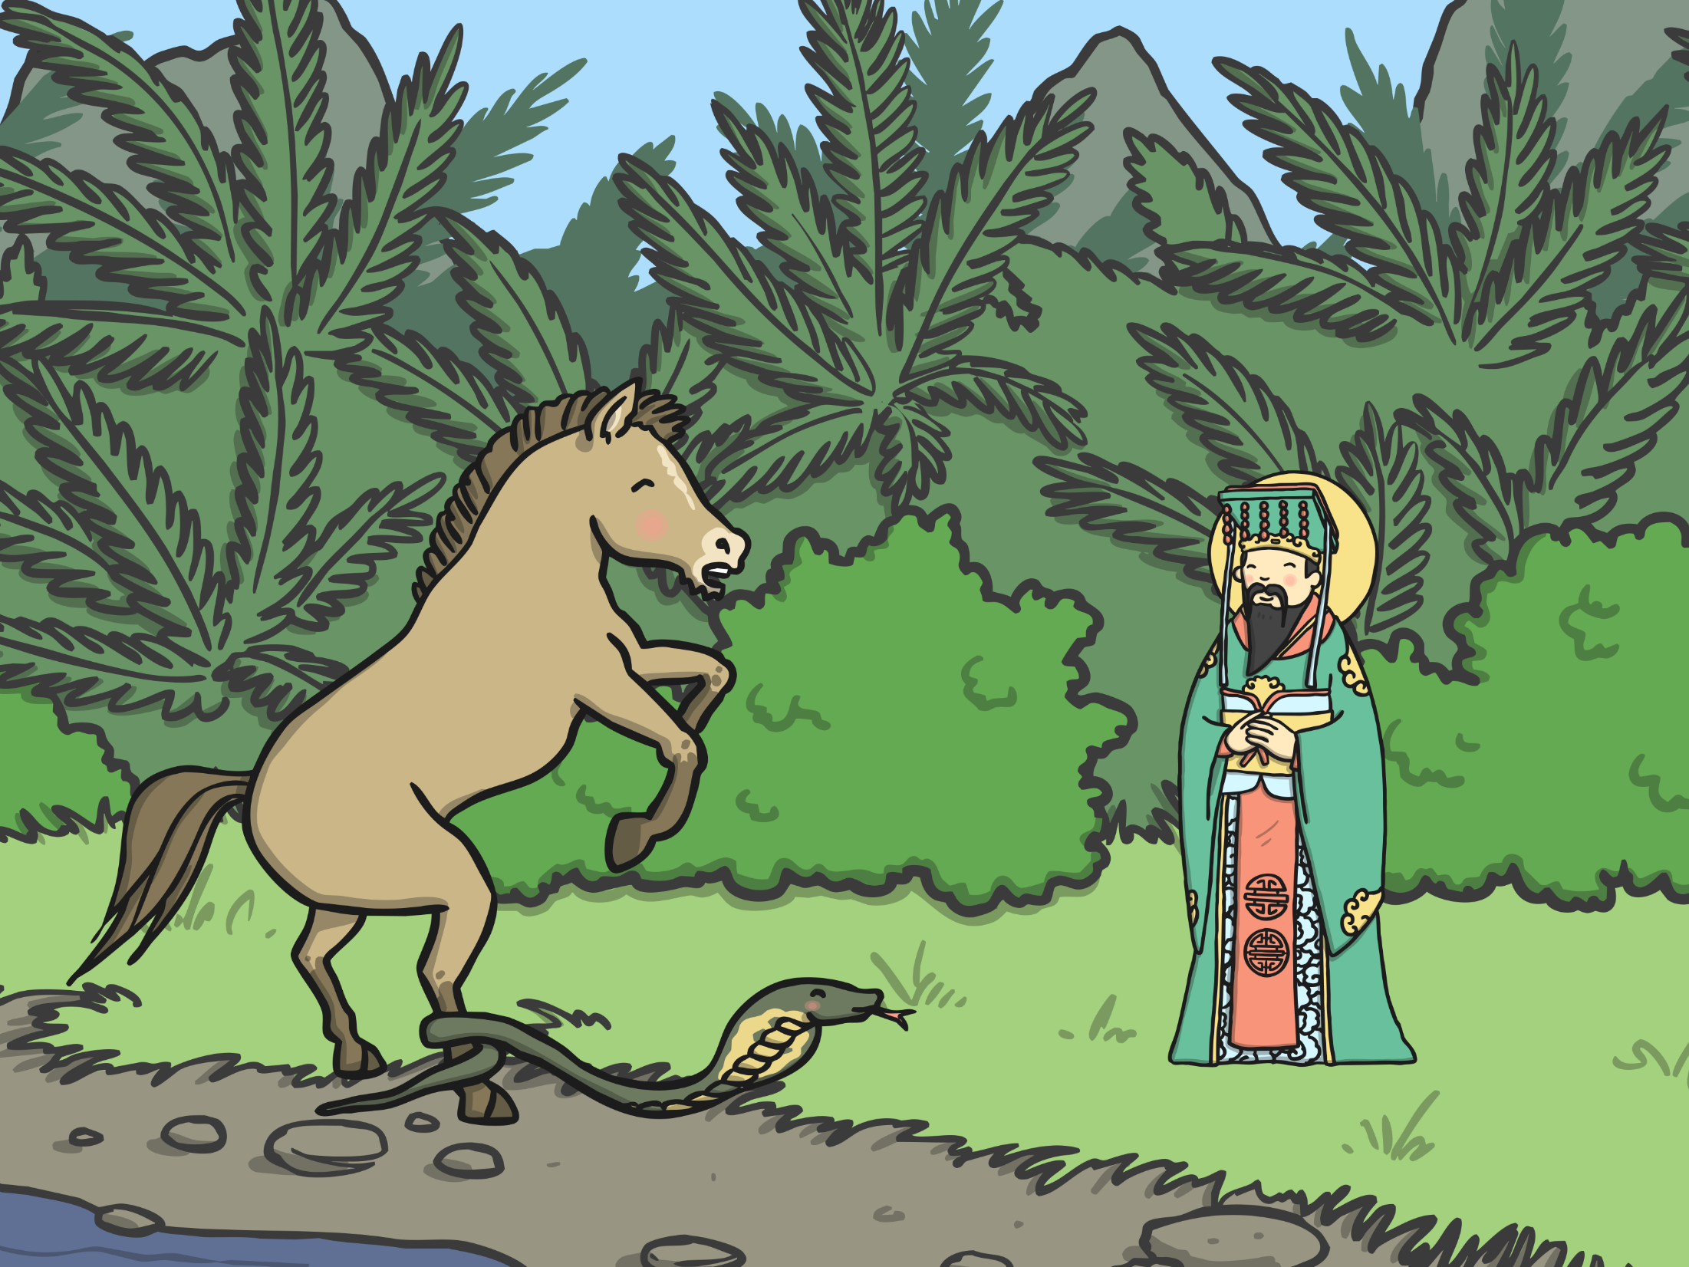
Heading towards the line was the horse. Just as the Emperor thought the horse would cross, the sly snake wriggled around one of the horse’s hooves. The horse was so surprised that he jumped backwards, giving the snake a chance to slither forward and take sixth place. The horse made it for seventh place.

Slide 10
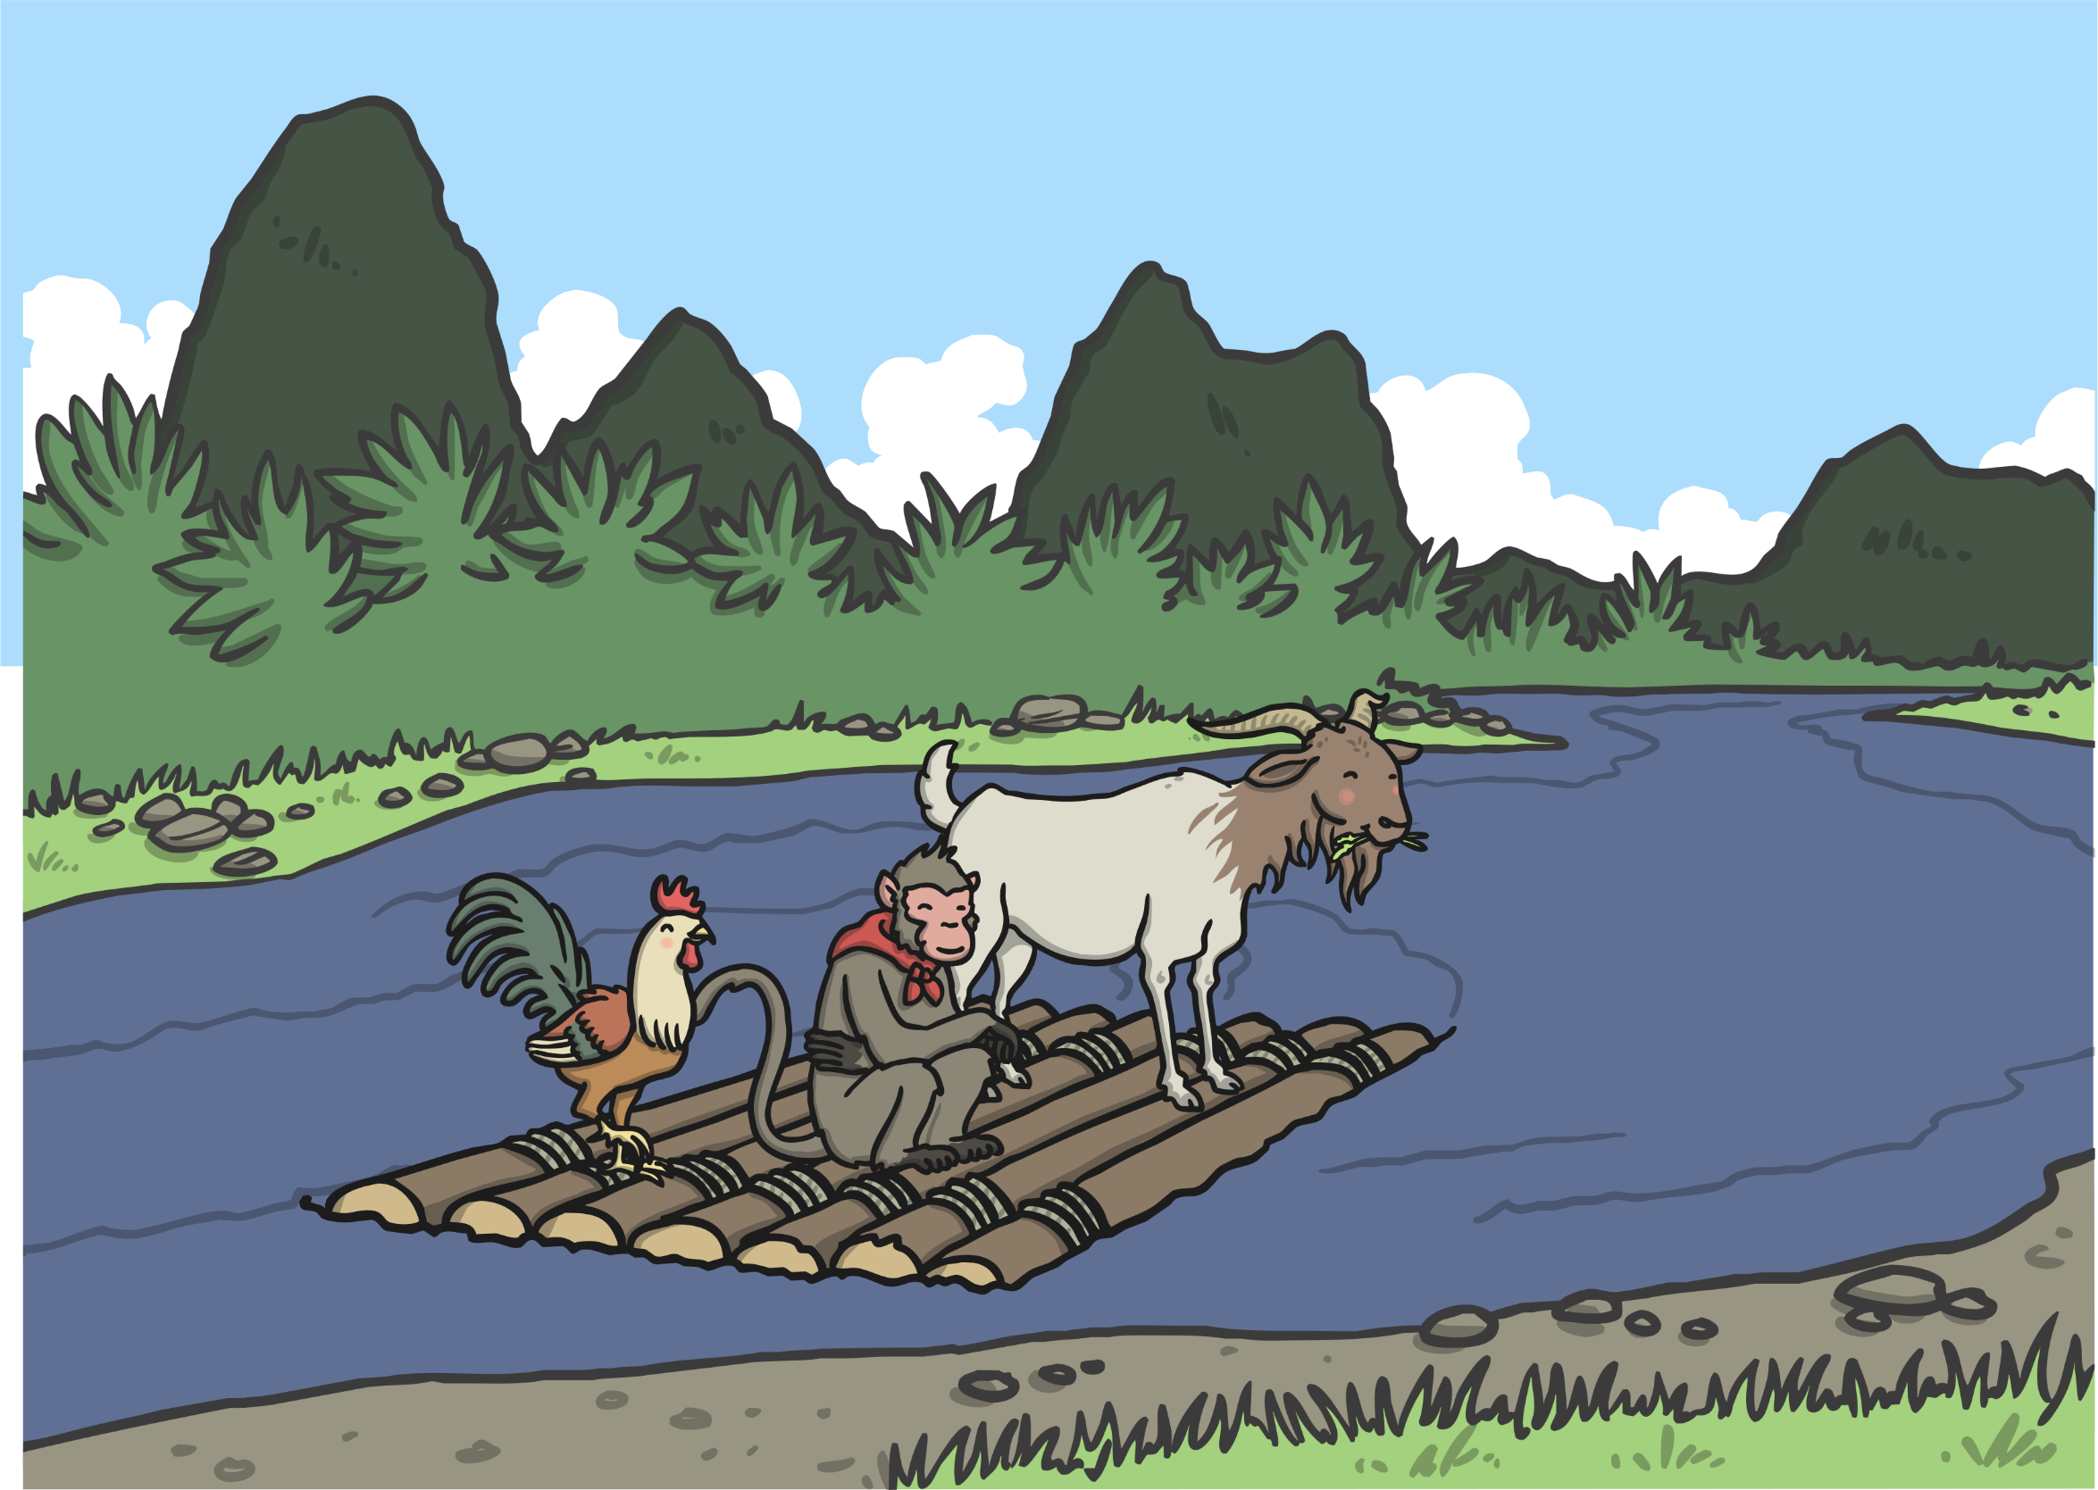
Not long afterwards, a raft arrived carrying the goat, the monkey and the rooster. They explained how they had worked as a team to get across. The
Emperor was very pleased. He said the goat would be the eighth year, the monkey the ninth and the rooster the tenth.

Slide 11
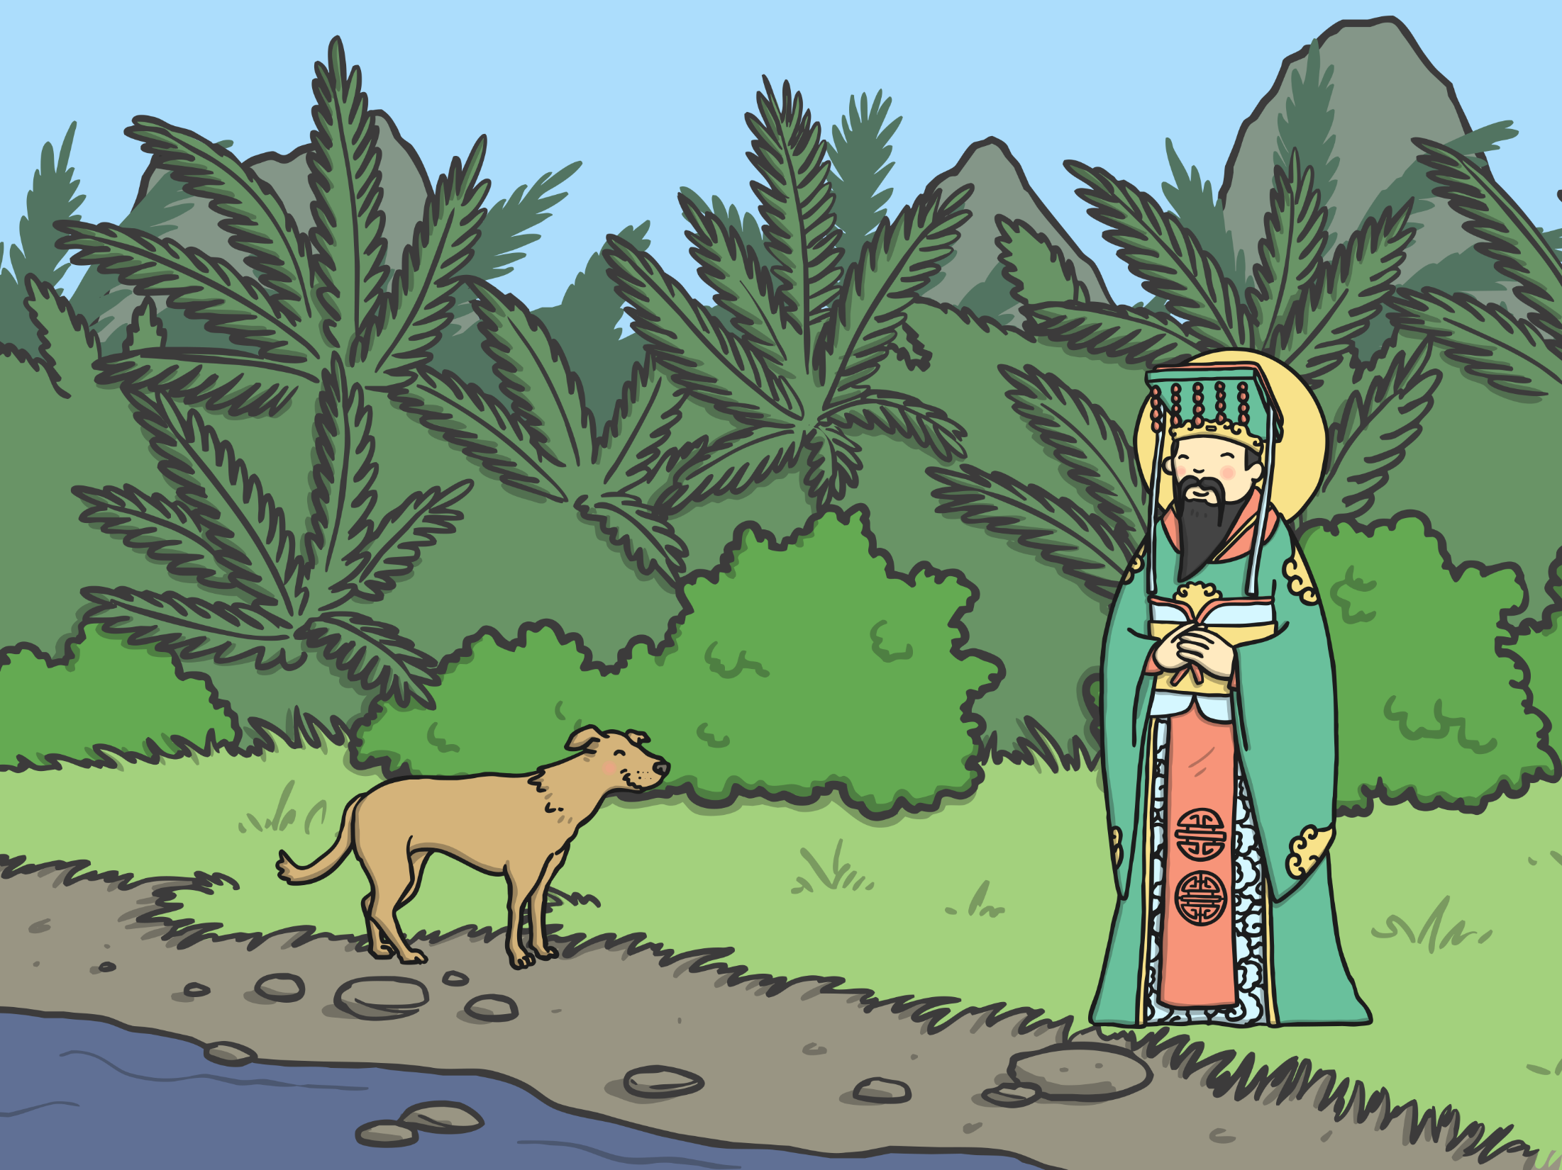
The next animal to arrive was the dog. “What took you so long, when you’re such a good swimmer?” asked the Emperor.
“The river was so clean that I decided to have a bath along the way,” the dog explained. He was rewarded with the eleventh year.

Slide 12
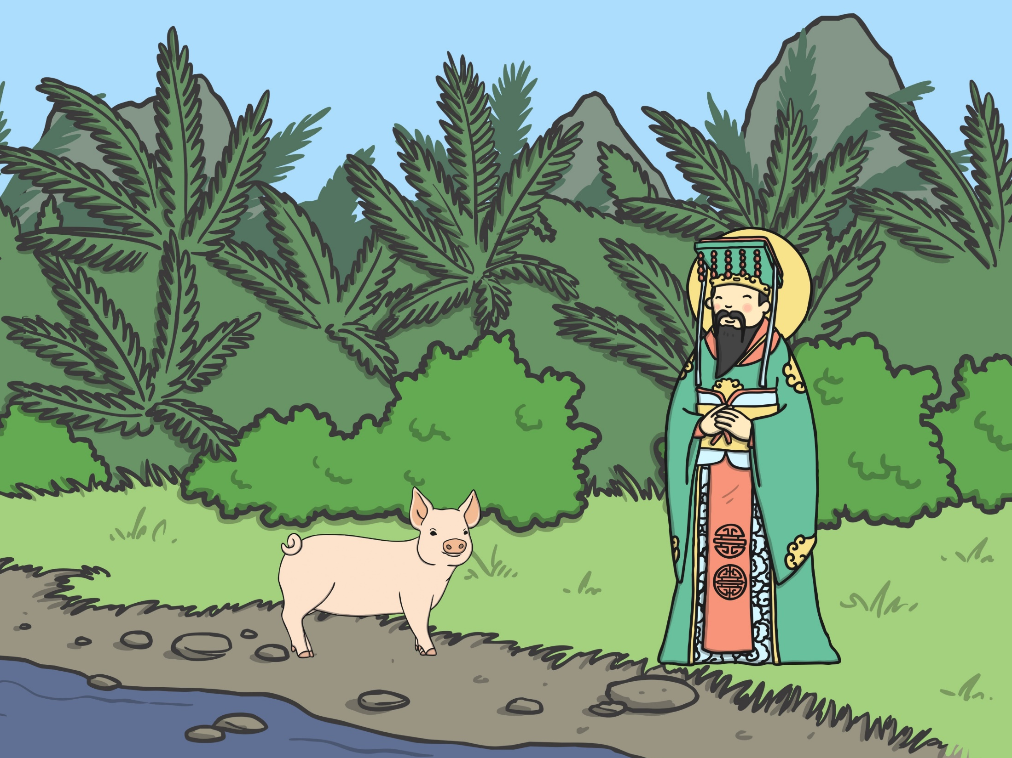
There was one place left in the Zodiac and the Emperor wondered who the last winner would be. All of a sudden, the pig turned up. “You took a long time. What happened?” the Emperor asked.
“I was hungry and stopped to eat, then I fell asleep,” said the pig. The twelfth year was given to the pig.

Slide 13
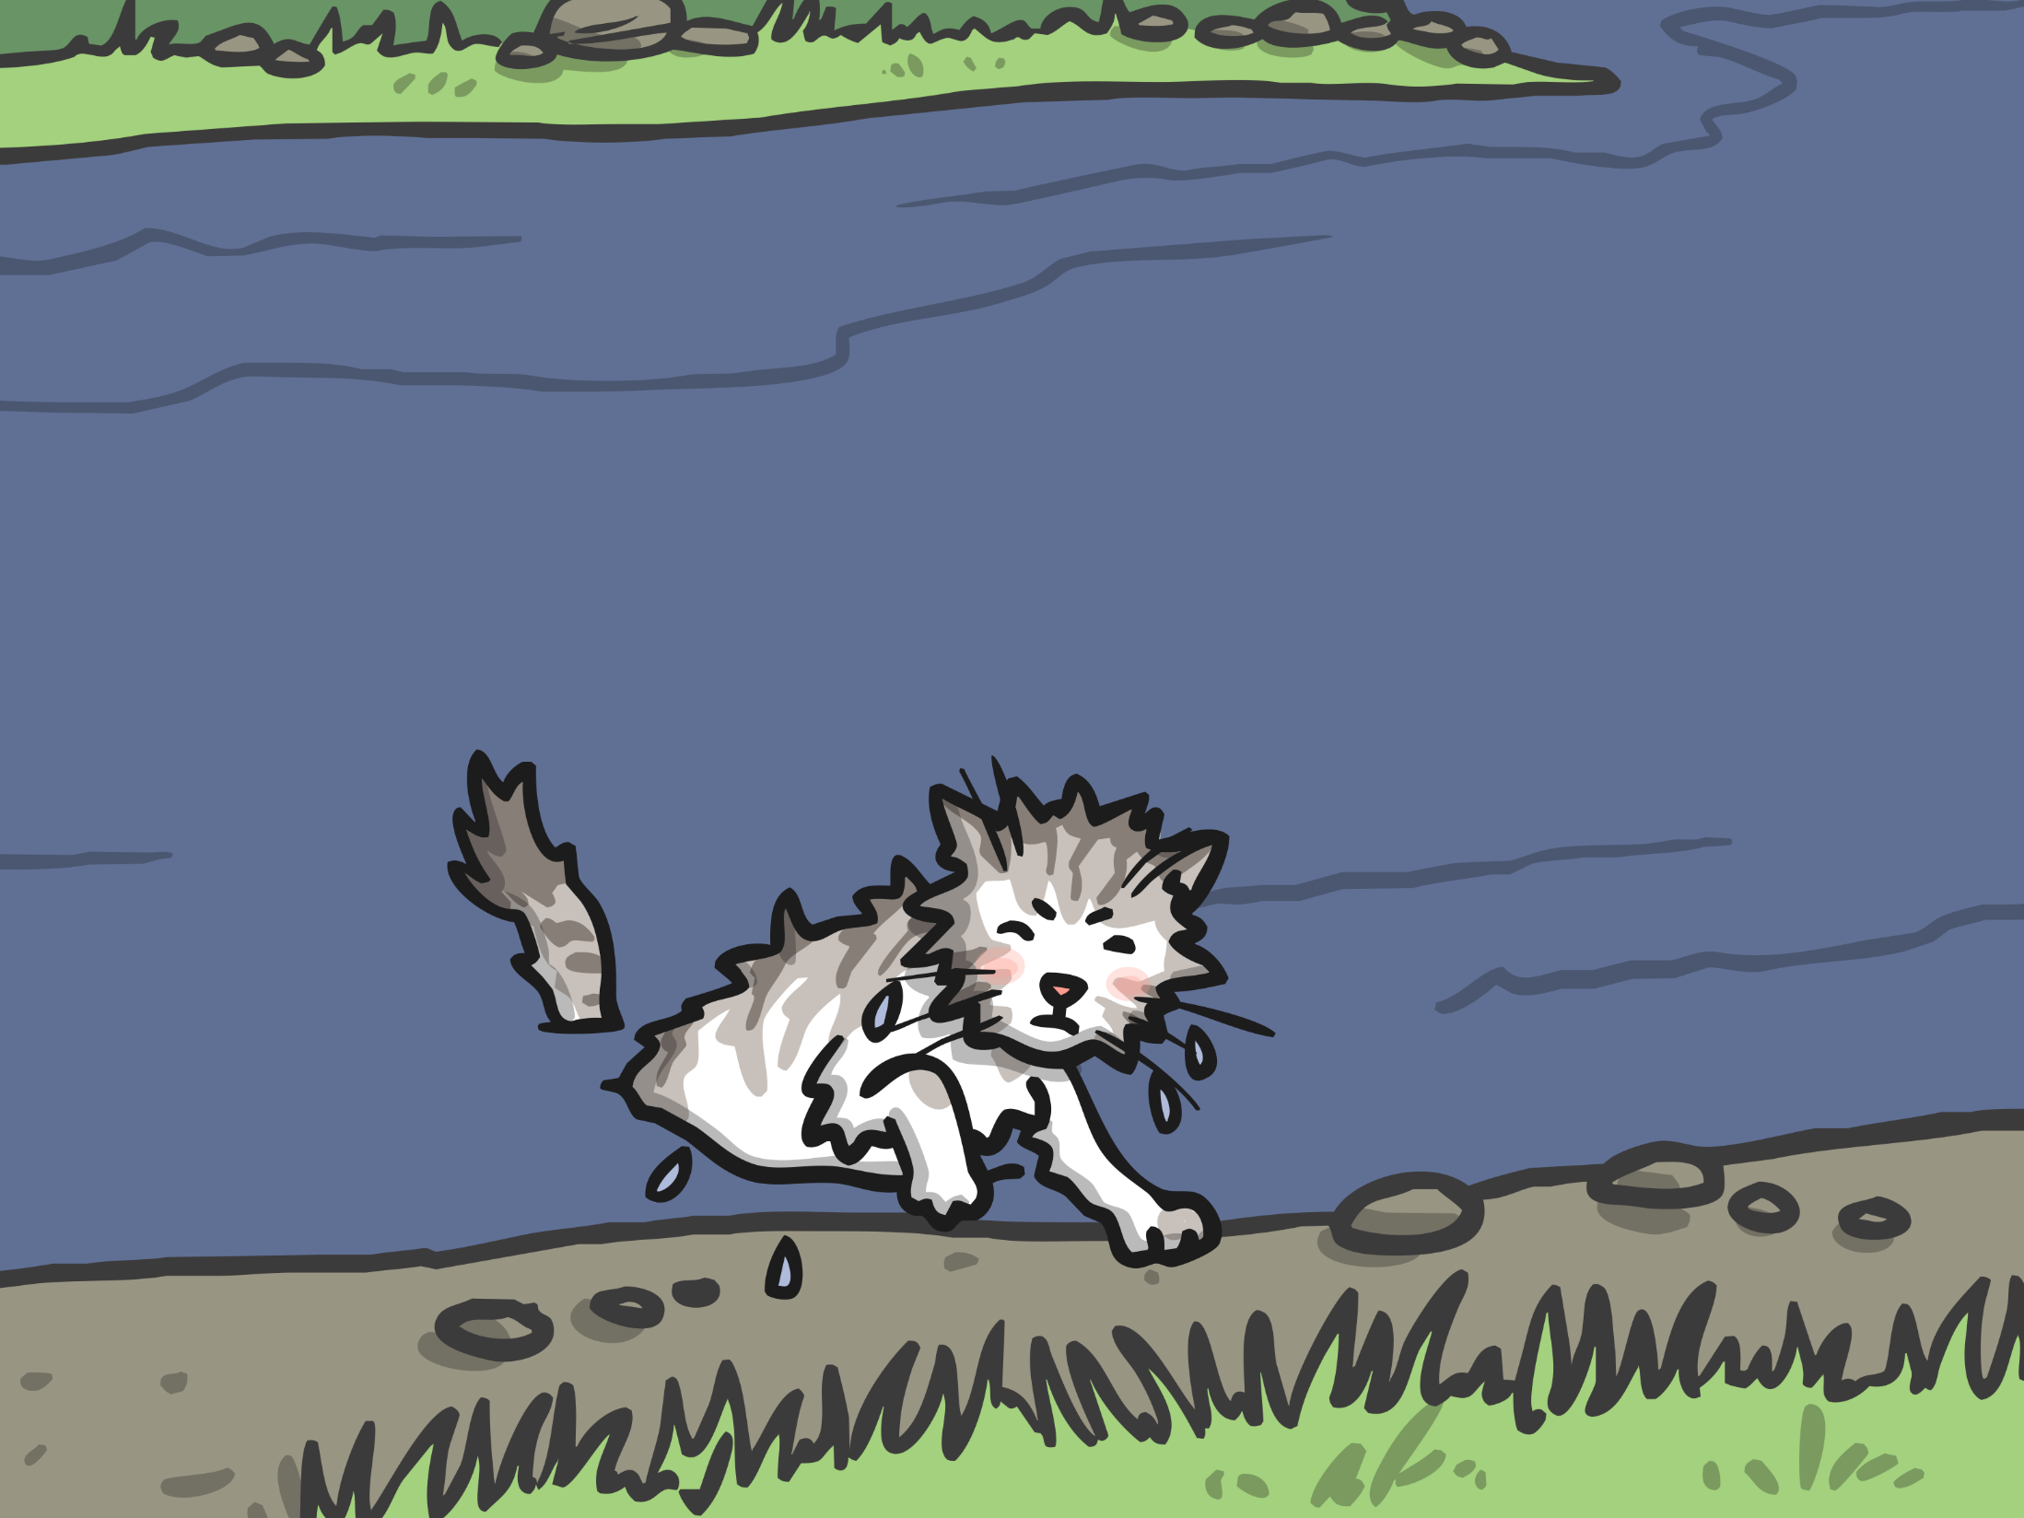
As for the cat, he finally crawled out of the river, but was too late to have a year named after him. He was very angry with the rat for pushing him in and since then, cats have never been friends with rats!

Slide 14
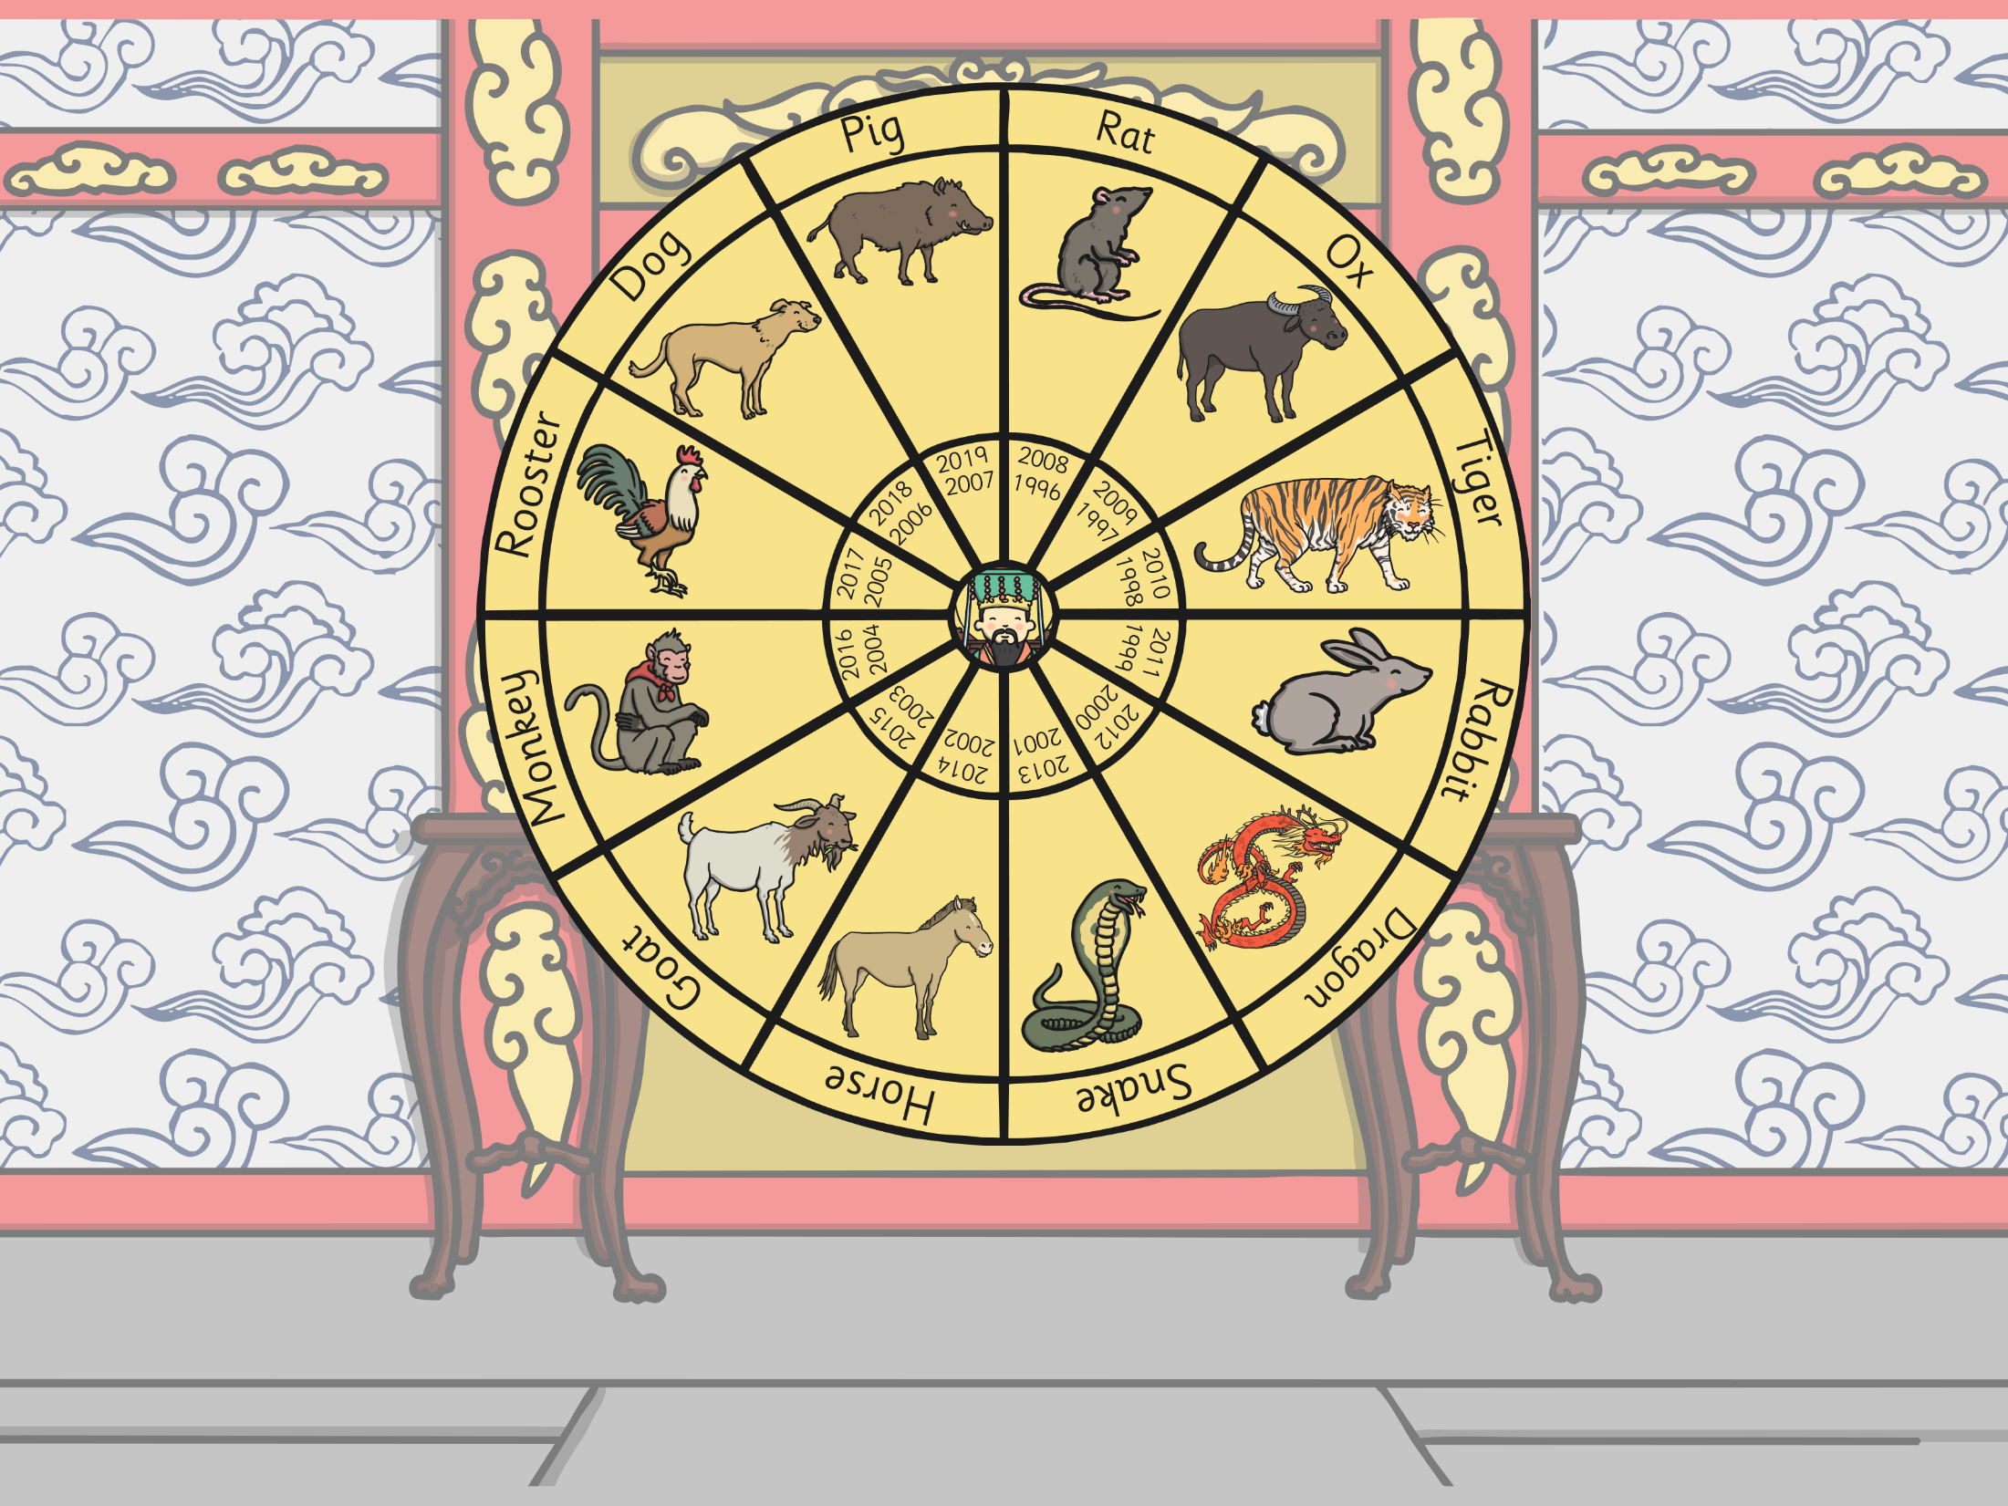
From that day to this, the Chinese Zodiac has followed this cycle of years, named after the twelve animals.

Slide 15
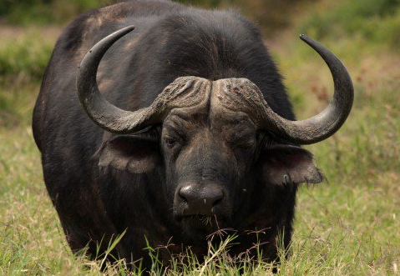
This year is the year of the Ox!

Slide 16
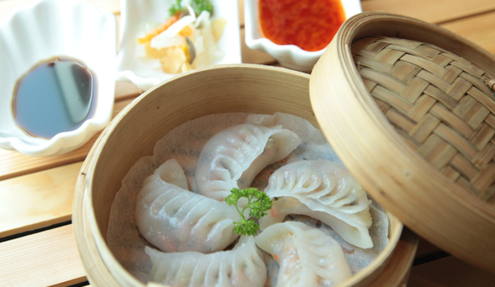
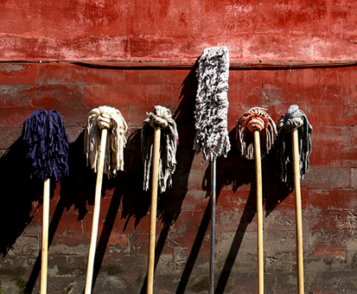
Notes:
Dumplings are cooked and eaten.
The house is cleaned to get rid of bad fortunes.

Slide 17
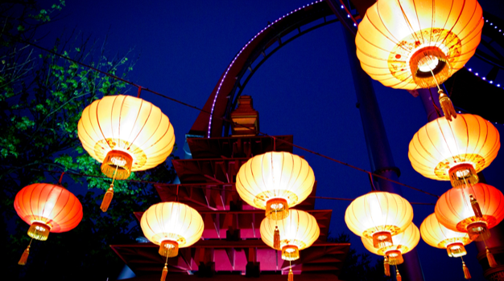
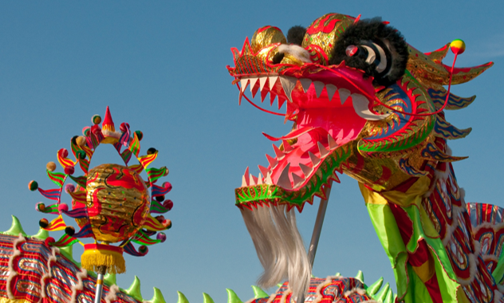
Notes:
Lanterns are lit and dragon dances happen.

Slide 18
Questions:
Which animal crossed the river first?
Which animal carried the cat and the rat?
What happened to the cat?
Why did the pig take so long to cross the river?

