Slide 1
f | l | m | n | r | s ss | v | z | sh | th | ng nk
b | c k ck | d | g | h | j | p | qu | t | w | x | y | ch
a | e | i | o | u
Speed Sounds
Speed Sounds

Slide 4
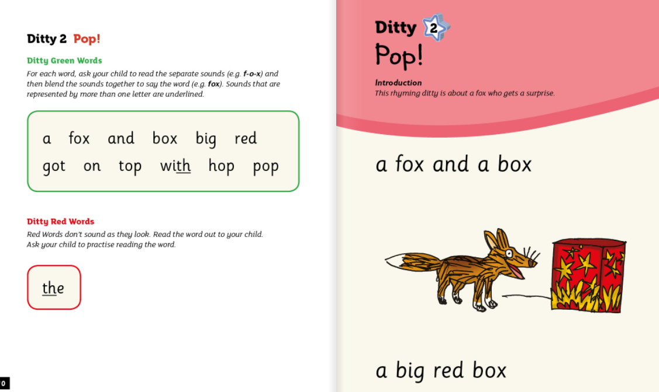

Slide 7
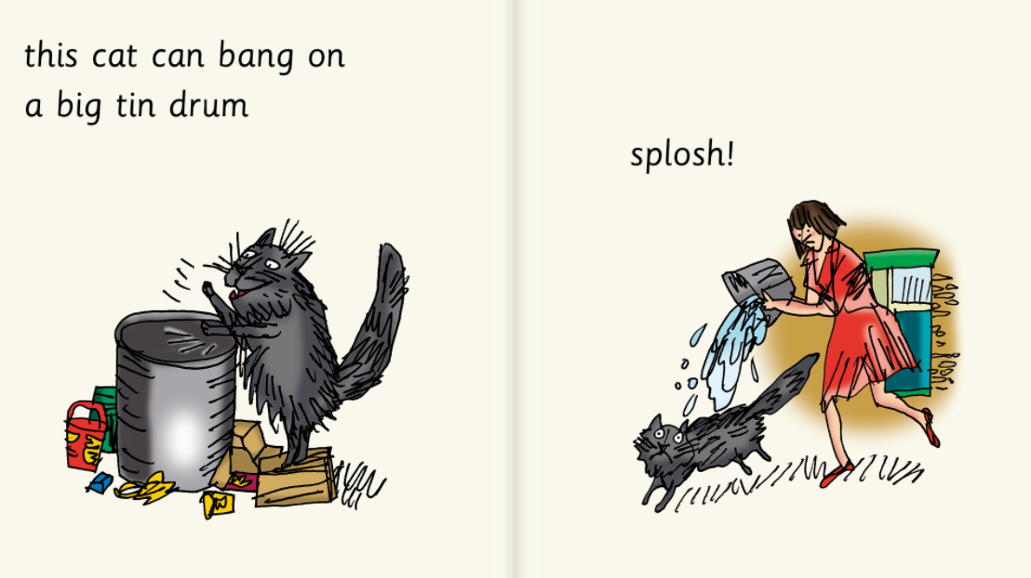

Slide 8
