Slide 1
Set 2 Sounds
ar
Notes:
Lets practise our set 2 sounds, today;’s sound is ar

Slide 2
Notes:
What do the clowns need to do? That’s right, they need to start the car

Slide 3
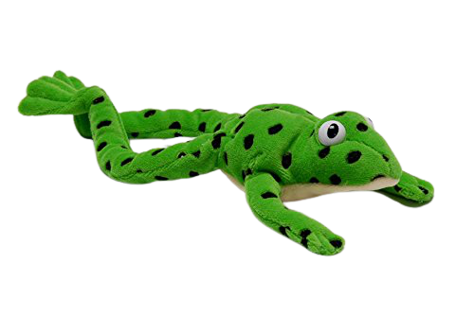
Notes:
Lets fred talk! S-t-ar-t, start, c-ar, car, p-ar-k, park

Slide 4
Notes:
This is our new sound ar. It has 2 letters but 1 sound, it’s a special friend

Slide 5
Notes:
Lets practice ar. My turn first…..

Slide 6
Notes:
Now its your turn, can you practice ar

Slide 7
car
_
.
park
_
.
.
start
_
.
.
.
Notes:
Lets read some green words! First lets use fred talk then read the word

Slide 8
Notes:
Let’s practice writing our sound - ar

Slide 9
Notes:
Let’s practice writing words with the ar sound in them star bar spark

