Slide 1
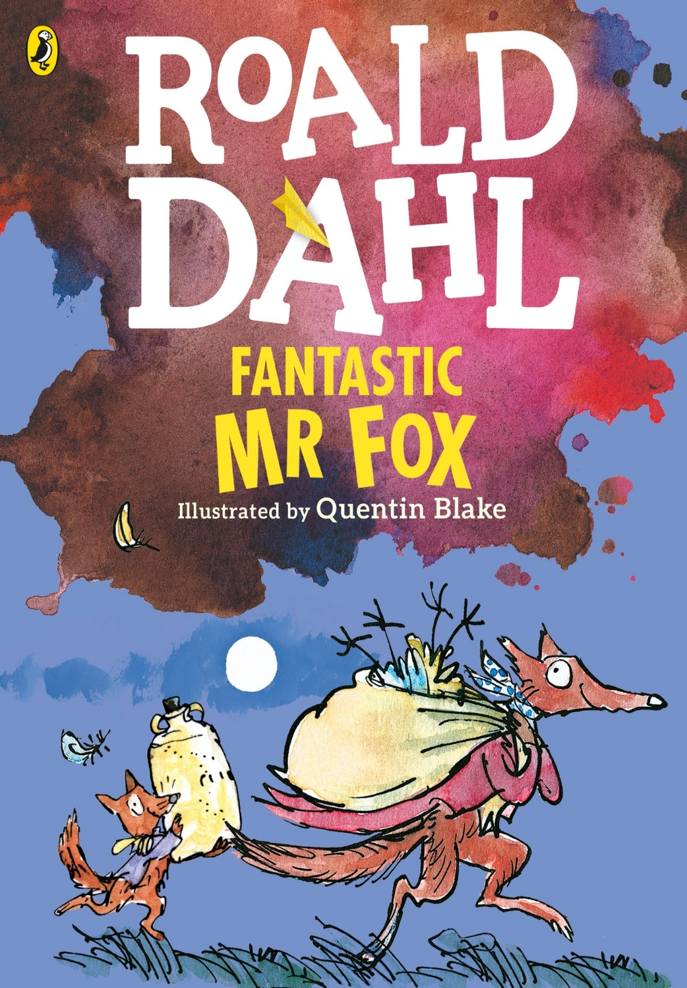

Fantastic Mr Fox
Roald Dahl

Slide 2
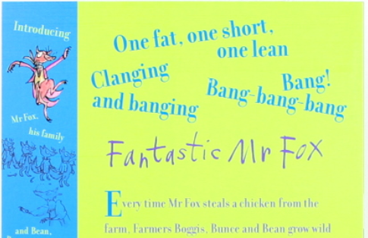
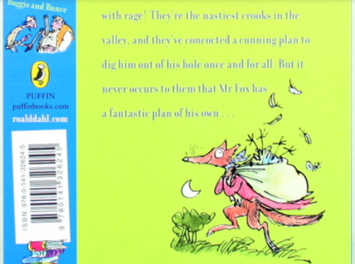
What is the blurb on the back cover of a book? What is its purpose?
The blurb is trying to persuade you to read the book. It tells you just enough to get you excited about the story, so that you have to find out what happens.
Does the blurb on Fantastic Mr Fox make you want to read it? Out of 10 how much do you want to read it: 1 means not at all – 10 means you want to do nothing else!

Slide 3
Key vocabulary
Smothered – covered in
Beastly – horrible, cruel, unkind
Gallon – an amount of a liquid equal to 4.5 litres
Crook – criminal
Plump – large
Approached – went up to
Thus – so
Yard – measurement of length just less than a metre
Blighter – someone you don’t like
Crafty - clever

Slide 4
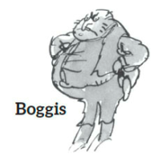
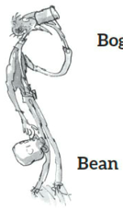
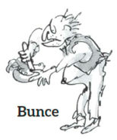
Task 1
Read the first chapter
As you read, make a note of each of the three farmers and their descriptions. Either create a spider diagram for each or draw a picture of the three farmers and find and write key descriptive words from the text. Look at my example below.
Example
farms chickens
enormously fat

Slide 5
Chapter 1 The Three Farmers
Down in the valley there were three farms. The owners of these farms had done well. They were rich men. They were also nasty men. All three of them were about as nasty and mean as any men you could meet. Their names were Farmer Boggis, Farmer Bunce and Farmer Bean.
Boggis was a chicken farmer. He kept thousands of chickens. He was enormously fat. This was because he ate three boiled chickens smothered with dumplings every day for breakfast, lunch and supper.
Bunce was a duck-and-goose farmer. He kept thousands of ducks and geese. He was a kind of pot- bellied dwarf. He was so short his chin would have been underwater in the shallow end of any swimming- pool in the world. His food was doughnuts and goose-livers. He mashed the livers into a disgusting paste and then stuffed the paste into the doughnuts. This diet gave him a tummy-ache and a beastly temper.

Slide 6
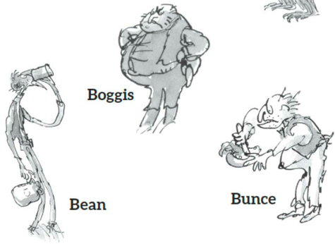
Bean was a turkey-and-apple farmer. He kept thousands of turkeys in an orchard full of apple trees. He never ate any food at all. Instead, he drank gallons of strong cider which he made from the apples in his orchard. He was as thin as a pencil and the cleverest of them all.
‘Boggis and Bunce and Bean
One fat, one short, one lean.
These horrible crooks
So different in looks
Were none the less equally mean.’
That is what the children round about used to sing when they saw them.

Slide 7
Task 2
You need to carry on reading chapter 2.
Once you have got to the end I want you to make three predictions about what you think will happen next.
We will see if your predictions come true later in the story.
There is an example on the slide at the end of chapter 2.

Slide 8
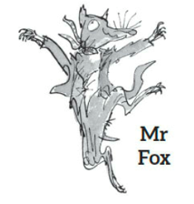
Chapter 2 Mr Fox
On a hill above the valley there was a wood.
In the wood there was a huge tree.
Under the tree there was a hole.
In the hole lived Mr Fox and Mrs Fox and their four Small Foxes.
Every evening as soon as it got dark, Mr Fox would say to Mrs Fox, ‘Well, my darling, what shall it be this time? A plump chicken from Boggis? A duck or a goose from Bunce? Or a nice turkey from Bean?’ And when Mrs Fox had told him what she wanted, Mr Fox would creep down into the valley in the darkness of the night and help himself.
Boggis and Bunce and Bean knew very well what was going on, and it made them wild with rage. They were not men who liked to give anything away. Less still did they like anything to be stolen from them. So every night each of them would take his shotgun and hide in a dark place somewhere on his own farm, hoping to catch the robber.

Slide 9
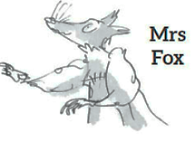
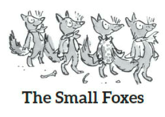
But Mr Fox was too clever for them. He always approached a farm with the wind blowing in his face, and this meant that if any man were lurking in the shadows ahead, the wind would carry the smell of that man to Mr Fox’s nose from far away. Thus, if Mr Boggis was hiding behind his Chicken House Number One, Mr Fox would smell him out from fifty yards off and quickly change direction, heading for Chicken House Number Four at the other end of the farm.
‘Dang and blast that lousy beast!’ cried Boggis.
‘I’d like to rip his guts out!’ said Bunce.
‘He must be killed!’ cried Bean.

Slide 10
‘But how?’ said Boggis. ‘How on earth can we catch the blighter?’
Bean picked his nose delicately with a long finger. ‘I have a plan,’ he said.
‘You’ve never had a decent plan yet,’ said Bunce.
‘Shut up and listen,’ said Bean. ‘Tomorrow night we will all hide just outside the hole where the fox lives. We will wait there until he comes out. Then . . .Bang! Bang- bang-bang.’
‘Very clever,’ said Bunce. ‘But first we shall have to find the hole.’
‘My dear Bunce, I’ve already found it,’ said the crafty Bean. ‘It’s up in the wood on the hill. It’s under a huge tree . . .’

Slide 11
Prediction
You could use these sentence starters to help you or you could make up your own.
I think that Boggis, Bunce and Bean will…
As Mr Fox is clever, I think…
Boggis, Bunce and Bean are nasty characters so I predict that…
The four young foxes might…

