Slide 1

Learning Intention
How to stay safe

Slide 2

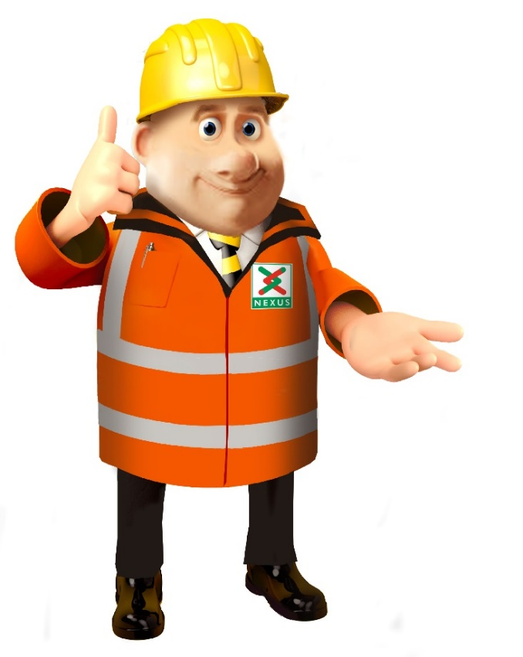
Do you know what this is?

Slide 3
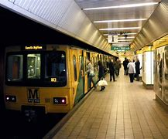
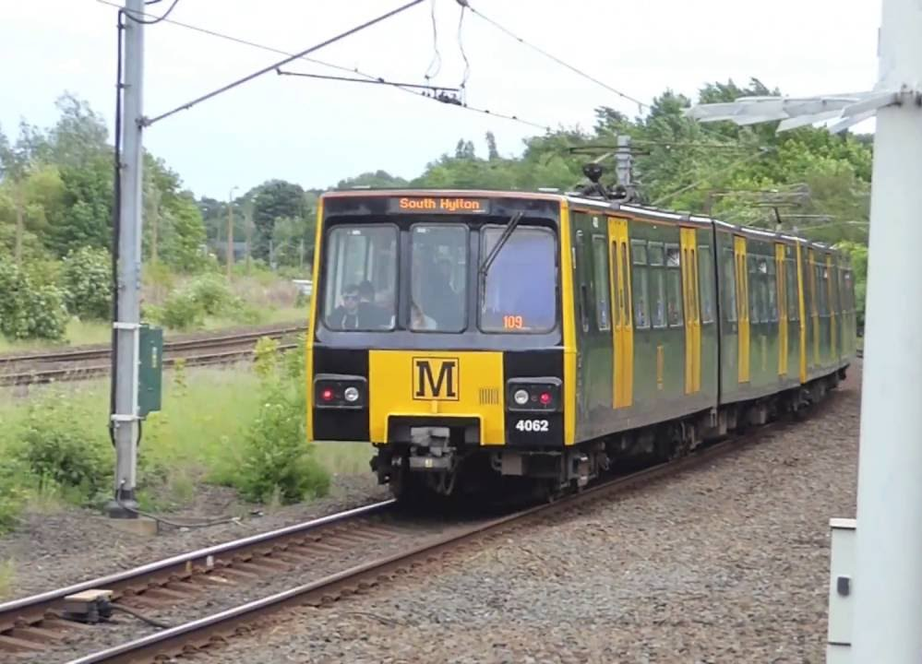


Nexus looks after the Tyne and Wear Metro service. Have you been on this?

Slide 4
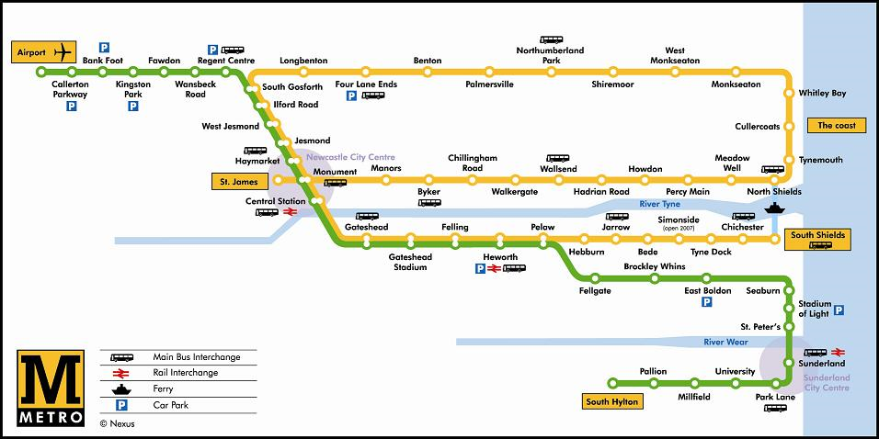
Here is a map of the Metro.

Slide 5
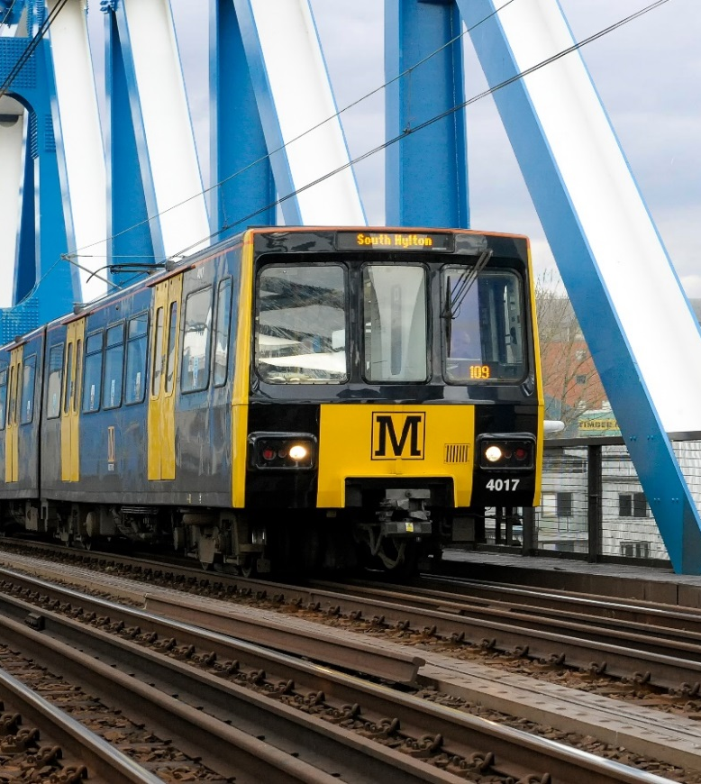
Let’s look at this important information about the Metro service
90 trains
40 tonnes each
50 mph
150 metres to stop in an emergency
That is as long as 1 ½ football pitches!
1500 volts of electricity
Jump 1 metre

Slide 6




28 Feb
15 Feb
Between 15th and 28th February the Metro will be closed for two weeks.
It will be closed between Longbenton and Felling.
Notes:
Between the 15th February

Slide 7
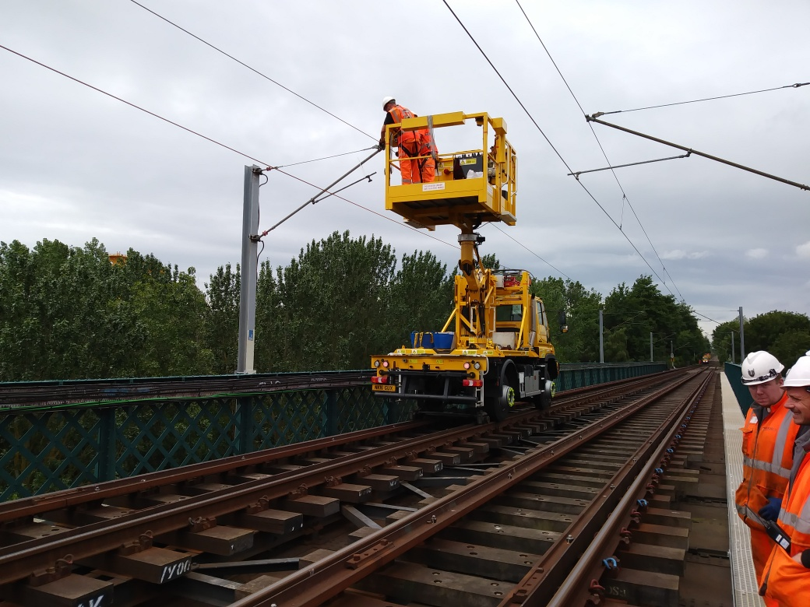
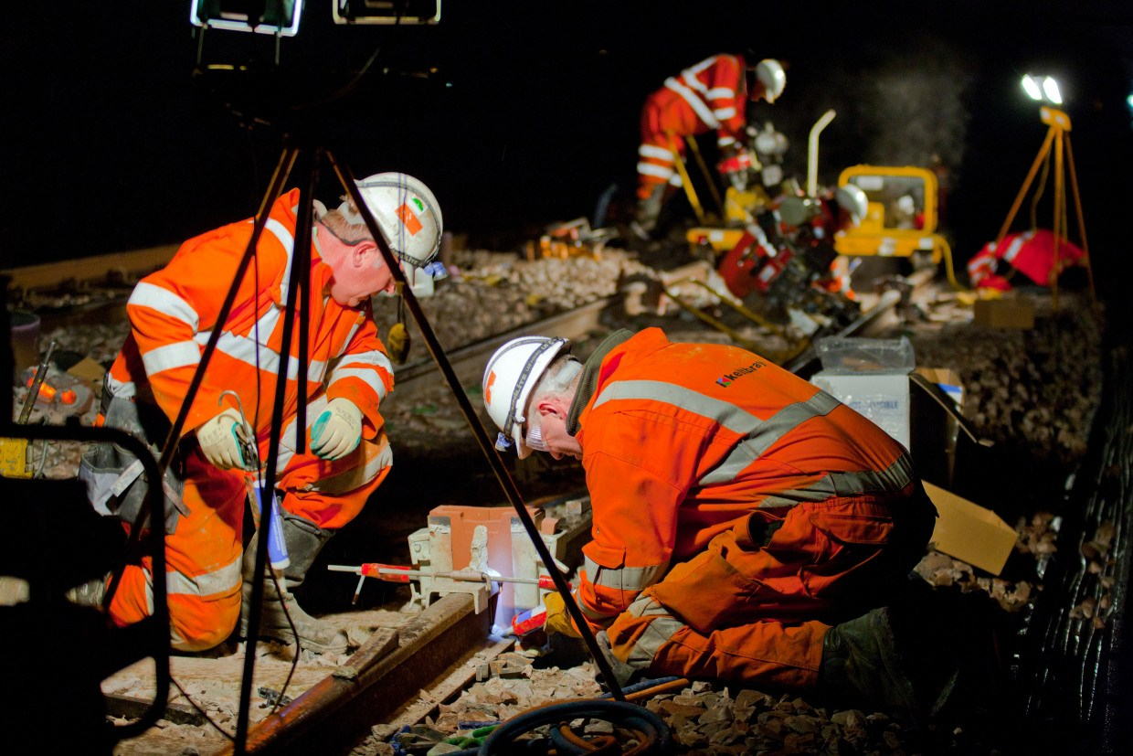
Day
Night
This is an engineer
Day and night the engineers will be working to replace the overhead lines.

Slide 8

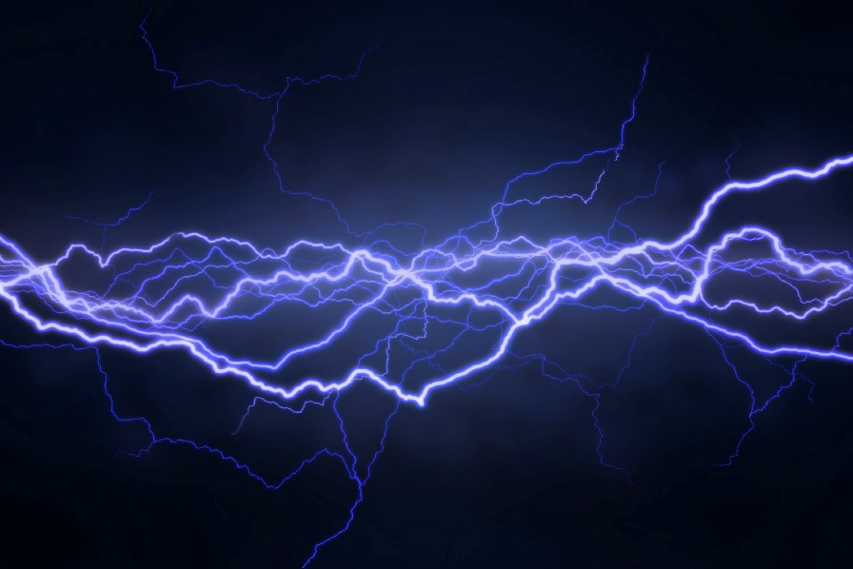
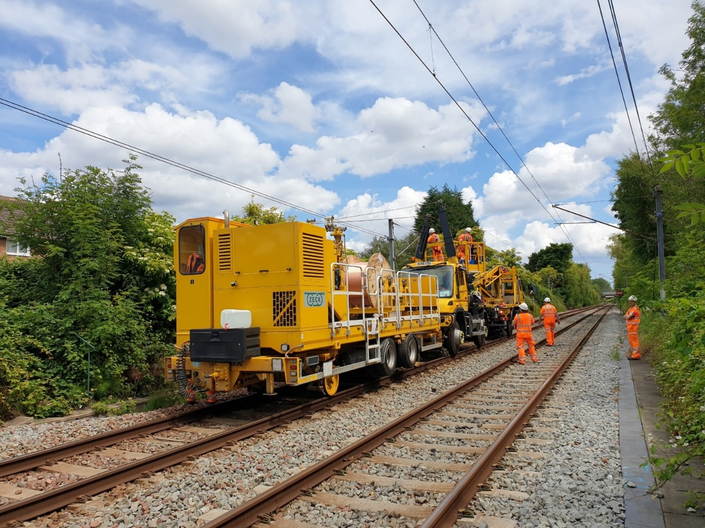
Here the engineers are putting up new lines
What makes the train work?
The electricity that flows through the overhead lines.

Slide 9


Should you go near the tracks?
If not why not?
Why might it be dangerous?

Slide 10
What happens when you get electrocuted?
A. A tingling or painful sensation.
B. A painful shock, muscles contract and grip the electrical source so you’re unable to let go.
C. The heart ‘flutters’ (ventricular fibrillation). Burns at entry and exit points and internal damage.
or D. Prolonged exposure or strong muscular contractions stop the heart. Internal organs, tissue and skin burn.
The effects vary depending on the electric current and frequency, but they affect the whole of the body…

Slide 11
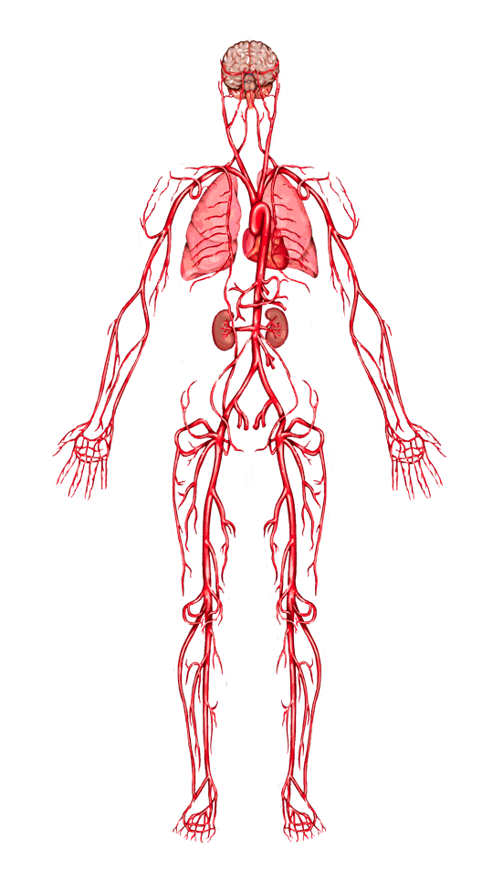
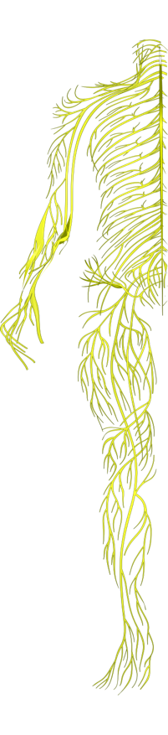
When you get electrocuted all of the things on the last slide can happen.
Lungs: breathing can stop.
Hands, heels, head: points of contact with the electrical source and the ground can be burned.
Heart: ‘flutters’ and fails to pump blood properly. Goes into cardiac arrest, resulting in death.
Nervous system: disrupts the tiny electrical impulses that enable you to sense, move, think, respond and remember.

Slide 12
When you get electrocuted…
Spine/Bones: being thrown by force of the electricity can lead to broken bones or an injured spine.
Muscles: sometimes you grip the electrical source so you can’t let go!
Skin and tissue: electricity burns beneath the skin and skin can melt.
FACT: 9 out of 10 people die from the electric shock received
from getting too close to railway electric overhead lines.

Slide 13
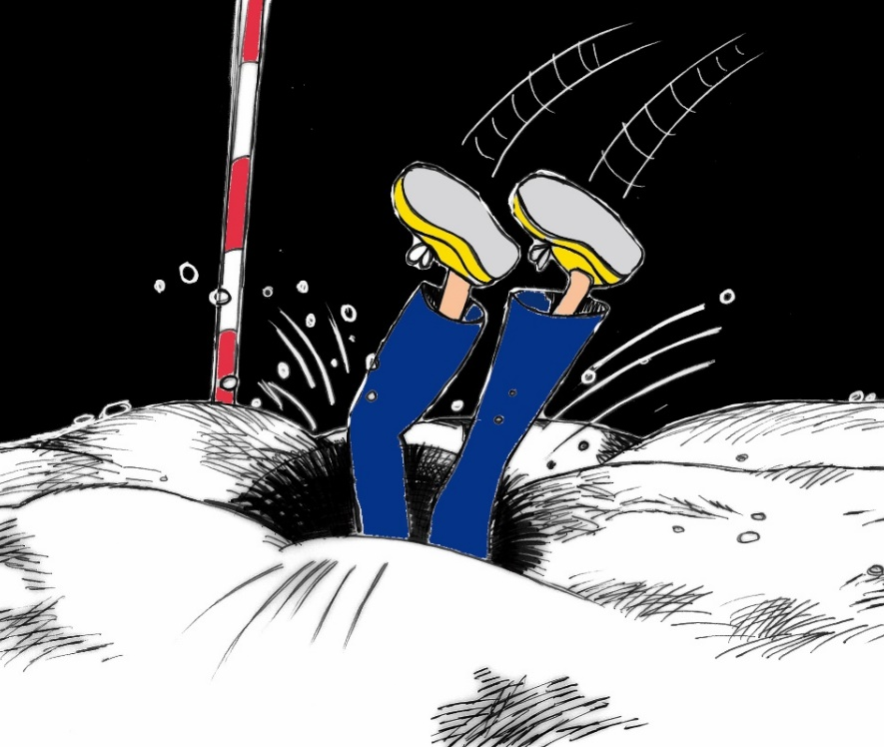
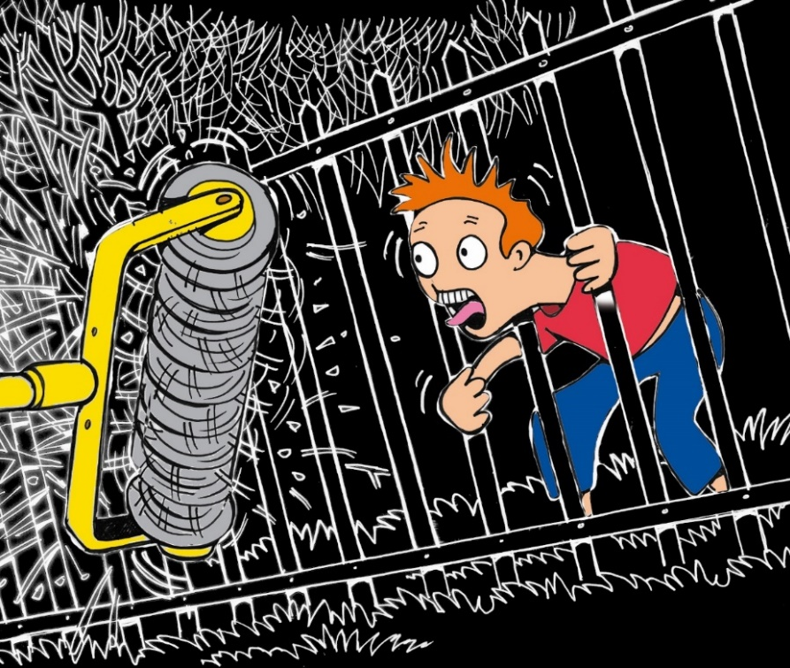
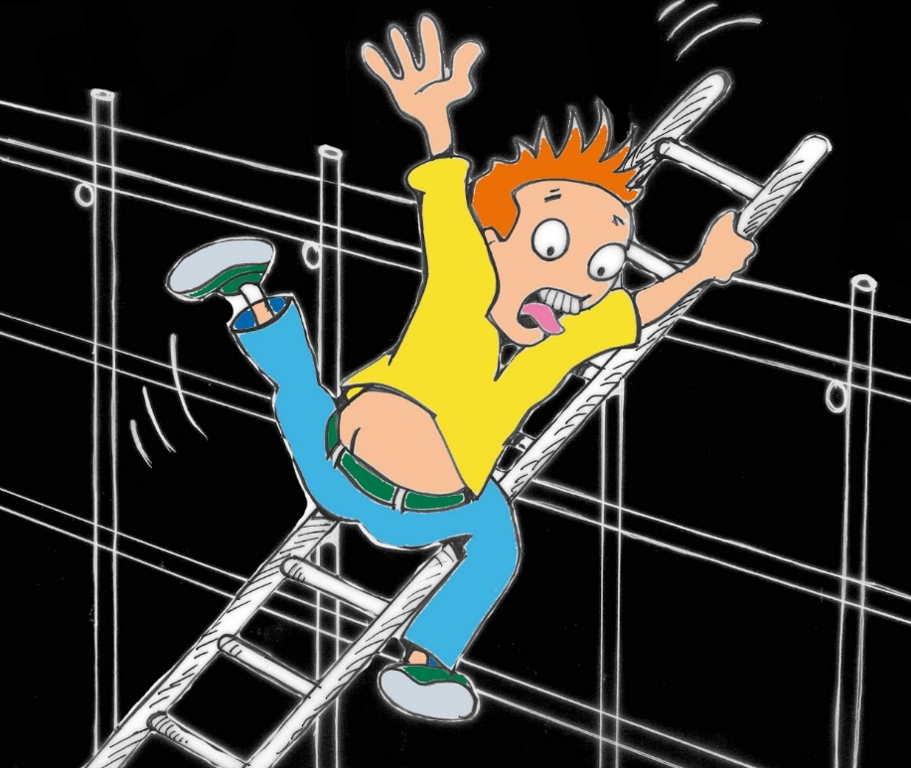
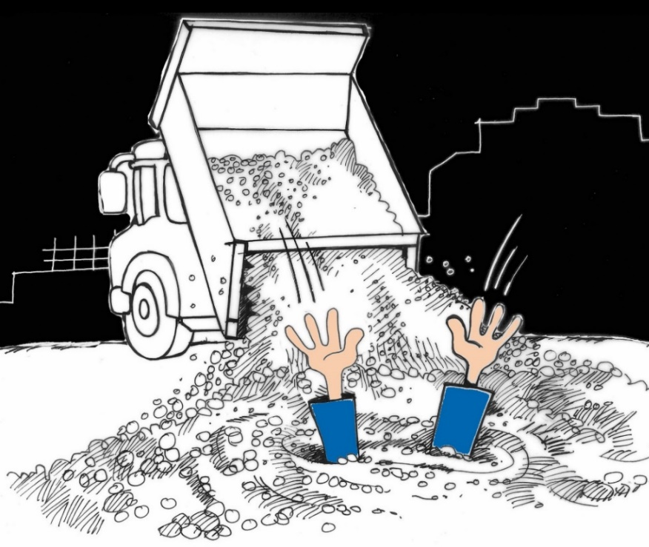
What can you see?
Are these dangerous?

Slide 14
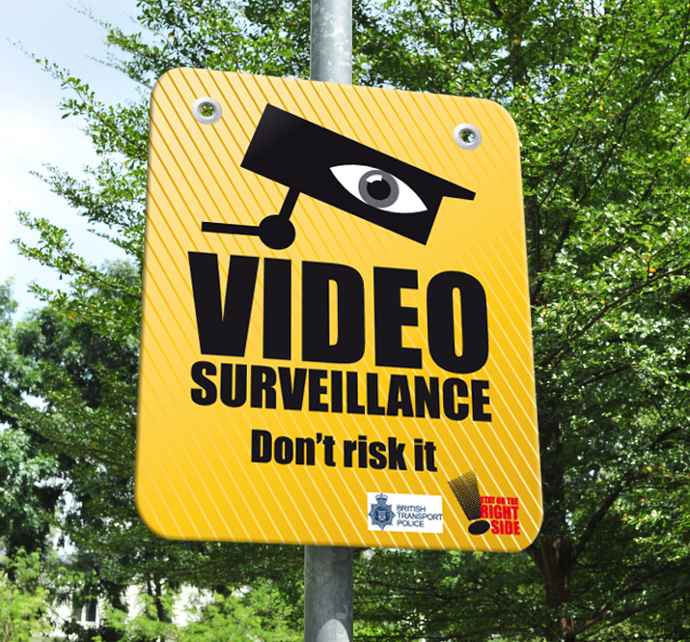
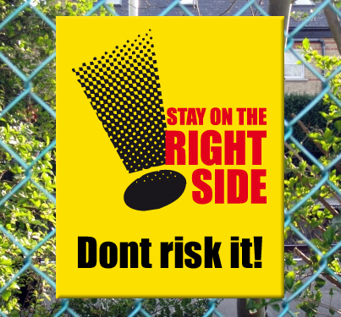
These signs tell you not to go near the train tracks
because it is dangerous.

Slide 15


Play Safe Stay Safe

