Slide 1
LI: To work with number bonds
Alternative 2
Number Bonds to 5

Slide 2
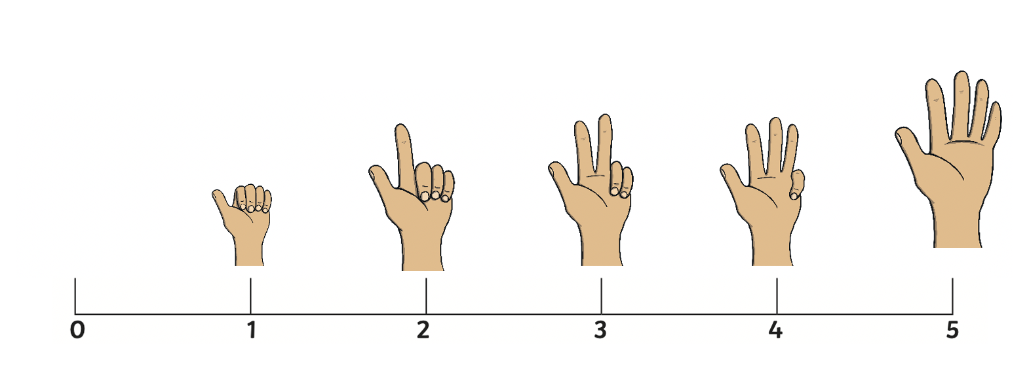
Count to 5

Slide 3
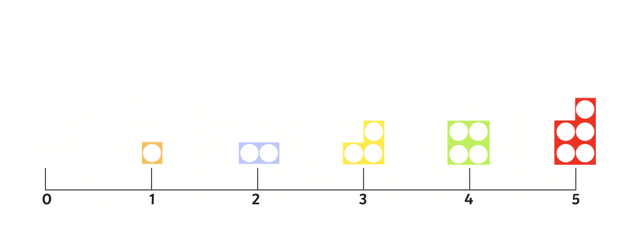
Count to 5

Slide 4
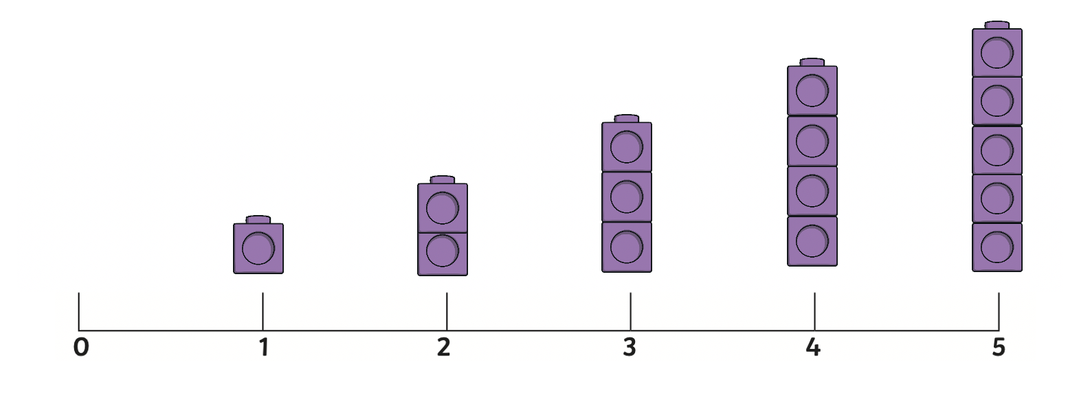
Count to 5

Slide 5
How many triangles can you see?
1
2
3
4
5

Slide 6
How many are orange?
How many squares can you see?
1
2
3
4
5
How many are blue?

Slide 7
How many circles can you see?
1
2
3
4
5
How many are red?
How many are blue?

