Slide 1
Learning intention Identify the regions of Europe

Slide 2
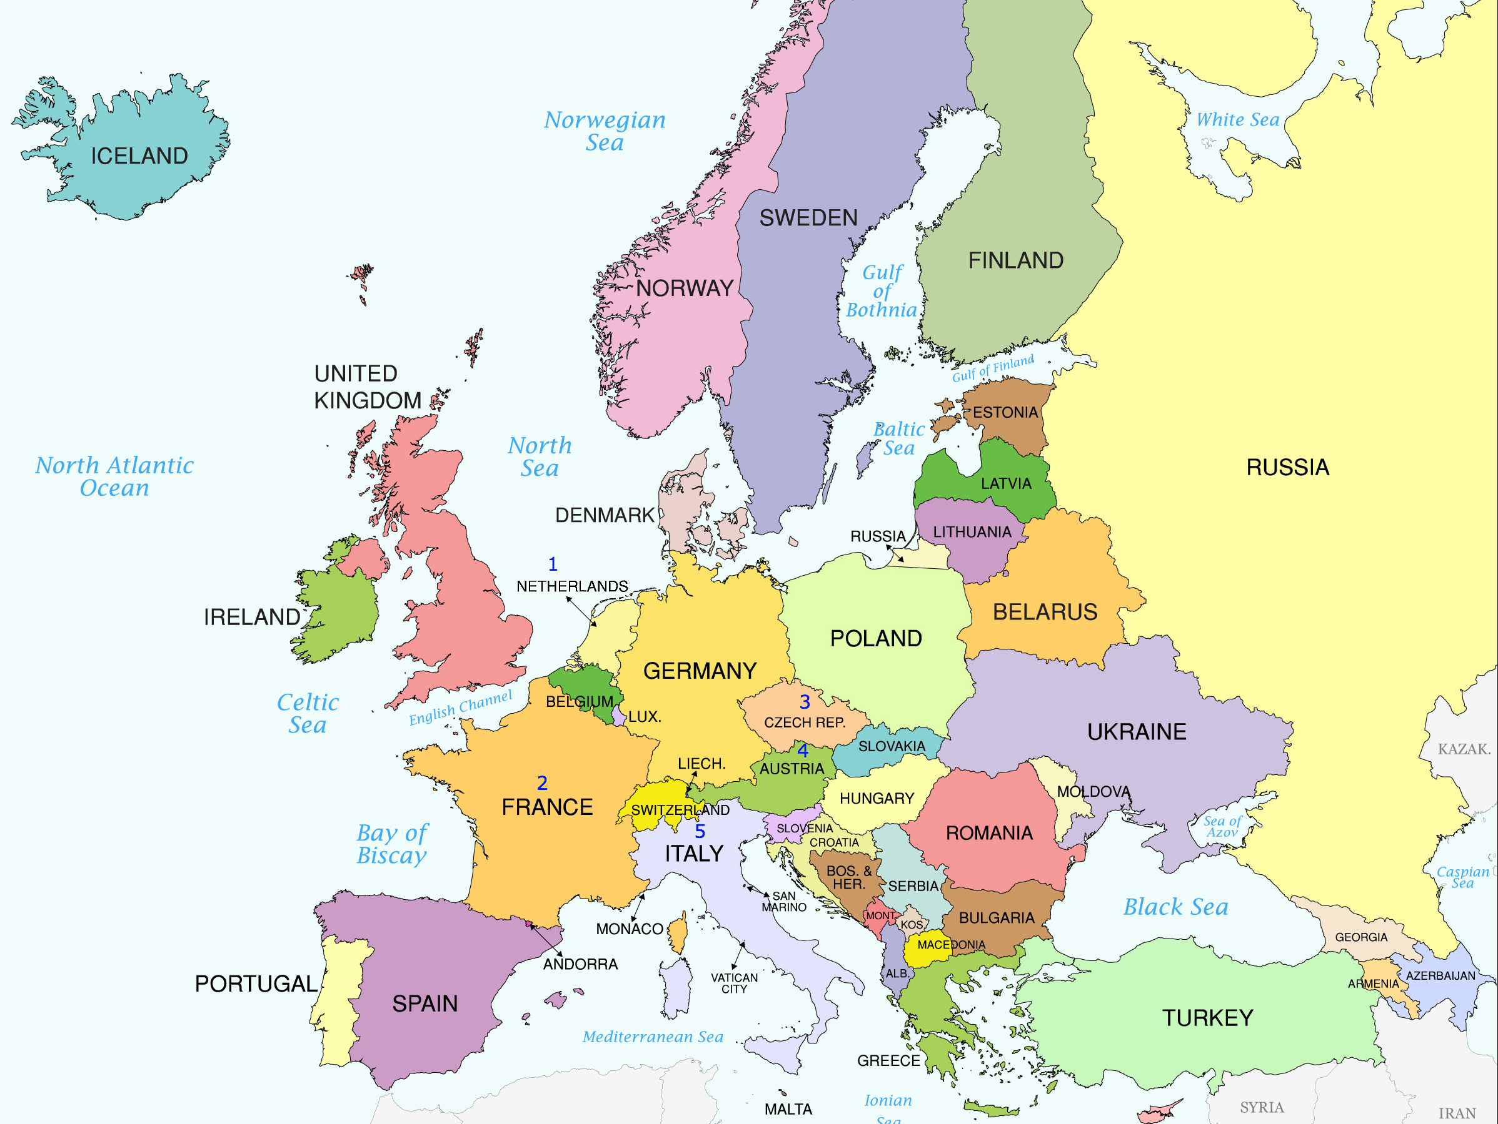
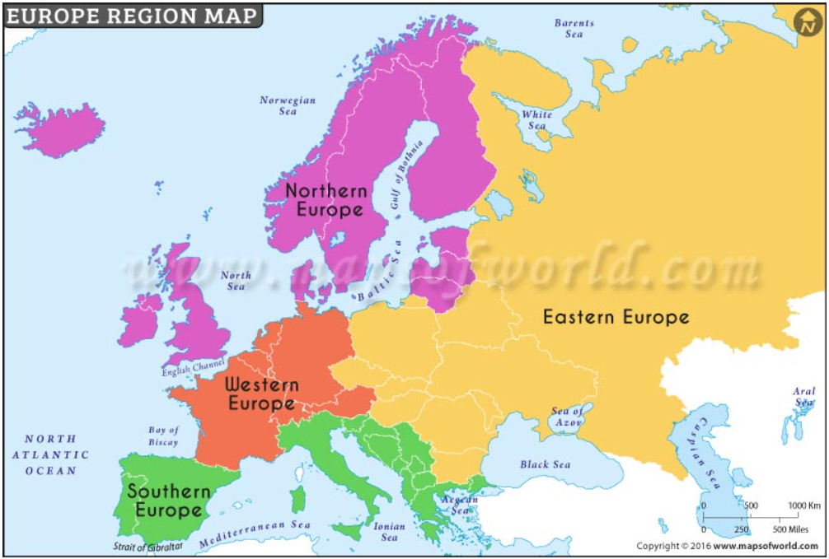
Which European Countries are
North
East
South
West
Find one of each, with an adult.
North
East
West
South

Slide 3
Northern Europe
The countries in Northern Europe include:
Norway, United Kingdom, Ireland and Lithuania.
Can you see any others?
The weather is very cold in winter and warm in the summer.

Slide 4
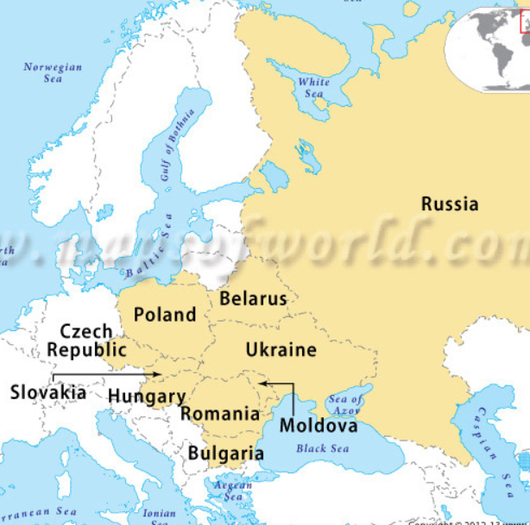
Eastern Europe
Eastern European countries include Poland, Romania and Russia.
Can you see any others?

Slide 5
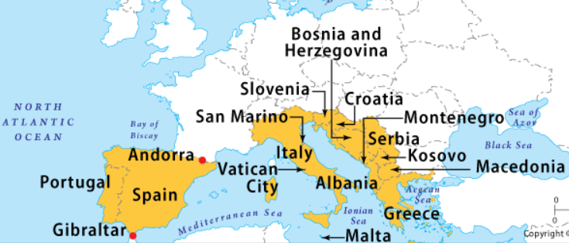
Southern Europe
Countries include Spain, Serbia and Italy.
Can you see any more?
The weather is hot in the summer and cool in winter.

Slide 6
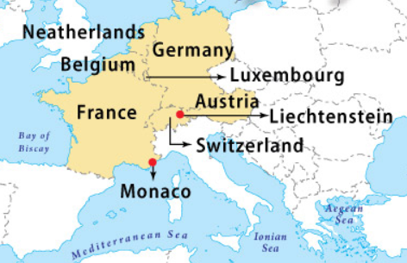
Western Europe
Western European Countries include France, Switzerland and Austria;
It can be hot in summer and cold in winter

Slide 7
Comparing regions of Europe
Find the sheet ‘Comparing regions of Europe- alternative.
On the sheet sort the pictures into North European and South European pictures.

