Slide 1
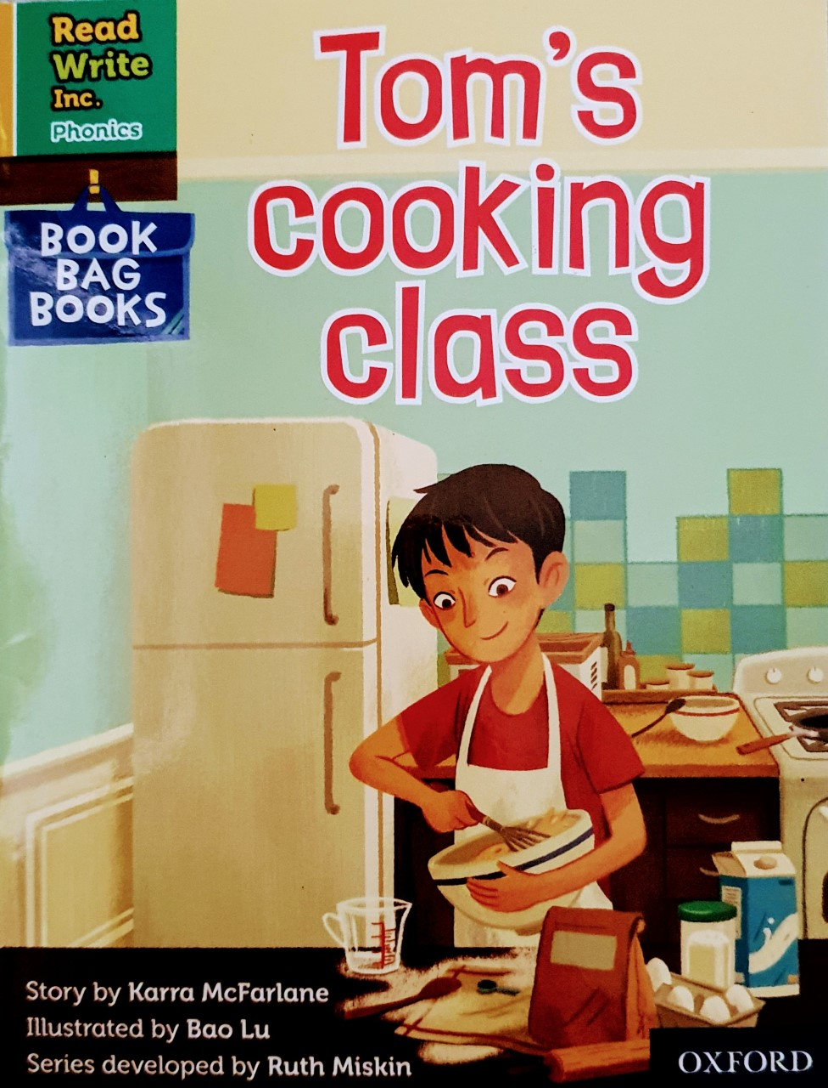

Slide 2
Let’s read these words together. These are words you will come across in the story.
Green Words
peel
added
party
pudding
crumble
toffee
Red Words
was
their
put
they
all
were
how

Slide 3
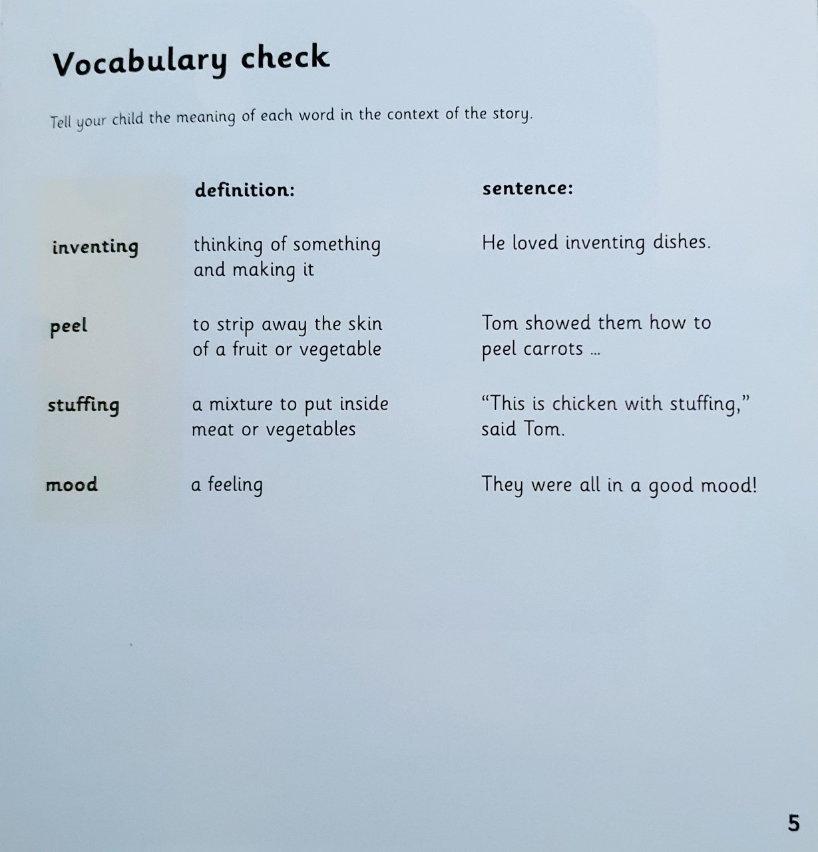

Slide 4
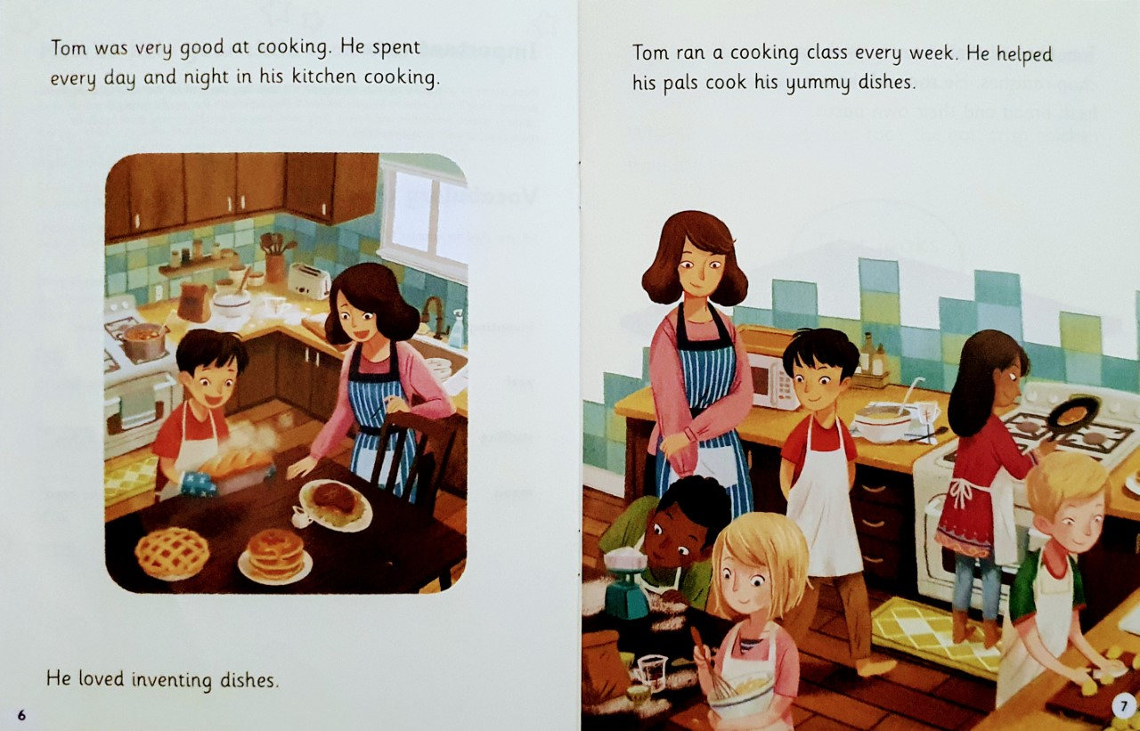
What did Tom love inventing?
What did he help his pals to do?

Slide 5
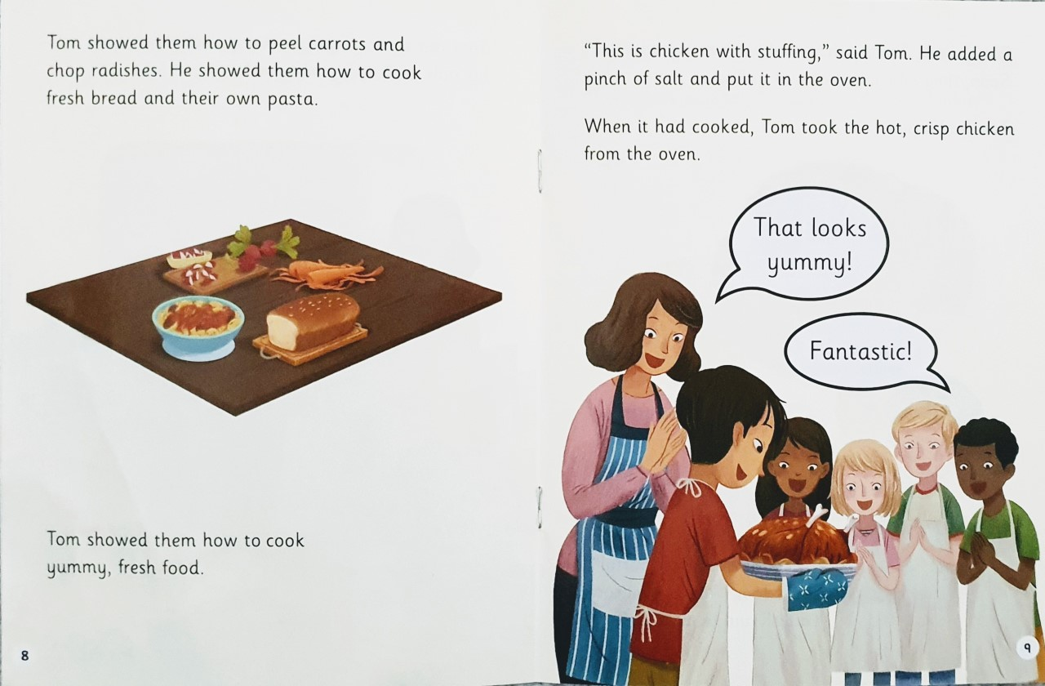
Can you tell us three things that Tom showed them?
What two words describe the chicken?

Slide 6
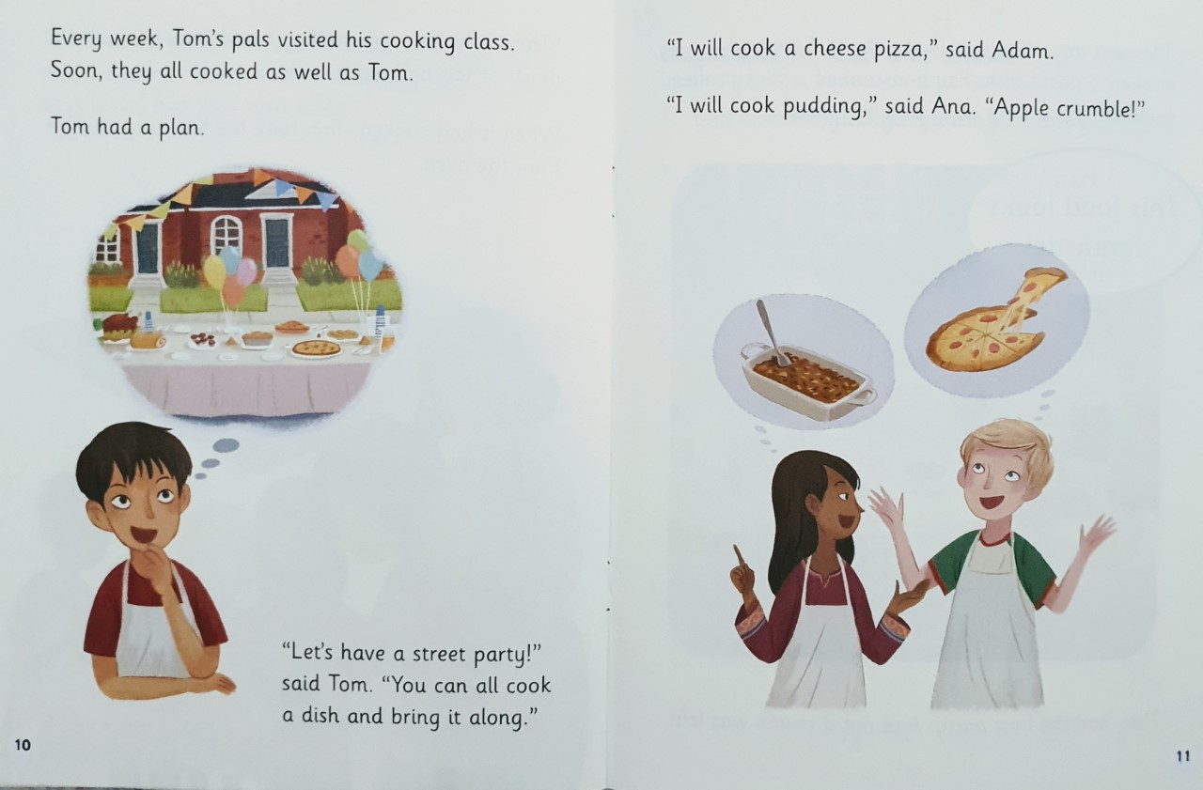
What was Tom’s plan?
What pudding did Ana say she would make?

Slide 7
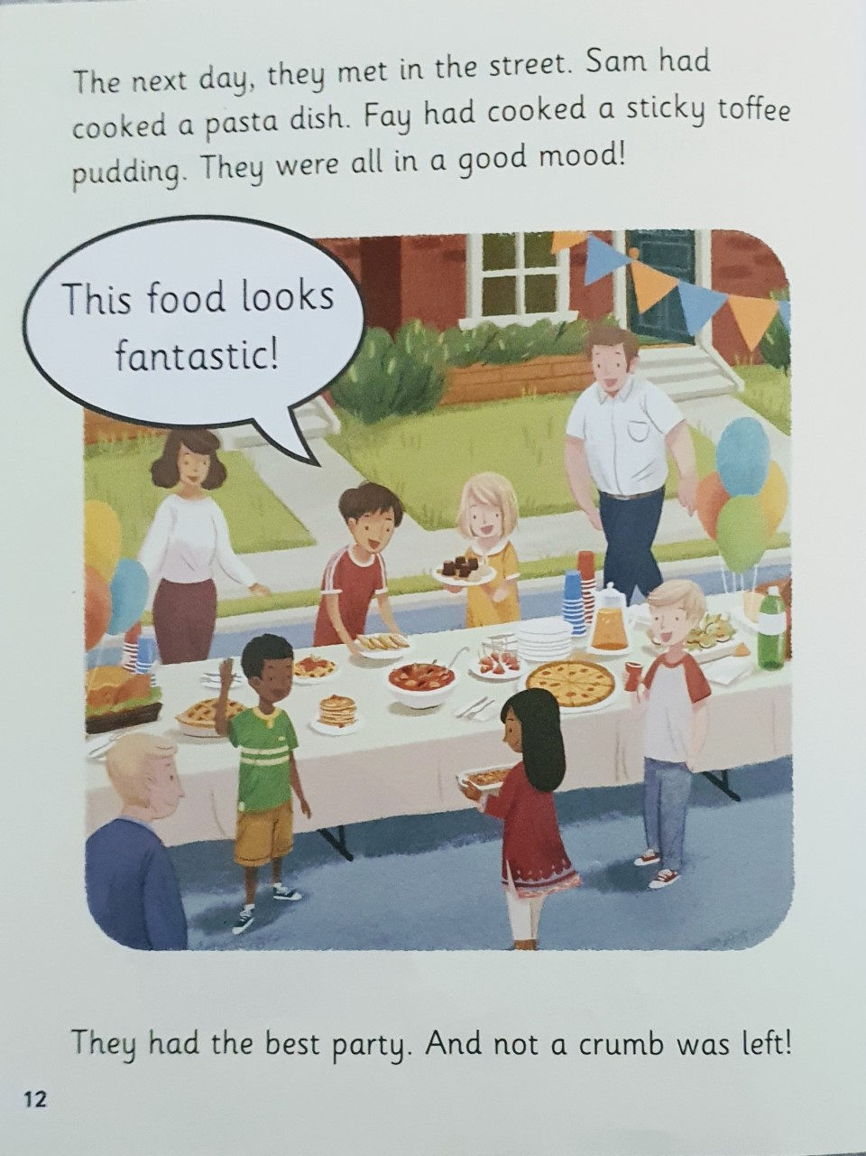
Why was everyone in a good mood?
What does it mean by there was not a crumb left?

Slide 8
