Slide 1
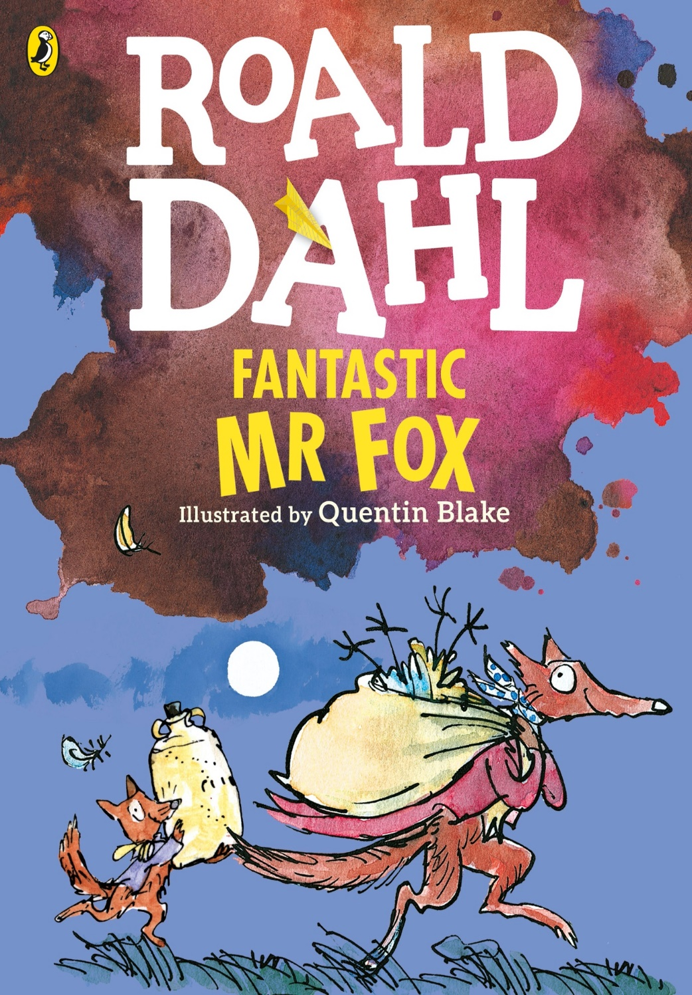
Fantastic Mr Fox Roald Dahl

Slide 2
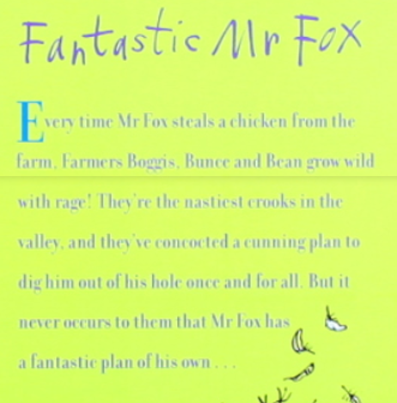
The blurb is trying to persuade you to read the book.
Does the blurb on Fantastic Mr Fox make you want to read it? Out of 10 how much do you want to read it:
1 means not at all – 10 means you want to do nothing else!

Slide 3
Key vocabulary
valley
farmer
Boggis
Bunce
Bean
Mr Fox
Mrs Fox
small Foxes

Slide 4
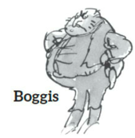
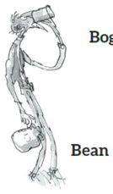
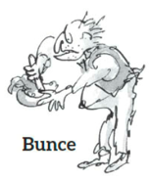
Task Listen and read the first two chapters
At the end, look at the sheet
‘English (alternative) the three farmers,’
Chose the correct words on the sheet to describe the three farmers.

Slide 5
Chapter 1 The Three Farmers
Down in the valley there were three farms. The owners of these farms had done well. They were rich men. They were also nasty men. All three of them were about as nasty and mean as any men you could meet. Their names were Farmer Boggis, Farmer Bunce and Farmer Bean.
Boggis was a chicken farmer. He kept thousands of chickens. He was enormously fat. This was because he ate three boiled chickens smothered with dumplings every day for breakfast, lunch and supper.
Bunce was a duck-and-goose farmer. He kept thousands of ducks and geese. He was a kind of pot- bellied dwarf. He was so short his chin would have been underwater in the shallow end of any swimming- pool in the world. His food was doughnuts and goose-livers. He mashed the livers into a disgusting paste and then stuffed the paste into the doughnuts. This diet gave him a tummy-ache and a beastly temper.

Slide 6
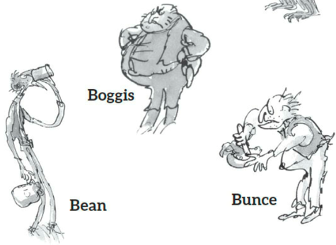
Bean was a turkey-and-apple farmer. He kept thousands of turkeys in an orchard full of apple trees. He never ate any food at all. Instead, he drank gallons of strong cider which he made from the apples in his orchard. He was as thin as a pencil and the cleverest of them all.
‘Boggis and Bunce and Bean One fat, one short, one lean. These horrible crooks So different in looks Were none the less equally mean.’
That is what the children round about used to sing when they saw them.

Slide 7
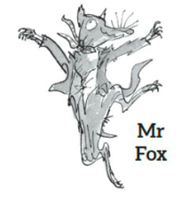
Chapter 2 Mr Fox
On a hill above the valley there was a wood. In the wood there was a huge tree. Under the tree there was a hole. In the hole lived Mr Fox and Mrs Fox and their four Small Foxes.
Every evening as soon as it got dark, Mr Fox would say to Mrs Fox, ‘Well, my darling, what shall it be this time? A plump chicken from Boggis? A duck or a goose from Bunce? Or a nice turkey from Bean?’ And when Mrs Fox had told him what she wanted, Mr Fox would creep down into the valley in the darkness of the night and help himself.
Boggis and Bunce and Bean knew very well what was going on, and it made them wild with rage. They were not men who liked to give anything away. Less still did they like anything to be stolen from them. So every night each of them would take his shotgun and hide in a dark place somewhere on his own farm, hoping to catch the robber.

Slide 8
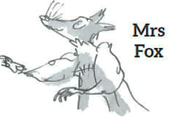
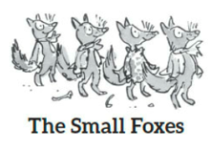
But Mr Fox was too clever for them. He always approached a farm with the wind blowing in his face, and this meant that if any man were lurking in the shadows ahead, the wind would carry the smell of that man to Mr Fox’s nose from far away. Thus, if Mr Boggis was hiding behind his Chicken House Number One, Mr Fox would smell him out from fifty yards off and quickly change direction, heading for Chicken House Number Four at the other end of the farm.
‘Dang and blast that lousy beast!’ cried Boggis.
‘I’d like to rip his guts out!’ said Bunce.
‘He must be killed!’ cried Bean.

Slide 9
But Mr Fox was too clever for them. He always approached a farm with the wind blowing in his face, and this meant that if any man were lurking in the shadows ahead, the wind would carry the smell of that man to Mr Fox’s nose from far away. Thus, if Mr Boggis was hiding behind his Chicken House Number One, Mr Fox would smell him out from fifty yards off and quickly change direction, heading for Chicken House Number Four at the other end of the farm.
‘Dang and blast that lousy beast!’ cried Boggis.
‘I’d like to rip his guts out!’ said Bunce.
‘He must be killed!’ cried Bean.

Slide 10
‘But how?’ said Boggis. ‘How on earth can we catch the blighter?’
Bean picked his nose delicately with a long finger. ‘I have a plan,’ he said.
‘You’ve never had a decent plan yet,’ said Bunce.
‘Shut up and listen,’ said Bean. ‘Tomorrow night we will all hide just outside the hole where the fox lives. We will wait there until he comes out. Then . . .Bang! Bang- bang-bang.’
‘Very clever,’ said Bunce. ‘But first we shall have to find the hole.’
‘My dear Bunce, I’ve already found it,’ said the crafty Bean. ‘It’s up in the wood on the hill. It’s under a huge tree . . .’

