Slide 1
Learning intention: Use the past or present tense correctly
Past tense tells us something that has already happened.
If something happened yesterday, last week, last month or even just an hour or a minute ago, this is all past tense.
Present tense tells us that something is happening right now.
Whatever you are doing right now is the present tense. If you are talking, reading or writing it is happening in the present.

Slide 2
When you are at school, what can you do at play time?

Slide 3
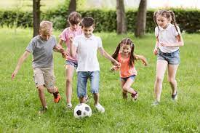
I usually play football.
Yesterday I played football.

Slide 4
Sometimes I run around playing tag.
This morning I ran around playing tag.

Slide 5
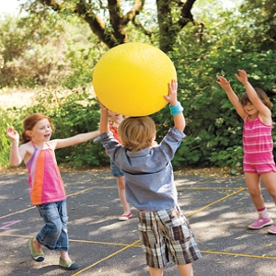
I throw the ball to my friend and she catches it.
I threw the ball to my friend and she caught it.

Slide 6
Regular verbs (add –ed in past tense)
play
laugh
need
look
ask
call
played
laughed
needed
looked
asked
called

Slide 7
Irregular verbs (they break the rules! You just have to learn them)
go
say
make
take
think
is
went
said
made
took
thought
was

Slide 8
Can you change these from the present to the past?
It is sunny. It was sunny.
We have Assembly today.
We go swimming.
I think P.E. is fun.
My dad helps me with my homework.
We need to tidy up the cloakroom.

Slide 9
We had Assembly today.
We went swimming.
I thought P.E. was fun.
My dad helped me with my homework.
We needed to tidy up the cloakroom.

