Slide 1
Year 1
Imperative verbs

Slide 2
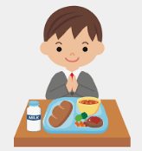
Imperative verbs are sometimes known as bossy verbs.
They are verbs which tell you what to do.
Eat your lunch.
Tidy your bedroom.

Slide 3
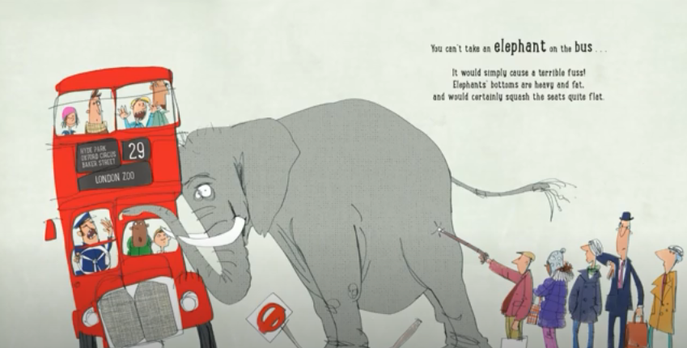
In our class book we have learnt that there are lots of imperative verbs. Lets remember some of them.
You can’t take an elephant on the bus.

Slide 4
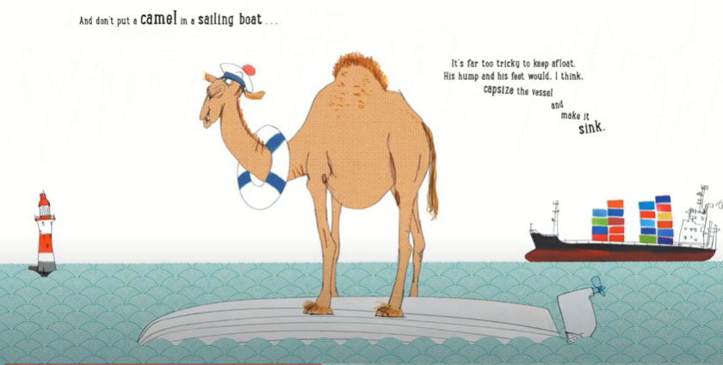
And don’t put a camel in a sailing boat.

Slide 5
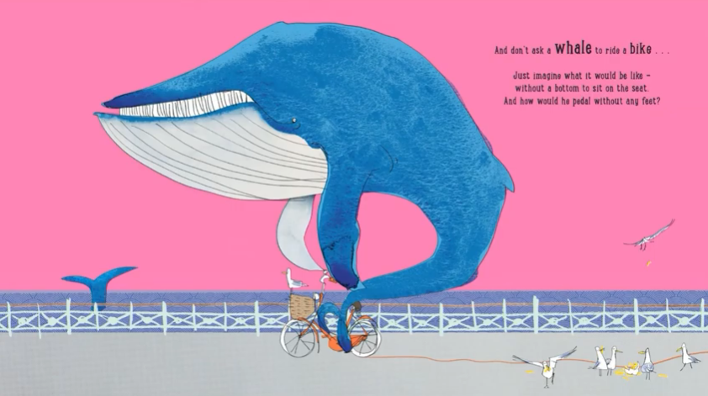
And don’t ask a whale to ride a bike.

Slide 6
Have a go at the worksheet

