Slide 1
Today we are going to start reading Anthony Browne’s version of Hansel and Gretel.
Some of the words will be new to us so we will need to have a think about what they mean.

Slide 2
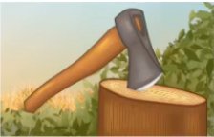
Book-specific vocabulary:
Famine: extreme lack of food. If there is a famine, people will be very hungry, especially if they are poor.
Woodcutter: someone who chops wood for their job.

Slide 3
Unfamiliar words:
You can skip the word to see what the word does in the sentence. Is it a noun (thing), verb (something you do) or an adjective (describing word).
You can also read around the word to see what other words would work in its place. By reading the rest of the sentence, you might be able to decide what the word means.

Slide 4
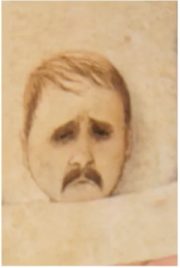
Example:
The woodcutter lay fretting in bed at night, tossing and turning.
It must be something he is doing in bed, so it is a verb (word for something you do).
Tossing and turning in bed means he can’t sleep, what might stop him from sleeping?
I think it might mean he is worrying.

Slide 5
While we read, you can look for the pictures we have already seen. Does the story match what you thought about the pictures?
You should also look for unfamiliar words to find what they mean, like we have just done.

Slide 6
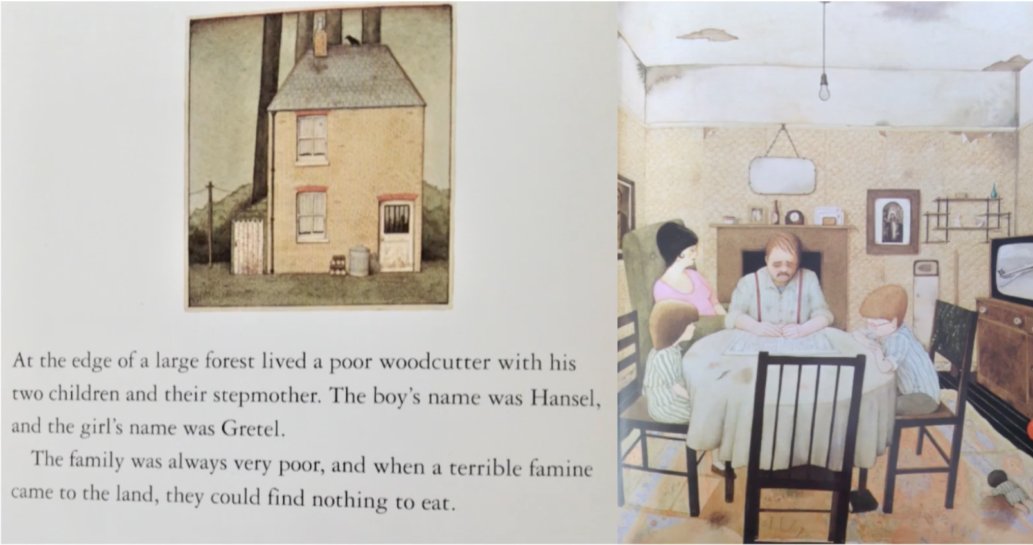

Slide 7
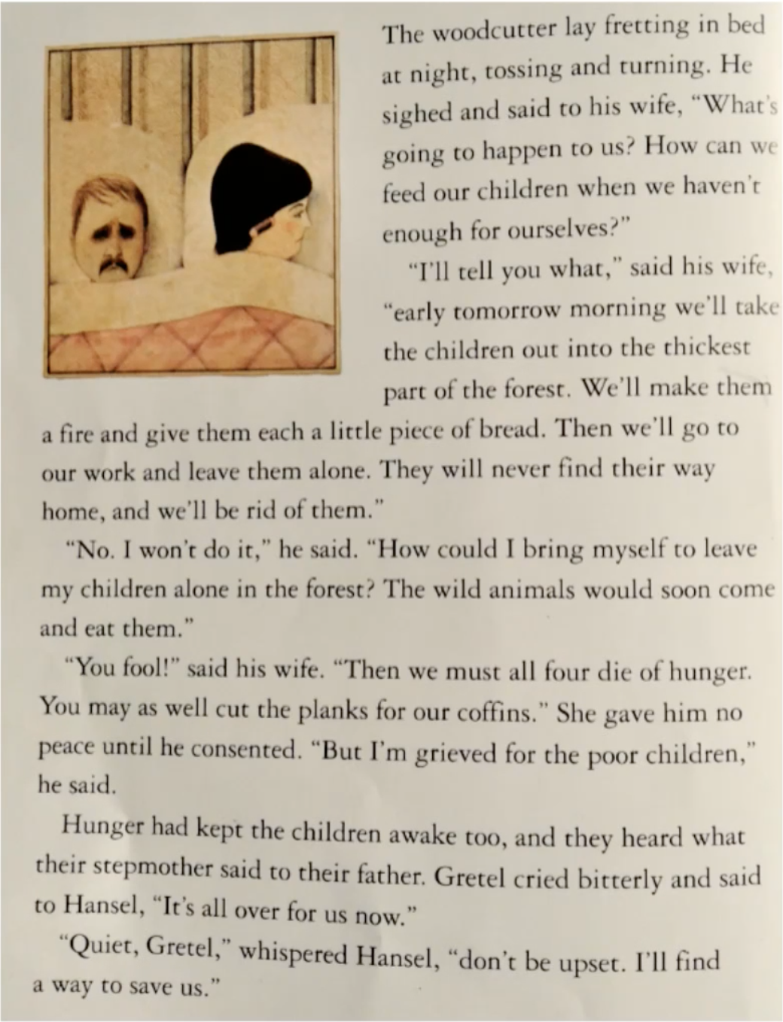

Slide 8
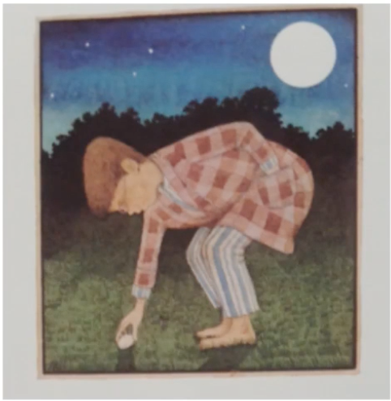
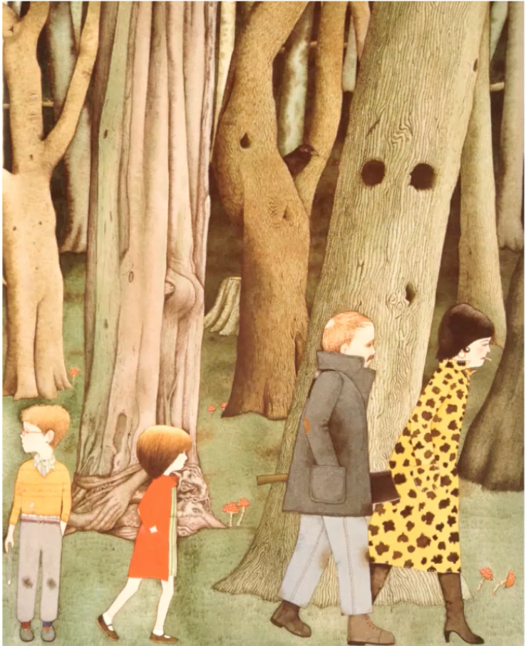
That night, Hansel collected lots of white pebbles. When the stepmother led them into the forest he had a clever plan. The young boy dropped the pebbles to make a trail so that he and Gretel could find their way home.

Slide 9
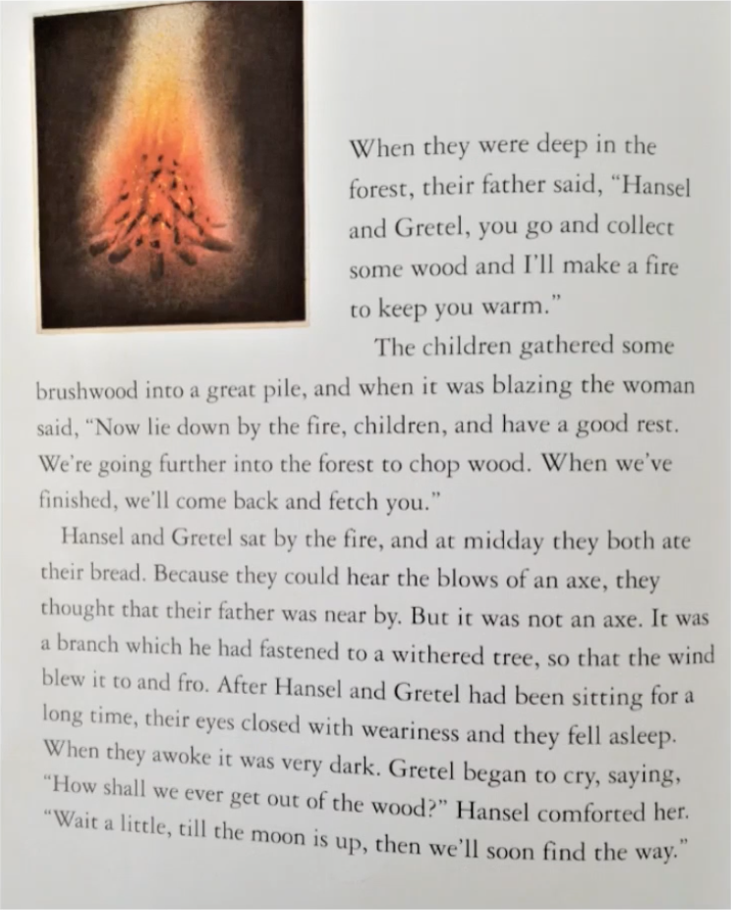
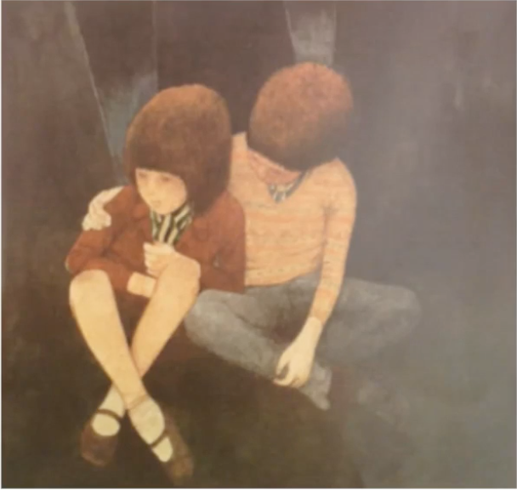
Hansel looked after his sister because she was worried they would never get out of the wood.

Slide 10
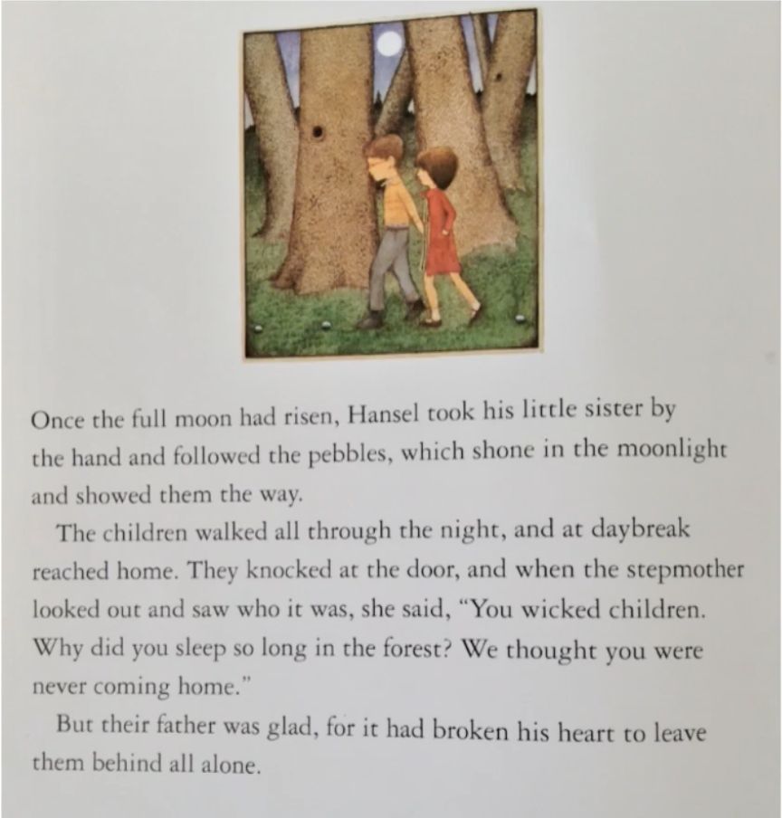
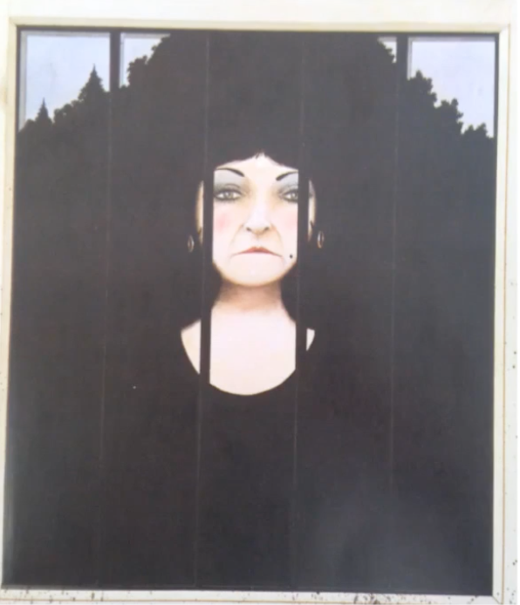
The stepmother was not pleased to see the children.

Slide 11
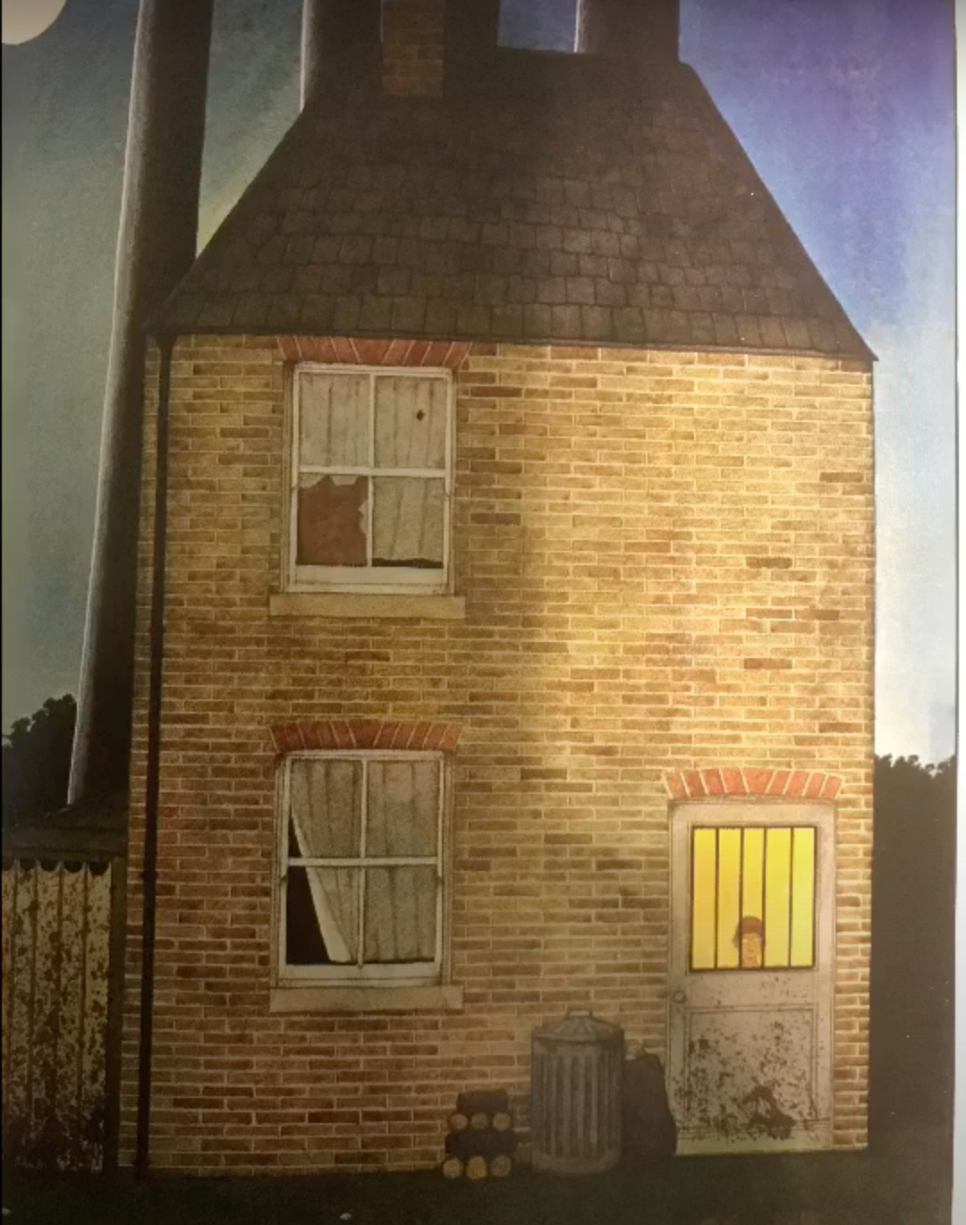
The stepmother immediately made a plan to take them back to the heart of the forest. Though she smiled, Hansel and Gretel knew her evil plan. Hansel went to collect more pebbles but he found that the door was locked.
Once again the family set off into the forest. This time all Hansel could do was to drop crumbs from the bit of bread that he had saved from breakfast.

Slide 13
Vocabulary check:
Consented - agreed, said yes
Grieved - sad
Weariness - tiredness
Comforted - looked after

