Slide 1
What is a traditional tale?
Traditional Tales
Notes:
A traditional tale is a story that has been told for a long time, by many people. This means that lots of people get to know the tale, but they might know slightly different versions. Do you think that you know any traditional tales?

Slide 2
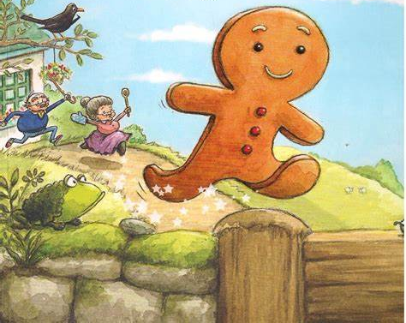
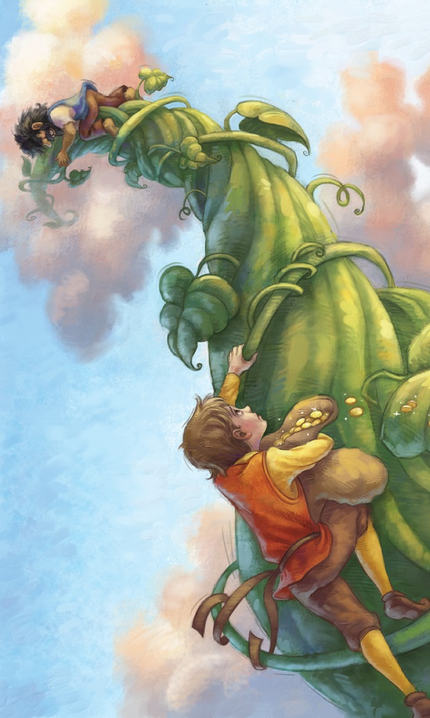
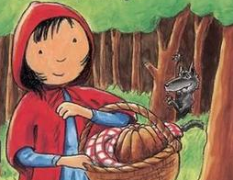
Notes:
Here are some examples of traditional tales that you might know. Do you recognise any of them?

Slide 3
Common features of a traditional tale:
An adventure or journey
Main characters
A moral to learn
A beginning, a middle and an end
Notes:
Let’s look at the features of many traditional tales: an adventure or journey, main characters, a moral to learn (this is a lesson that teaches the characters and readers something important) a beginning, a middle and an end, which is usually a happy ending. We will look at two of my favourites to see if they have the features…

Slide 4
Who is this?
Who is this?
Where is she going?
Notes:
First, which traditional tale is this? Oh yes! Little Red Riding Hood, we know that because of her hood. Where is she going? Yes! She’s going to Grandma’s house. Are there any other characters? Ooh, who is hiding in the trees? It’s the Big Bad Wolf! Is there a moral to learn? Yes! You should follow instructions and not leave the path to talk to strangers. Is the ending a happy one? Yes!

Slide 5
Where is he going?
Who are they?
Notes:
Now let’s look at this one: The Gingerbread Man. Who are the characters? What is the lesson to learn? Is there a happy ending? Not all tales have a happy ending.

Slide 6
Commentary
Slide 1: A traditional tale is a story that has been told for a long time, by many people. This means that lots of people get to know the tale, but they might know slightly different versions. Do you think that you know any traditional tales?
Slide 2: Here are some examples of traditional tales that you might know. Do you recognise any of them?
Slide 3: Let’s look at the features of many traditional tales: an adventure or journey, main characters, a moral to learn (this is a lesson that teaches the characters and readers something important) a beginning, a middle and an end, which is usually a happy ending. We will look at two of my favourites to see if they have the features…
Slide 4: First, which traditional tale is this? Oh yes! Little Red Riding Hood, we know that because of her hood. Where is she going? Yes! She’s going to Grandma’s house. Are there any other characters? Ooh, who is hiding in the trees? It’s the Big Bad Wolf! Is there a moral to learn? Yes! You should follow instructions and not leave the path to talk to strangers. Is the ending a happy one? Yes!
Slide 5: Now let’s look at this one: The Gingerbread Man. Who are the characters? What is the lesson to learn? Is there a happy ending? Not all tales have a happy ending.

