Slide 1
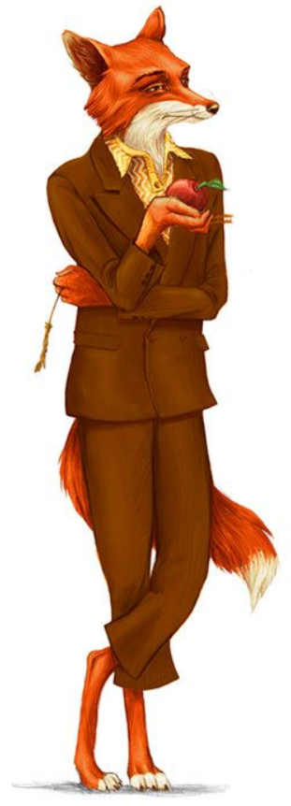
Fantastic Mr Fox Chapter 3 The Shooting
What do you think this chapter is going to be about?
Discuss with an adult.

Slide 2
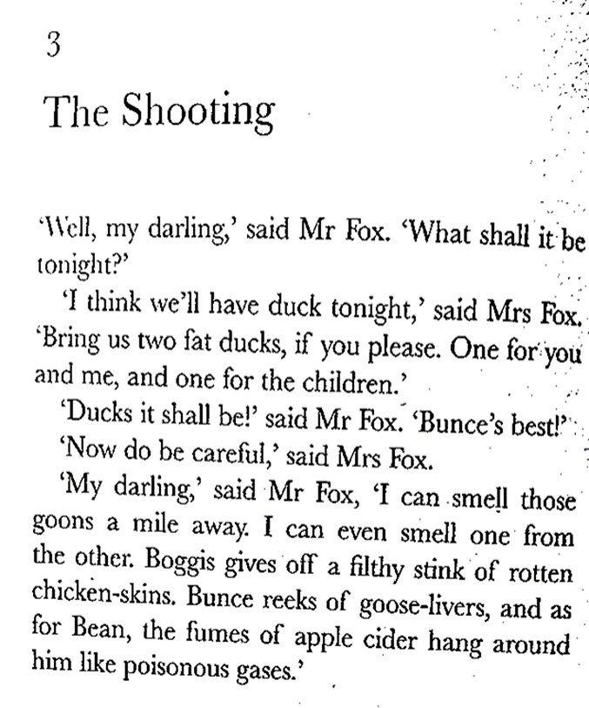

Slide 6
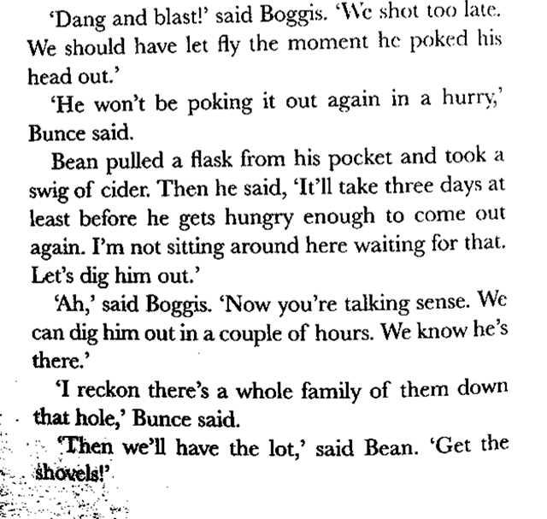

Slide 7
What has happened?
Discuss with an adult what has happened in this chapter.
What is your favorite part so far? Why?
What do you think might happen next?

Slide 8
Task Find the sheet marked (Alternative) Describing Mr Fox

Slide 9
