Slide 1
Learning intention performing poetry poetic devices

Slide 2
Poetic devices
We are going to read and listen to a few poems today.
We will then look at one of the Poetic Devices that are used to make poetry exciting and interesting to write, read, listen to and perform.

Slide 3
What is a Poetic Device?
A poetic device is a device (tool, trick or technique) that is used to make poetry interesting and exciting.
For example:
Rhyme
Rhythm
Alliteration
Onomatopoeia (bang, crash, screech-words that are spelt like they sound!))

Slide 4
Alliteration
Alliteration is when the start of one word is the same sound as the start of another word.
Examples:
Sammy the slimy slug, slowly slid by.
The ‘s’ sound is repeated.
Follow the link to
https://www.bbc.co.uk/bitesize/articles/zc3v6g8
Watch the two videos to see examples of alliteration and see poet Joseph Coelho talk about poetic devices.
To find out about alliteration, start watching at 1 minute and 18 seconds and finish at around 3 minutes and 17 seconds.

Slide 5
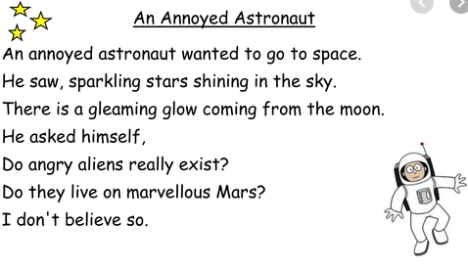
Look at this poem. Listen as I read. Can you hear the alliteration?

Slide 6
Look at this poem. Listen as I read. Can you hear the alliteration?

Slide 7
Task
Read back the poem.. Notice the alliteration.
Does it change the way you read the poem?
Try to read with expression which we have talked about before.
Now read the following poem.
Try useing a happy voice, a sad voice or an angry voice.

Slide 8
Your turn. Read this poem. Can you find alliteration? Remember the words have to start with the same sound.
The rain was driving down
Soaking the green grass below
Drenching the dark black feathers
Of a cold wet crow.
Thunder crashed and crackled
Splitting the sky with white light
The brown owls started hooting
The call of a wild wet night.
The wild wind was howling
Between the dark green trees.
The silver moon was shining
As the clouds drifted in the breeze.

