Slide 1
Learning intention: to talk about the six stages of the human life cycle.

Slide 2
The Human life cycle.
There are six stages of the Human lifecycle.
The foetus/gestation
Baby
Childhood
Adolescence
Adulthood
Old age

Slide 3
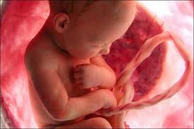
Stage 1- Foetus/ gestation period
This is the period of time the foetus spends in the womb (mothers stomach). For humans the gestation period is around 9 months.

Slide 4
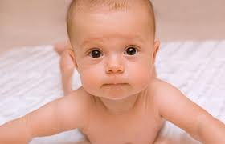
Stage 2- Baby
This is from when you are born, until you reach childhood. In the human cycle this is roughly two years.

Slide 5
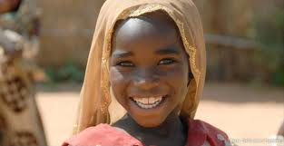
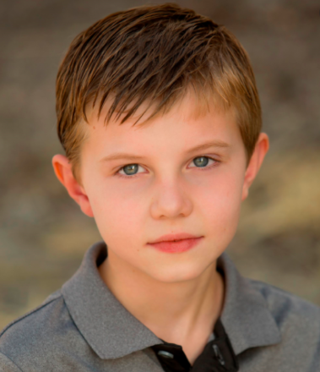
Stage 3- Childhood
Childhood is when you are still dependent on your parents but you are also growing up and learning to do things on your own. In the human life cycle this is roughly from the age of two until twelve years old. This stage can also be known as the juvenile period.

Slide 6
Stage 4- Adolescence
This is the period when your body is changing from a child into an adult. In the human cycle this is from the age of 13 until 19. In this period of time you are still dependent on your parents, but growing more and more independent.

Slide 7
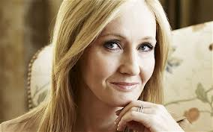
Stage 5- Adulthood
In the human cycle this is from when you are aged 20 to around 75. When you are able to have complete independence.

Slide 8
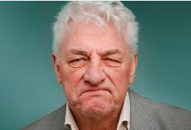
Stage 6- Old age
Old age is the last part of the human cycle. The period begins at around 76 and continues until death.

