Slide 1
Today we are going to read the end of Anthony Browne’s version of Hansel and Gretel.
Some of the words will be new to us so we will need to have a think about what they mean.

Slide 2
Unfamiliar words:
You can skip the word to see what the word does in the sentence. Is it a noun (thing), verb (something you do) or an adjective (describing word).
You can also read around the word to see what other words would work in its place. By reading the rest of the sentence, you might be able to decide what the word means.

Slide 3
Example:
The old woman’s kindness was only pretence, for she was really a wicked witch.
It must be something about her kindness.
She is a wicked witch so her kindness
can’t be real.
I think it might mean she is pretending
to be kind because pretence looks like
‘pretend’ and her kindness is not real.

Slide 4
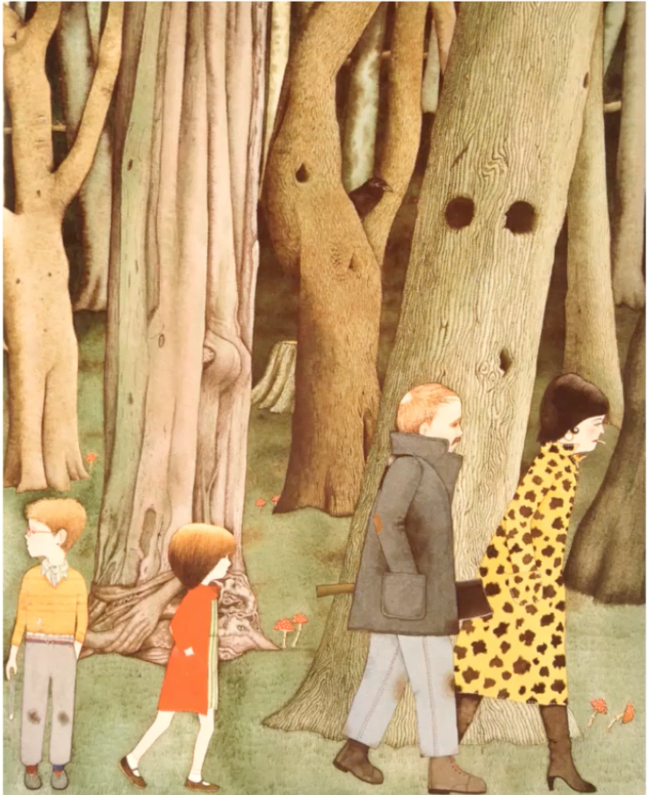
What happened in the part of the story we just read?

Slide 5
While we read, you can look for the pictures we have already seen. Does the story match what you thought about the pictures?
You should also look for unfamiliar words to find what they mean, like we have just done.

Slide 6
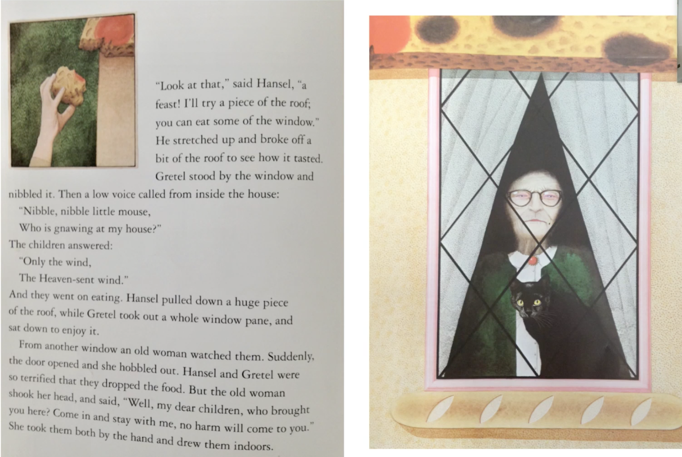

Slide 7
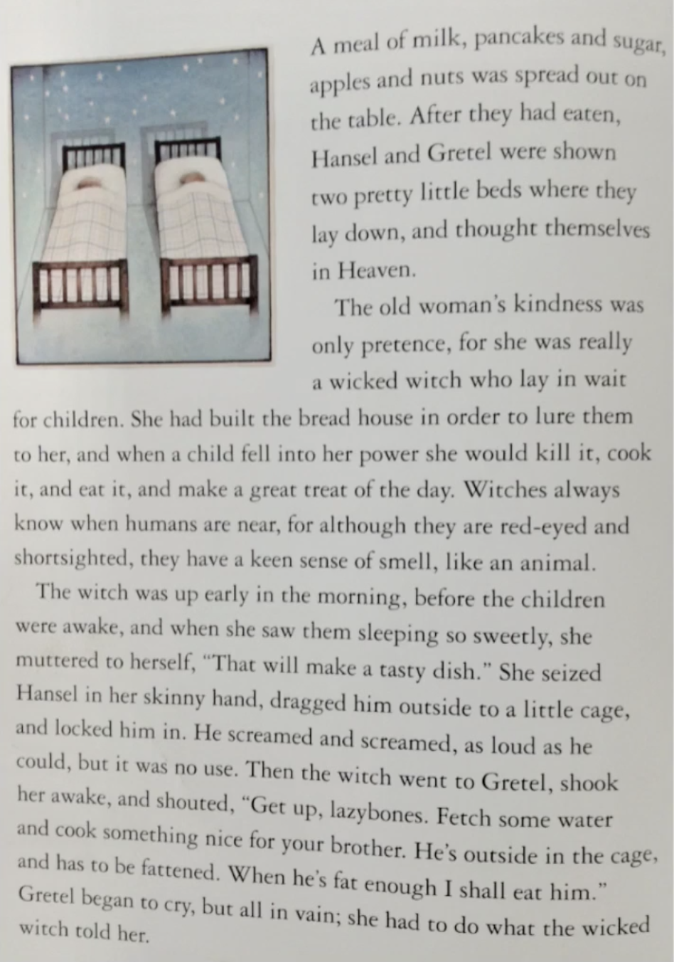
Gretel cried but she could not save Hansel yet.

Slide 8
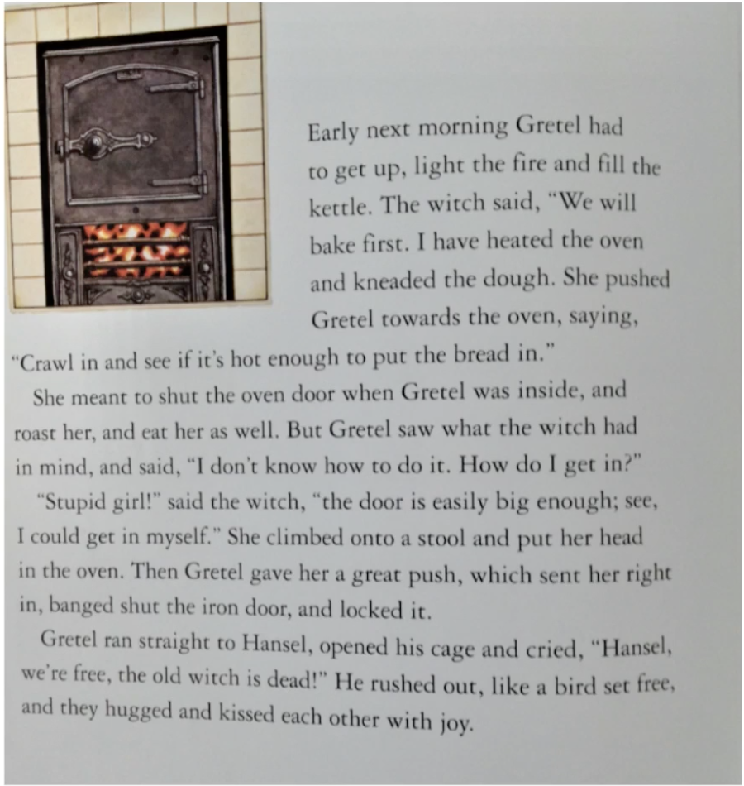

Slide 9
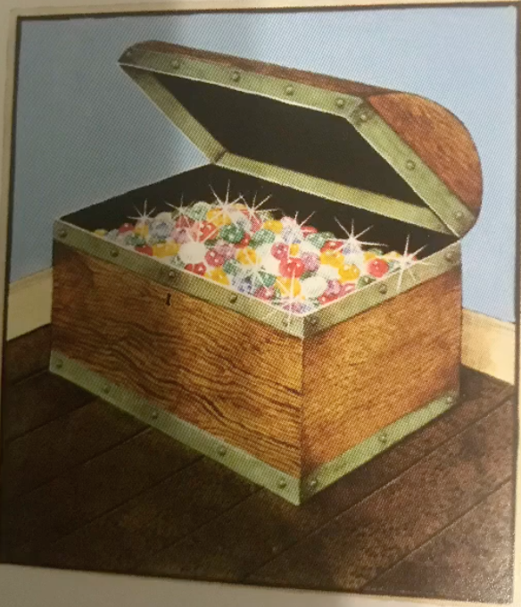
Hansel and Gretel searched through the house and filled their pockets with all her gold and all her jewels. They left the house and began their journey home. Eventually they arrived home. Their father was waiting for them and their stepmother had died! The gold and jewels meant that the family would never be hungry again and they lived happily ever after in their little house.

Slide 10
Vocabulary check:
Gnawing - biting, eating
Lure - bring someone somewhere to trap them
In vain - useless, no point

