Slide 2
f ff | l ll le | m mm | n nn kn | r rr | s ss se | v ve | z zz s | sh | th | ng nk
b bb | c k ck | d dd | g gg | h | j | p pp | qu | t tt | w wh | x | y | ch tch
Speed Sounds

Slide 3
a at | e hen | i in | o on | u up | ay day | ee y see | igh high | ow blow
oo zoo | oo look | ar car | or for | air fair | ir whirl | ou shout | oy boy
Speed Sounds

Slide 4
Jay | lump | clay | tray | cuts | flat | ring
brush
bott om
Story Green Words

Slide 5
lay -> lays | press -> presses | add -> adds
spot -> spots | roll -> rolls
Story Green Words

Slide 6
he | of | so | taller
makes | making | the | you
said | her | want | your
some | to | go | no
Red words

Slide 7
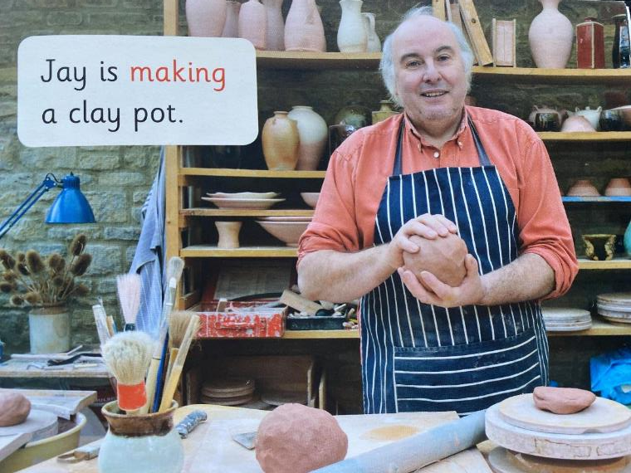
Jay’s clay pot

Slide 8
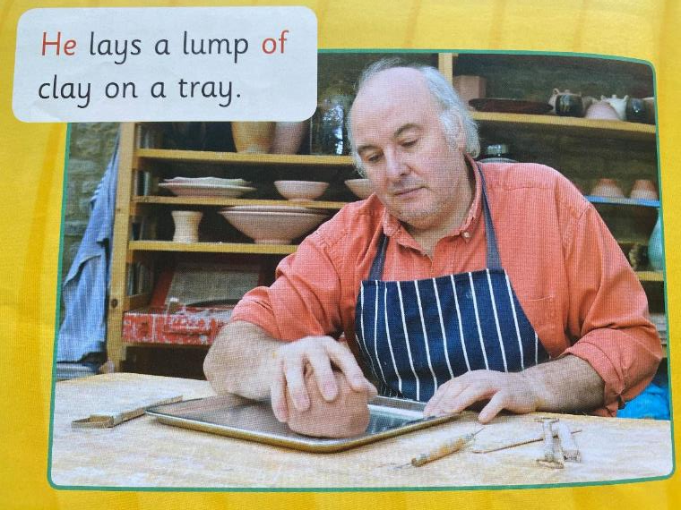

Slide 9
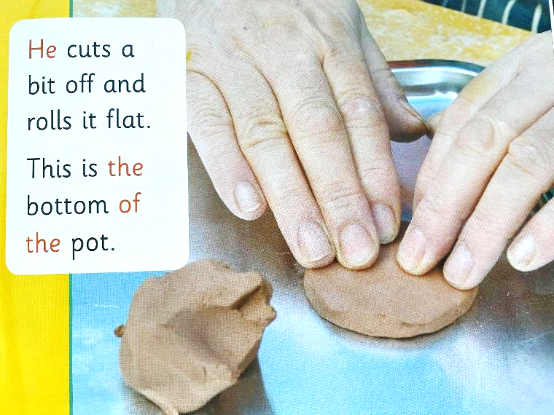

Slide 10
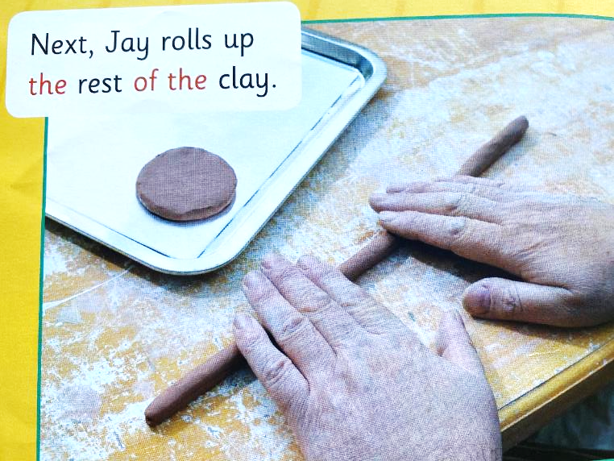

Slide 11
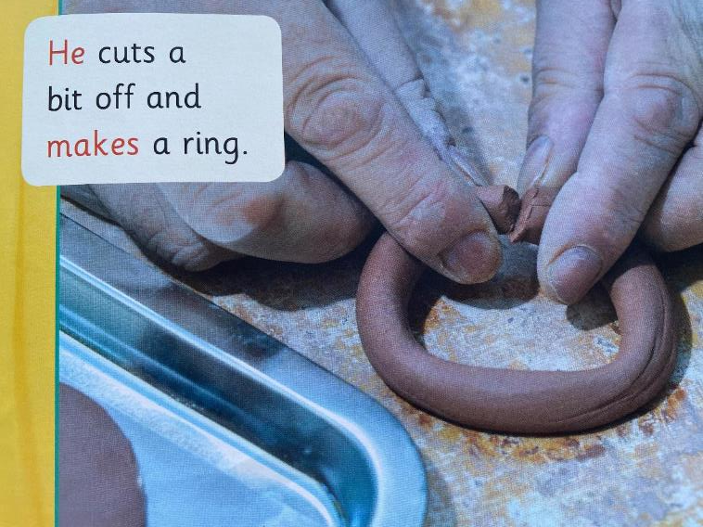

Slide 12
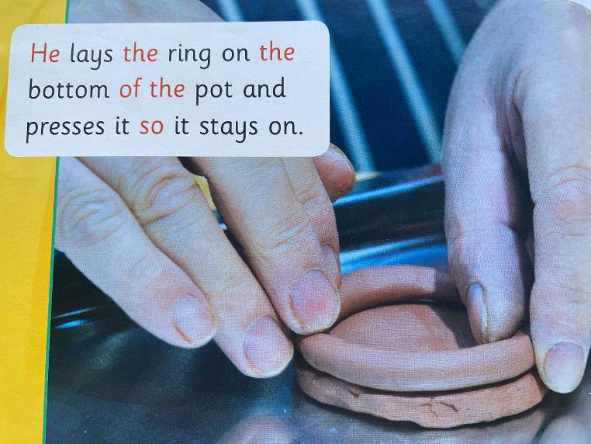

Slide 13
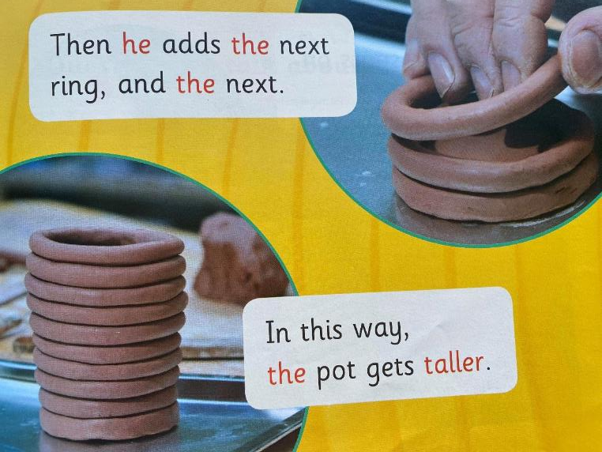

Slide 14
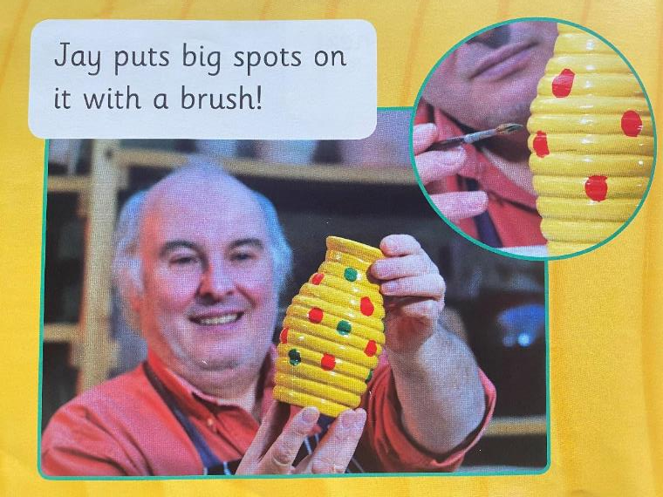

Slide 15
What is the man called?
2. What does he use to make the pot?
3. Why does Jay use a brush?

