Slide 1
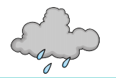
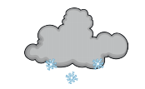
Year 1 Science
The Weather

Slide 2
We have been learning about four types of weather, can you name them?

Slide 3
Did you get them right?
Wind
Rain
Sun
Snow

Slide 4
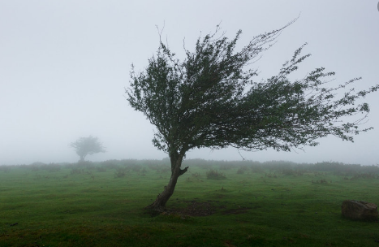
Wind

Slide 5
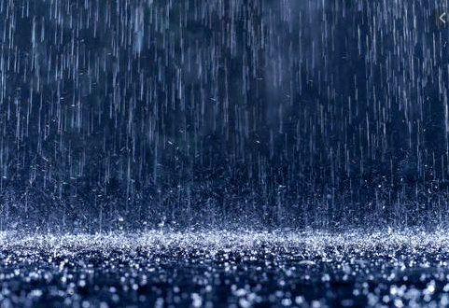
Rain

Slide 6
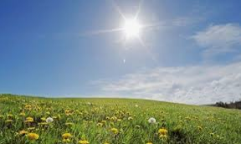
Sun

Slide 7
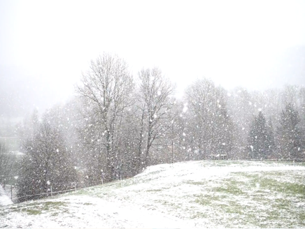
Snow

Slide 8
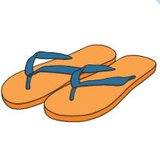
What should we wear in different weathers?

Slide 9
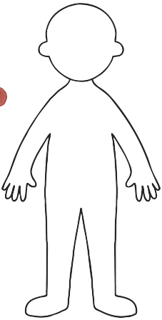
What should we wear in the sun?

Slide 10
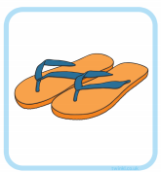
What should we wear in the rain?

Slide 11
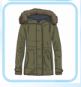
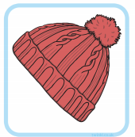
What should we wear in the snow?

Slide 12
Slide 1 – Hello year 1, today we will be learning about the weather.
Slide 2 – In class we have been learning about the weather, look at the pictures, can you name them?
Slide 3 – That’s right, we have been learning about the wind, the rain, the sun and the snow.
Slide 4 – This is a photo of the wind, what can you see? Tell your grown up what happens when it is windy.
Slide 5 – This is a picture of the rain, what can you see? Tell your grown up what happens when it rains.
Slide 6 – This is a picture of the sun, what can you see? Tell your grown up what happens when it is sunny.
Slide 7 – This is a picture of the snow, what can you see? Tell your grown up what happens when it snows.
Slide 8 – Now we are going to look at what we should wear in different weathers. Which weather might you wear this hat in? Which weather might you wear your flip flops in? Which weather might you use an umbrella?
Slide 9 – Now have a go at drawing a person and add the clothes you think you would wear in the sun. I’ve put some pictures on to help you, but look closely because you don’t need all of these clothes in the sun.
Slide 10- Now have a go at drawing a person and add the clothes you think you would wear when it rains.
Slide 11 - Now have a go at drawing a person and add the clothes you think you would wear when it snows. Would I wear a swimming costume when it snows?

