Slide 1
Capital Cities of Europe

Slide 2
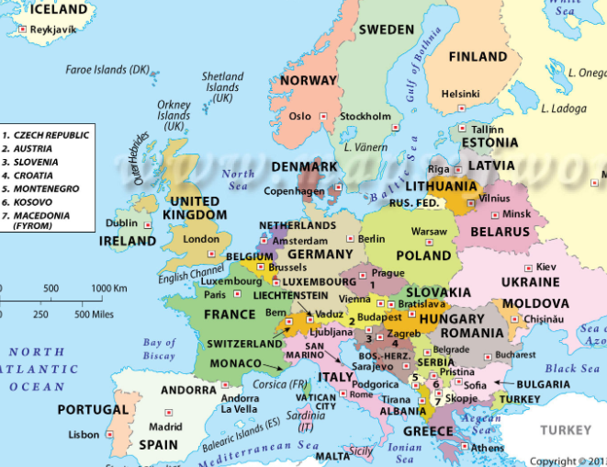
Look at this map of Europe.
Can you see the countries that we have talked about?
Find Germany, Italy, Switzerland, Greece and Portugal.
Can you see in each country there is one city marked. For Example in Germany it is Berlin.
These are the capital cities of each country.

Slide 3
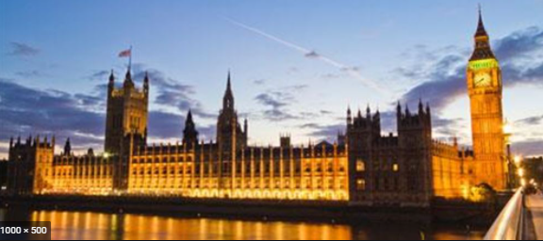
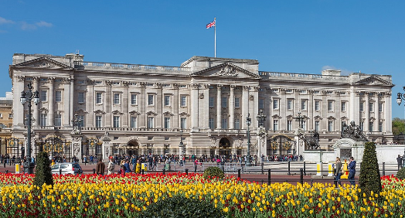
What is a Capital City?
A capital is a city or town of a country, set down in that countries law, that is the main city in that country. It is where the government of that country usually meets. The countries leaders and officials also usually work in the capital. For example in London is where you will find the Houses of Parliament which is where our Government meets. You will also find our head of State the Queen lives in Buckingham Palace, which is in London.

Slide 4
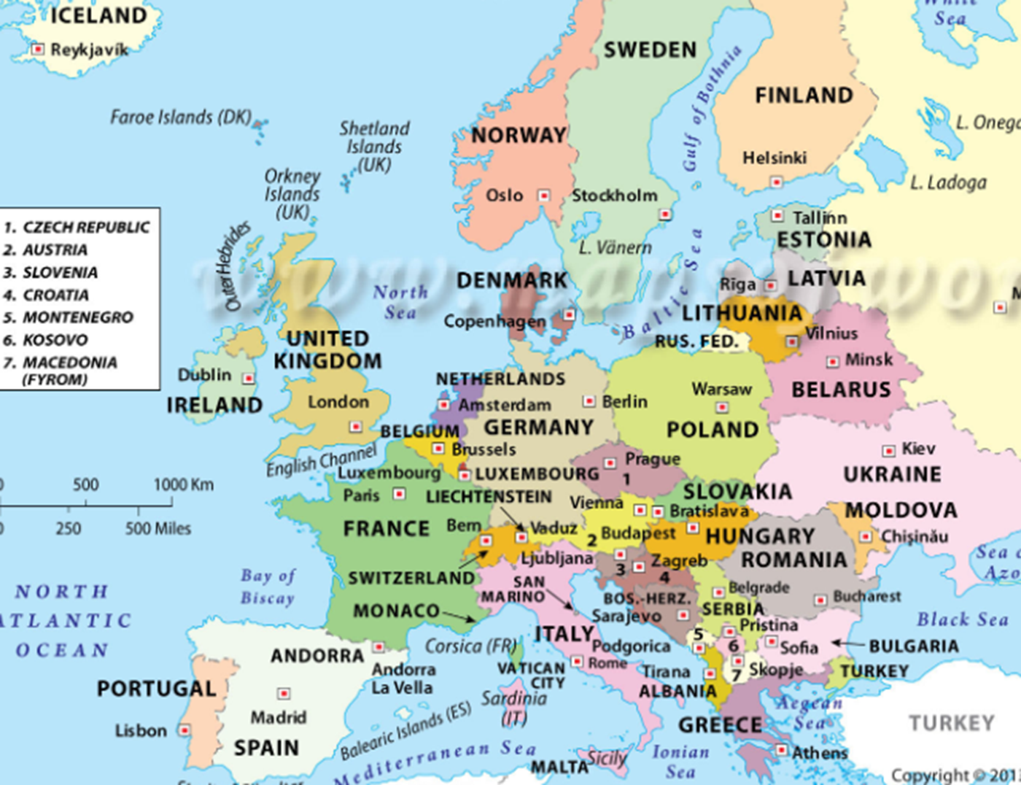
Task 1
Find and name the capital cities for these countries.
Spain –
France –
Denmark –
Finland –
Ukraine –
Poland –
Ireland –
Romania –
Slovakia –
Moscow

Slide 5
Task 2
Research at least 2 of the capital cities on the internet. Search for example ‘Helsinki facts for kids’. You can use the fact sheet called ‘city facts’ if you would prefer.
Create a fact file for each capital. Include some of the following details.
Population,
Country it is in,
Land marks (tourist attractions and famous places)
Famous people that have come from their

